Slide 1



DAY 1: VIOLENCE AGAINST WOMEN AND SAFETY PLANNING
Grades 10-12
Notes:
Point of Slide: This slide introduces the Violence Is Preventable (VIP) Program, and why PEACE Program counsellors are in the classroom and informs the students of the purpose of the presentation.
Speaking Notes:
Introduce yourself:
Who you are
What organization you are from
What your role is
A brief overview of the presentation.
For example:
I am happy to be here today and I am looking forward to sharing this meaningful time together. In my work, I help kids of all ages stay safe in their friendships and homes. I also help kids who may have been scared, confused or upset because one adult in their home is hurting another adult. I work for a program called the PEACE Program and we are sharing this presentation today on the Violence is Preventable (VIP) Program. I am visiting all kinds of classrooms in BC for students of all ages in classrooms just like this one.
Acknowledge the traditional territory you are on.
Thank the teacher for having you in their classroom.

Slide 2


PEACE Program
Free.
Confidential program across BC.
For children and youth aged 3 to 18 who have experienced violence in their home.
Notes:
Point of the Slide: To explain what the PEACE program does.
You might wish to share the PEACE Program PSA to help explain the PEACE Program to the class: https://youtu.be/ZWt_6uUQq90?si=XQDUy_-VSHIbtmkZ
The PEACE Program offers free, confidential support to children and youth aged 3-18 in BC who have experienced violence in their homes.
There are 87 PEACE Programs located all across BC.
PEACE programs provide age-appropriate services that help Children and Youth to:
label and express the feelings they have experienced regarding the violence they have encountered;
understand healthy ways of dealing with anger and expressing anger;
understand that they are not at fault for the violent actions of others;
teach safety skills, strategies and develop safety plans;
encourage open communication;
acknowledge loss and separation issues;
facilitate understanding of abuse and myths about violence against women;
explore other violence issues such as violence in the media; and
encourage self-confidence.

Slide 3


VIP Outline for Grades 10-12
Violence Against Women and Safety Planning
Healthy vs Unhealthy Relationships
The Cycle of Abuse & Consent
Online Health and Safety & The Bystander Effect
Notes:
Point of the Slide: To introduce the students to the key themes of the VIP curriculum. Also, advise them that classes across BC who are participating in VIP are receiving the same presentation.
Speaking Notes:
We are here to have a conversation with you about important topics including domestic violence, safety planning, healthy relationships, online safety and the bystander effect.
Let students know what to expect during the presentation and advise them of the number of presentations you will be delivering (1-4).
Disclaimers:
Discussing sensitive topics;
Self-care e.g., stepping outside of the classroom for a few minutes, going to the bathroom or visiting the school counsellor
Address any housekeeping, such as one person speaking at a time, raising hands for questions and comments, self-care and cellphone use.
You may wish to invite the class to share some “community agreement” or “rules”. Come up with a list together on the board or a flip chart so it’s visible throughout the presentation.
Talk about confidentiality and disclosures: Let the students know that if they feel uncomfortable talking about their own experiences that they can say “a friend that I know” or “I heard this happened” or talk to you after or outside of class.
Remind the class that you will be available after every session if anyone needs support or has questions. This includes wanting support because you know someone else is having this experience.
If you are offering more than one presentation, let students know that they will have the opportunity to share anonymous questions and comments at the end of the first presentation and these will be addressed in subsequent presentations in a way that maintains anonymity but gives space for the issues that are relevant for the individuals in the classroom.

Slide 4
Violence Against Women and Safety Planning
Objectives:
Raise awareness of the prevalence of domestic violence.
Share resources to support students with experiences of violence and strategies for staying safe.
Define violence and abuse.
Explain the PEACE and VIP Programs.
Answer any questions.
Notes:
Point of Slide:
To inform students of the objectives of the presentation and help them understand how to connect with the PEACE Program .
Speaking Notes:
Start the conversation by telling students that education is prevention and you are going to support them by:
sharing strategies for staying safe by creating a safety plan;
sharing media and statistics about domestic violence;
sharing tools and resources that support children and youth with experiences of domestic violence; and
increasing awareness about violence against women and domestic violence.
Inquire if they remember receiving the VIP presentation in past years. If so, ask them what they remember.
Remind students of the definition of violence and abuse: Violence or abuse is when we use our body or words to control and hurt someone.
Explain the VIP and PEACE Program goals locally and around the province
Answer any questions.

Slide 5
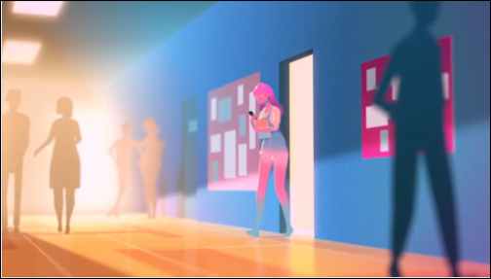
Sunshine - Don’t Confuse Love and Abuse
Notes:
Point of Slide: Allow the students to learn via a different medium about violence and safety planning by watching a video. The movie illustrates the difference between love and abuse to spark ideas and conversations.
Speaking Notes:
Introduce the video: Explain they will be watching a short video about the difference between love and abuse. Ask them to please pay attention to the behaviours and feelings of the 2 main characters who are in a relationship.
This video illustrates a couple in a romantic relationship. Ask them to notice the behaviour and think about whether or not the actions of the characters are healthy or unhealthy while you are watching.
Advise them there will be a discussion after the video.
Dialogue to Introduce the Video
“We are talking about violence in relationships today. Many people get into their first romantic relationship in their teen years. Romantic relationships can be fun, supportive and meaningful. Students like yourself may also have negative, hurtful and violent experiences in their romantic relationships.”
“Today we are going to be watching a short video, “Don’t Confuse Love and Abuse.” This video depicts the difference between love and abuse and the specific ways this may look in a real-life relationship. Please pay attention to the behaviors and feelings of the two main characters who are in a relationship. This video illustrates a couple in a romantic relationship. Notice the behavior and think about whether or not the actions of the characters are healthy or unhealthy while you are watching. We will have an opportunity to discuss the video afterwards.”
Watch Video: Sunshine- Don’t Confuse Love and Abuse. https://www.youtube.com/watch?v=1L6HB97lbrQ
Note: There are two videos provided for this lesson plan. The facilitator can determine whether or not they have time for both.

Slide 6
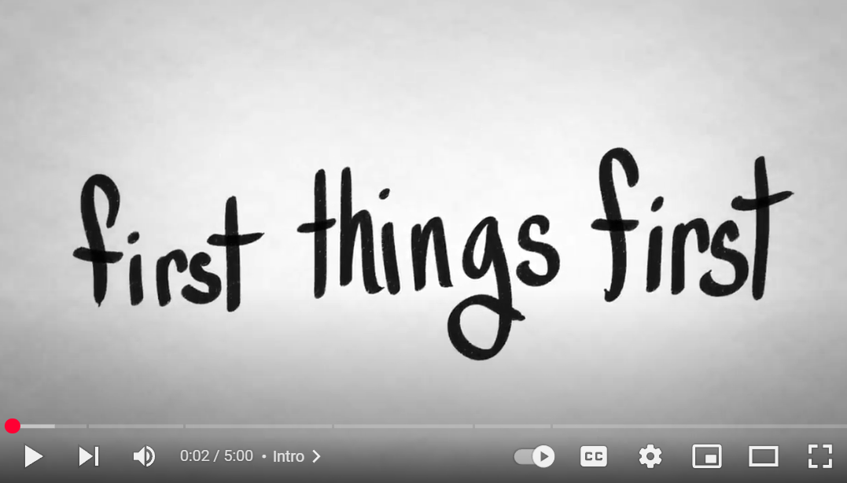
How to Leave an Abusive Relationship
Notes:
**OPTIONAL AND IF YOU HAVE TIME**
Point of Slide: Allow the students to learn via a different medium about violence and safety planning by watching a video. The movie shows how to tell if you're in an abusive relationship, and how to safely get out of it.
Speaking Notes:
Introduce the video: Explain they will be watching a short video about how to identify signs of abuse and ways to leave an abusive relationship
Advise them there will be a discussion after the video.
Watch Video: WellCast – How To Leave an Abusive Relationship. https://www.youtube.com/watch?time_continue=62&v=lwNr0eQmmuI&feature=emb_logo

Slide 7
Discussion
What are the main messages in the video(s)?
What are some strategies you can use to keep yourself safe?
Did you see any abusive or violent behaviour in the video?
Can we brainstorm the types of violence and abuse that can occur in a relationship?
Notes:
Point of the Slide: Allow the students an opportunity to discuss the video(s) as they relate to the VIP curriculum topic of violence against women and safety planning.
Speaking Notes:
Ask the class to respond to the questions on the slide and discuss as a group.
What were the main messages in the video?
What are some strategies you can use to keep yourself safe?
Did you see any abusive or violent behaviour in the video?
Can we brainstorm the types of violence and abuse that can occur in a relationship? Such as physical, emotional, verbal, sexual, financial, technology-facilitated gender-based violence, etc.
As part of the brainstorm session, see the VIP curriculum for Day 1 Lesson Plan Grades 10-12 as to more details about types of abuse (page 53).

Slide 8

Support Network Activity
Notes:
Point of the Slide: To allow the students an opportunity to explore who they have in their support networks to keep themselves safe.
Speaking Notes:
What is your support network? What can you do?
Support network activity:
Direct the class in a brainstorming session about how to stay safe in potentially abusive or violent situations.
This activity might be done in small groups or as a whole class.
What are some important things we can do to stay safe?
What does it mean to stay safe in a relationship?
You might ask the students to write out their individual safety plans. You can ask them to create one for at home, and one for at school, if they were to be facing these situations.
You can use the Safety Planning worksheet on page 55 of the VIP Curriculum assist with this conversation.
An age-appropriate description of the Kids Help Phone can also be useful here. See page 53 of the VIP Curriculum.

Slide 9

Anonymous Question or Comment
Notes:
Point of Slide: To gauge what is relevant for the classroom you are presenting to in preparation for the next session
Provide all youth with a blank piece of paper and a pen. Request that each student write something related to the presentation e.g. a comment about something that was interesting or a question they might be wondering about.
Be clear that these are totally anonymous and request that no real names are used. If they have a question about a scenario, they can use pseudonyms.
Let students know that you will begin your next session by addressing themes and questions which emerge through their anonymous comments and questions.

Slide 10
Thank You
Name:
Peace PROGRAM Counsellor:
ORGANIZATION Name:
Phone Number:
Email:
Office hours:
Notes:
Point of Slide: Recap the main messages of the VIP curriculum lesson plan and thank the class.
Speaking Notes:
Recap main messages.
Thank them for being a wonderful class and let the students know your contact information and what information you will be sending home with them, such as VIP post cards, VIP wallet cards, agency brochure, PEACE Program brochure, and any other additional resources.
Reiterate your contact information and office hours on the slide and encourage them to reach out if they have any questions or concerns about the presentation.
Communicate clearly about when you will return.

Slide 11
DAY 2: healthy vs. unhealthy relationships
Grades 10-12
Notes:
Point of Slide: This slide introduces the Violence Is Preventable (VIP) Program, and why PEACE Program counsellors are in the classroom and informs the students of the purpose of the presentation.
Speaking Notes:
Introduce yourself:
Who you are
What organization you are from
What your role is
A brief overview of the presentation.
For example:
I am happy to be here today and I am looking forward to sharing this meaningful time together. In my work, I help kids of all ages stay safe in their friendships and homes. I also help kids who may have been scared, confused or upset because one adult in their home is hurting another adult. I work for a program called the PEACE Program and we are sharing this presentation today on the Violence is Preventable (VIP) Program. I am visiting all kinds of classrooms in BC for students of all ages in classrooms just like this one.
Acknowledge the traditional territory you are on.
Thank the teacher for having you in their classroom.

Slide 12
PEACE Program
Free.
Confidential program across BC.
For children and youth aged 3 to 18 who have experienced violence in their home.
Notes:
Point of the Slide: To explain what the PEACE program does.
You might wish to share the PEACE Program PSA to help explain the PEACE Program to the class: https://youtu.be/ZWt_6uUQq90?si=XQDUy_-VSHIbtmkZ
The PEACE Program offers free, confidential support to children and youth aged 3-18 in BC who have experienced violence in their homes.
There are 87 PEACE Programs located across BC.
PEACE programs provide age-appropriate services that help Children and Youth to:
label and express the feelings they have experienced regarding the violence they have encountered;
understand healthy ways of dealing with anger and expressing anger;
understand that they are not at fault for the violent actions of others;
teach safety skills, strategies and develop safety plans;
encourage open communication;
acknowledge loss and separation issues;
facilitate understanding of abuse and myths about violence against women;
explore other violence issues such as violence in the media; and
encourage self-confidence.

Slide 13
VIP Outline for Grades 10-12
Violence Against Women and Safety Planning
Healthy vs Unhealthy Relationships
The Cycle of Abuse & Consent
Online Health and Safety & The Bystander Effect
Notes:
Point of the Slide: To introduce the students to the key themes of the VIP curriculum. Also, advise them that classes across BC who are participating in VIP are receiving the same presentation.
Speaking Notes:
We are here to have a conversation with you about important topics including domestic violence, safety planning, healthy relationships, online safety and the bystander effect.
Remind students of the number of presentations you will be delivering (1-4).
Disclaimers:
Discussing sensitive topics;
Self-care e.g., stepping outside of the classroom for a few minutes, going to the bathroom or visiting the school counsellor
Address any housekeeping, such as one person speaking at a time, raising hands for questions and comments, self-care and cellphone use.
You may wish to revisit the “community agreement” or “rules.” from the previous session and have these visible throughout the presentation.
Talk about confidentiality and disclosures: Let the students know that if they feel uncomfortable talking about their own experiences that they can say “a friend that I know” or “I heard this happened” or talk to you after or outside of class.
Remind the class that you will be available after every session if anyone needs support or has questions. This includes wanting support because you know someone else is having this experience.

Slide 14
Questions from last time
Notes:
Point of slide: Respond to anonymous questions/comments raised at the previous presentation & give students the opportunity to engage in meaningful dialogue around these
Speaking Notes
Introduce the presentation: “Today we are going to begin by reviewing the anonymous questions from the last presentation. Following that, we will talk about Healthy and Unhealthy Relationships. This topic can be upsetting for those in the room who have experienced domestic violence or abuse in a relationship. Please remember to take care of yourselves as the content covered in these presentations can be upsetting. I will also be available after the presentation.”
Activity – Answer Anonymous Questions from Previous Presentation
Acknowledge with the class that you are not an expert, but rather you are facilitating a conversation about topics that are sometimes hard to talk about.
Before beginning, thank the class for their contributions to the anonymous questions and comments that were shared at the end of the previous presentation.
Ensure that they know you are addressing themes shared and that you are grateful for the time they took to ask such real and relevant questions.
This activity may take 10-15 minutes if students bring up meaningful questions and engage in dialogue.
You can finish this activity by letting students know you are available after class if any questions do not feel resolved or if they want more specific support on a particular topic.

Slide 15

Healthy Relationships
Notes:
Point of the Slide: Introduce the VIP curriculum topic of healthy relationships.
Speaking Notes:
“Healthy relationships may be different for everyone; however, they have some common elements. Today we are going to discuss qualities and elements that make up healthy relationships, and why they are important.”
Activity – Brainstorm Healthy Relationships
Encourage the students to think about a close relationship in their life that is NOT romantic, such as parents, siblings and friends, etc.
Ask the class to think about attributes or qualities that are important to their relationships. Some examples are,
How do you treat your parents, your siblings, and friends and how do you want to be treated by them?
Is there a particular quality to this relationship that you like?
What is one thing that you do or say in this relationship that feels healthy?
Conduct a group brainstorm with the class and write their ideas down on the board or a flipchart and remind students that there is no wrong answer.
Consider requesting to hear from everyone with the option for students to pass if they wish not to contribute. This can help engage and make space to hear from everyone in the class and gather more diverse ideas.
Emphasize that the qualities they listed are all important in all relationships.
Some ideas that may emerge:
Mutual respect
Love
Trust
Open and honest communication
Boundaries

Slide 16
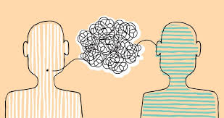
Listening Exercise
Notes:
Point of the Slide: Students can practice and reflect on their communication styles
Speaking Notes:
Introduce the exercise, Listening Exercise
Ask students to find a partner. Each partner gets one minute to talk and one minute to listen. Pick a simple topic that is easy to share about such as: ‘what are you going to do after school?’ or ‘what type of food do you like to eat?’
Be clear that the job of the listener is to simply listen.
After everyone has had an opportunity to be in both roles, ask students to reflect on the exercise. Things that they might notice:
Some of us are better at talking than listening.
Some of us have a hard time finding words.
Communication is hard and sometimes awkward and, like any skill, it requires practice.
It helps to feel patience, support and a smile from the person we are communicating with. Body language, pacing and tone of voice influence how we communicate.

Slide 17

What Teens Think About:
Healthy Relationships
Notes:
Point of the Slide: Allow the students to learn via a different medium about healthy relationships by watching a video to spark ideas and conversations.
Speaking Notes:
Introduce the video, What Teens Think About Healthy relationships.
Explain they will be watching a short video about healthy versus unhealthy relationships.
While watching the video, encourage students to think about the list of qualities that are important in all healthy relationships that were brainstormed in the previous activity and posted on the board or flip chart.
Watch Video: What Teens Think About: Healthy Relationships https://www.youtube.com/watch?v=DPb_B0pTBoQ

Slide 18
Discussion
Small Group discussion:
Are there any themes from the video that we can add to our list of qualities of a healthy relationship?
What is the difference between a healthy and unhealthy relationship?
What does it mean to have open and honest communication?
Notes:
Point of slide: To provide students with an opportunity to discuss the video as it relates to the VIP curriculum topic of healthy relationships.
Speaking Notes:
Divide the class into small groups and ask them to go over the questions in the slide and discuss.
Are there any themes from the video that we can add to our list of qualities of a healthy relationship?
What is the difference between a healthy and unhealthy relationship?
What does it mean to have open and honest communication?
Report Back to Class:
Ask the class to come back together and ask each group to answer one of the questions, you can ask popcorn style by randomly selecting students or ask groups to volunteer by raising their hands or ask the groups to identify a spokesperson.
Emphasize the importance of asking ourselves what we want and don’t want in a relationship and what the other person values. Remind the class that personal boundaries are helpful as they help to define the elements of a healthy relationship.
Message to the Class: It’s important to know, trust and love yourself in order to be in a healthy relationship. You may choose to ask students about the things they do to be in a good relationship with themselves. What are activities or things you do that help you take care of you?

Slide 19
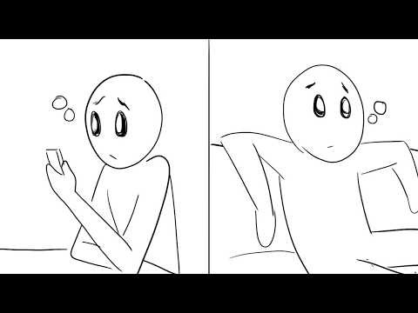
12 Signs That You Are In A Healthy Relationship
Notes:
**OPTIONAL AND IF YOU HAVE TIME**
Depending on how long the previous parts of the presentation take, this video may have to be left out or used in a later session.
Point of Slide: Allow the students to learn via a different medium about healthy relationships by watching a video to spark ideas and conversations.
Speaking Notes:
Introduce the video, 12 Signs That You Are in A Healthy Relationship
Explain they will be watching a short animation that summarizes some of the key components of a healthy relationship.
Watch Video: Psych2Go (Aug 28, 2018) 12 Signs That You Are In A Healthy Relationship https://www.youtube.com/watch?v=kCQIDvEnrTg

Slide 20
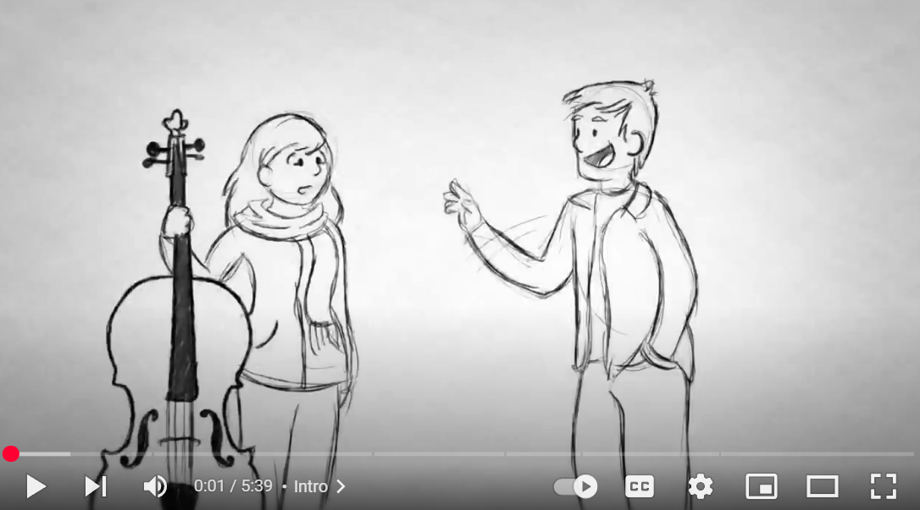
How To Break Up
Notes:
**OPTIONAL AND IF YOU HAVE TIME**
Depending on how long the previous parts of the presentation take, this video may have to be left out or used in a later session.
Point of Slide: Allow the students to learn via a different medium about healthy relationships by watching a video to spark ideas and conversations.
Speaking Notes:
Introduce the video, How To Break Up
Explain they will be watching a short video that shares some tools to communicate how to end a relationship in a respectful way.
Watch Video: How To Break Up https://www.youtube.com/watch?v=XpXpHjT2ACo

Slide 21
Thank You
Name:
Peace Counsellor:
ORGANIZATION Name:
Phone Number:
Email:
Office hours:
Notes:
Point of Slide: Recap the main messages of the VIP curriculum lesson plan and thank the class.
Speaking Notes:
Recap main messages.
Let them know that sometimes a topic like healthy relationships can seem simple and like common sense. However, remind them that violent relationships are not uncommon and taking the time to self-reflect about what we want and need to be safe and happy in our relationships is important.
Thank them for being a wonderful class and let the students know your contact information and what information you will be sending home with them, such as VIP post cards, VIP wallet cards, agency brochure, PEACE Program brochure, and any other additional resources.
Reiterate your contact information and office hours on the slide.
If you are returning for another presentation, let the class know when you will be back and remind them to stay and ask any questions or concerns that may have arisen during the presentation.

Slide 22
DAY 3: the CYCLE OF ABUSE AND CONSENT
Grades 10-12
Notes:
Point of Slide: This slide introduces the Violence Is Preventable (VIP) Program, and why PEACE Program counsellors are in the classroom and informs the students of the purpose of the presentation.
Speaking Notes:
Introduce yourself:
Who you are
What organization you are from
What your role is
A brief overview of the presentation.
For example:
I am happy to be here today and I am looking forward to sharing this meaningful time together. In my work, I help kids of all ages stay safe in their friendships and homes. I also help kids who may have been scared, confused or upset because one adult in their home is hurting another adult. I work for a program called the PEACE Program and we are sharing this presentation today on the Violence is Preventable (VIP) Program. I am visiting all kinds of classrooms in BC for students of all ages in classrooms just like this one.
Acknowledge the traditional territory you are on.
Thank the teacher for having you in their classroom.

Slide 23
PEACE Program
Free.
Confidential program across BC.
For children and youth aged 3 to 18 who have experienced violence in their home.
Notes:
Point of the Slide: To explain what the PEACE program does.
You might wish to share the PEACE Program PSA to help explain the PEACE Program to the class: https://youtu.be/ZWt_6uUQq90?si=XQDUy_-VSHIbtmkZ
The PEACE Program offers free, confidential support to children and youth aged 3-18 in BC who have experienced violence in their homes.
There are 87 PEACE Programs located across BC.
PEACE programs provide age-appropriate services that help Children and Youth to:
label and express the feelings they have experienced regarding the violence they have encountered;
understand healthy ways of dealing with anger and expressing anger;
understand that they are not at fault for the violent actions of others;
teach safety skills, strategies and develop safety plans;
encourage open communication;
acknowledge loss and separation issues;
facilitate understanding of abuse and myths about violence against women;
explore other violence issues such as violence in the media; and
encourage self-confidence.

Slide 24
VIP Outline for Grades 10-12
Violence Against Women and Safety Planning
Healthy vs Unhealthy Relationships
The Cycle of Abuse & Consent
Online Health and Safety & The Bystander Effect
Notes:
Point of the Slide: To introduce the students to the key themes of the VIP curriculum. Also, advise them that classes across BC who are participating in VIP are receiving the same presentation.
Speaking Notes:
We are here to have a conversation with you about important topics including domestic violence, safety planning, healthy relationships, online safety and the bystander effect.
Remind students of the number of presentations you will be delivering (1-4).
Disclaimers:
Discussing sensitive topics;
Self-care e.g., stepping outside of the classroom for a few minutes, going to the bathroom or visiting the school counsellor
Briefly review the topics you have addressed before and address any housekeeping, such as one person speaking at a time, raising hands for questions and comments, self-care and cellphone use.
You may wish to revisit the “community agreement” or “rules.” from the previous sessions and have these visible throughout the presentation.
Talk about confidentiality and disclosures: Let the students know that if they feel uncomfortable talking about their own experiences that they can say “a friend that I know” or “I heard this happened” or talk to you after or outside of class.
Remind the class that you will be available after every session if anyone needs support or has questions. This includes wanting support because you know someone else is having this experience.

Slide 25
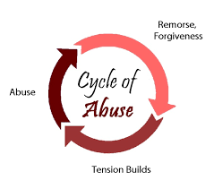
Cycle of Abuse & Consent
Notes:
Point of slide: Introduce the VIP curriculum topic of the cycle of abuse & consent
Speaking Notes:
Today we are going to talk about the cycle of abuse and consent in intimate relationships. This topic can be upsetting for those in the room who have experienced violence or abuse at home or in a relationship. I want all of you to please take care of yourselves as the content covered in these presentations can be upsetting. I will be available at anytime if needed.
While every relationship is different, it is important to be able to identify similar patterns that may emerge in unhealthy relationships. Today we will be learning about the cycle of abuse as well as consent as we continue to differentiate between healthy and unhealthy relationships.

Slide 26
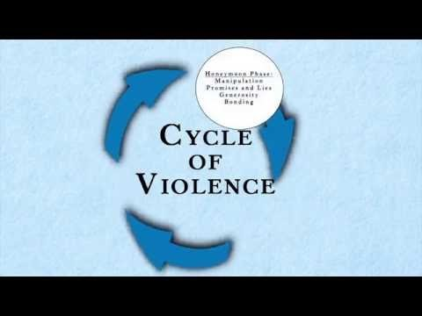
Cycle of Violence
Notes:
Point of the Slide: To provide the students an opportunity to learn via a different medium – watch and discuss a video about the cycle of violence.
Speaking Notes:
We are going to watch a short video about the cycle of violence and we will have a group discussion afterwards.
Watch Video: Cycle of Violence https://www.youtube.com/watch?v=w0Q2bqLYjnY
It is worth acknowledging that not all abusive relationships will follow this cycle. However, most abusive relationships have some resemblance to the cyclical nature described in this video.
Take the time to ask students if they have any questions and review the different stages of the cycle of abuse through definitions and examples.
It can be helpful to draw the cycle on the board and review or brainstorm some different examples of each stage of the cycle.
Activity: Group Discussion – How To Leave and Abusive Relationship
Recall the safety plans for home and school that you created and discussed in the first presentation and refer to the Safety Planning tips provided in Appendix A of the VIP Curriculum
Teenagers in abusive relationships are most likely to tell other teenagers rather than their parents or trusted adults. Let students know that if their friend opens up to them about being in an abusive relationship, encourage them to create a safety plan that includes a trusted adult.
Let students know that if they are concerned with their safety, that it is important they discuss their plan for leaving the relationship with someone they trust, and that a person they trust accompanies them when they go to end the relationship.

Slide 27
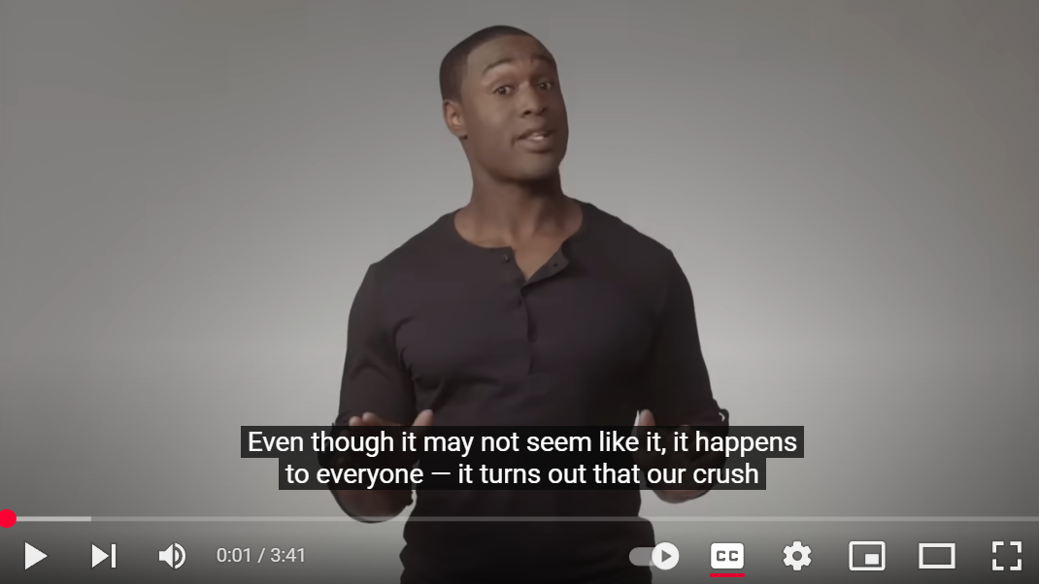
When Someone Doesn’t Want To Have Sex: What Is Consent?
Notes:
Point of the Slide: To provide the students an opportunity to learn via a different medium – watch and discuss a videos about consent
Speaking Notes:
We are going to watch a short video that breaks down and demonstrates what consent looks like. There are also specific references to times when consent is not possible legally. We will have a group discussion afterwards.
Watch Video: When Someone doesn’t want to have sex: What is Consent? https://www.youtube.com/watch?v=QSDjSetlGiw
Note: There are two videos provided for this part of the lesson plan. The facilitator can determine whether or not they have time for both or if they wish to choose one.

Slide 28
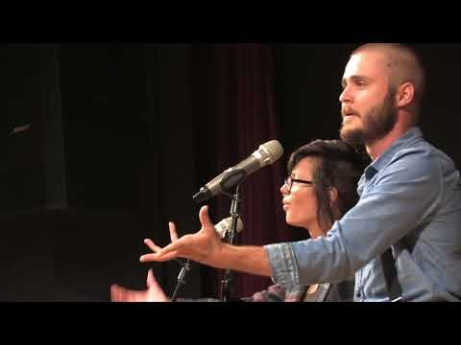
One Colour
Notes:
Point of the Slide: To provide the students an opportunity to learn via a different medium – watch and discuss a videos about consent
Speaking Notes:
We are going to watch a spoken word poem demonstrating the subtleties of consent and highlighting the truth that most sexual violence happens with people we are in relationship with. There is also a focus on how we can teach prevention better. We will have a group discussion afterwards.
Watch Video: One Colour https://www.youtube.com/watch?v=OnSuR3bFWcQ
Note: There are two videos provided for this part of the lesson plan. The facilitator can determine whether or not they have time for both or if they wish to choose one.

Slide 29
Discussion
What does consent look like? What are some situations where consent is grey and unclear?
What stands out for you in the video? How can we teach consent & prevention more effectively?
Have you talked about consent with your parents?
What aspects of consent do you think could be shared differently?
What elements of consent are still not being addressed in youth culture? What does this look like and how can we continue to teach this issue more completely?
Notes:
Point of the Slide: To provide students with an opportunity to discuss the video(s) as they relate to the VIP curriculum topic of consent
Activity: Small Group Discussion – Consent
Break the class into small groups and ask them to spend some time discussing the questions on the slide. You may consider taking time for some questions and dialogue between the videos.
What does consent look like? What are some situations where consent is grey and unclear?
What stands out for you in this spoken word poem? How can we teach consent and prevention more effectively?
Have you talked about consent with your parents?
What aspects of consent do you think could be shared differently? What elements of consent are still not being addressed in youth culture? What does this look like and how can we continue to teach this issue more completely?
Invite the class to be creative. Acknowledge that the issue of consent has changed significantly in the last decade. It used to emphasize the saying ‘No’ when you didn’t consent to something. Now, it is expected by law that we verbally hear the word ‘Yes,’ in order to indicate consent. You can even bring in some recent news articles on the topic of consent or the #Metoo movement if that feels relevant for you and the class.
Consent means giving someone a choice about touch or actions and respecting their answer. Some facilitators use the language “asking for permission.” It is important to discuss how to set boundaries and make decisions about their own bodies, how to ask for permission, and respond appropriately when someone says no to them.
VIP presenters can familiarize themselves with the BELIEVE Curriculum to find more tools to support youth to engage and converse about consent within the classroom.

Slide 30
Thank You
Name:
Peace PROGRAM Counsellor:
ORGANIZATION Name:
Phone Number:
Email:
Office hours:
Notes:
Point of Slide: Recap the main messages of the VIP curriculum lesson plan and thank the class.
Speaking Notes:
Recap main messages.
Thank them for being a great class and having you as a guest. Acknowledge that you have now spent close to 3 hours discussing topics that are incredibly important for being safe and happy long term in our lives.
Remind them that sometimes topics like the ones we discussed today can make us sensitive and uncomfortable. However, remind them that abusive relationships are common and taking the time to self-reflect about what we want and need to be safe and happy in our relationships is important.
Remind students of what information you will be sending home with them, such as VIP post cards, VIP wallet cards, agency brochure, PEACE Program brochure, and any other additional resources.
Reiterate your contact information and office hours on the slide. Remind them to stay and ask any questions or share any concerns that may have arisen during the presentation.
If you are returning for another presentation, let the class know when you will be back.

Slide 31
DAY 4: Online safety and the bystander effect
Grades 10-12
Notes:
Point of Slide: This slide introduces the Violence Is Preventable (VIP) Program, and why PEACE Program counsellors are in the classroom and informs the students of the purpose of the presentation.
Speaking Notes:
Introduce yourself:
Who you are
What organization you are from
What your role is
A brief overview of the presentation.
For example:
I am happy to be here today and I am looking forward to sharing this meaningful time together. In my work, I help kids of all ages stay safe in their friendships and homes. I also help kids who may have been scared, confused or upset because one adult in their home is hurting another adult. I work for a program called the PEACE Program and we are sharing this presentation today on the Violence is Preventable (VIP) Program. I am visiting all kinds of classrooms in BC for students of all ages in classrooms just like this one.
Acknowledge the traditional territory you are on.
Thank the teacher for having you in their classroom.

Slide 32
PEACE Program
Free.
Confidential program across BC.
For children and youth aged 3 to 18 who have experienced violence in their home.
Notes:
Point of the Slide: To explain what the PEACE program does.
You might wish to share the PEACE Program PSA to help explain the PEACE Program to the class: https://youtu.be/ZWt_6uUQq90?si=XQDUy_-VSHIbtmkZ
The PEACE Program offers free, confidential support to children and youth aged 3-18 in BC who have experienced violence in their homes.
There are 87 PEACE Programs located across BC.
PEACE programs provide age-appropriate services that help Children and Youth to:
label and express the feelings they have experienced regarding the violence they have encountered;
understand healthy ways of dealing with anger and expressing anger;
understand that they are not at fault for the violent actions of others;
teach safety skills, strategies and develop safety plans;
encourage open communication;
acknowledge loss and separation issues;
facilitate understanding of abuse and myths about violence against women;
explore other violence issues such as violence in the media; and
encourage self-confidence.

Slide 33

Online Safety & The Bystander Effect
Notes:
Point of slide: To introduce the VIP curriculum topic of online safety and the bystander effect.
Speaking Notes: :
“Today we are going to talk about online safety and the bystander effect. Similar to the topic of healthy and unhealthy relationships, these issues can be found in intimate relationships, social networks and friendships. This topic can be upsetting for those in the room who have experienced bullying online or in person and for anyone who has had their trust violated online. As a reminder, please take care of yourselves and I will be available after class.”

Slide 34
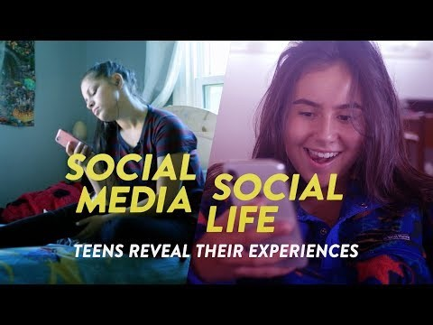
Social Media, Social Life: Teens Reveal Their Experiences
Notes:
Point of slide: To provide students the opportunity to learn via a different medium – watching a video that discusses both the positive and negative effects of social media on the lives of teenagers.
Speaking Notes:
Explain that they will be watching a short video that reveals both the positive and negative effects of social media on the lives of teenagers. They will then watch a second video and the videos will be followed by a group discussion.
Watch Video : CommonSenseMedia. (September 10, 2018). Social Media, Social Life: Teens Reveal Their Experiences https://www.youtube.com/watch?v=GGGDfciqyvw

Slide 35
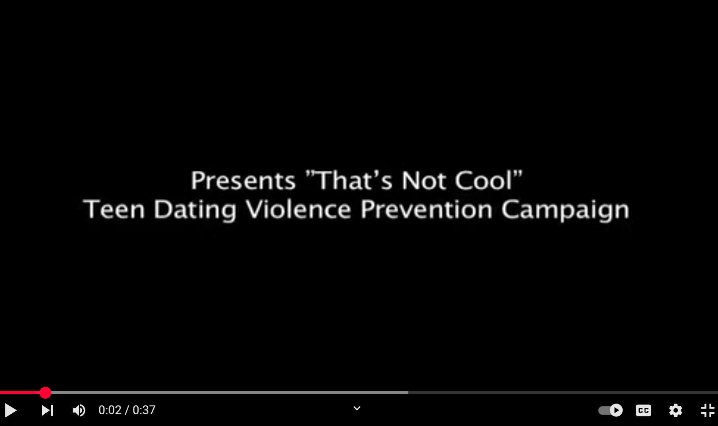
That’s Not Cool
Notes:
Point of slide: To provide students the opportunity to learn via a different medium – watching a video that demonstrates how online relationships can start out harmless and become unhealthy and abusive.
Speaking Notes:
Explain that they will be watching a short video that demonstrates how online relationships can start out harmless and become unhealthy and abusive. The video will be followed by a group discussion.
Watch Video : Futures Without Violence. (April 19, 2011). That’s Not Cool – PSA https://youtu.be/GB8XCOu1-dQ

Slide 36
Discussion
What are some challenges and strengths social media and online communication have on your capacity to contribute to healthy relationships? (Friendships and romantic relationships)
Create a list of the ways you can stay safe and create boundaries in online relationships.
What does this look like in real life?
How can social media and online communication impact our communication skills?
Notes:
Point of slide: To provide students with an opportunity to discuss the videos as they relate to the VIP curriculum topic of online safety
Activity: Small Group Discussion
Break up the class into small groups and ask them to discuss the challenges and strengths that social media and online communication have on their capacity to contribute to healthy relationships (friendships and romantic relationships).
Then invite students to create a list of the ways that they can stay safe and create boundaries in online relationships. What does this look like in real life? How does social media and online communication impact their communication skills? (i.e. remind students about the listening exercise from Day 2)

Slide 37
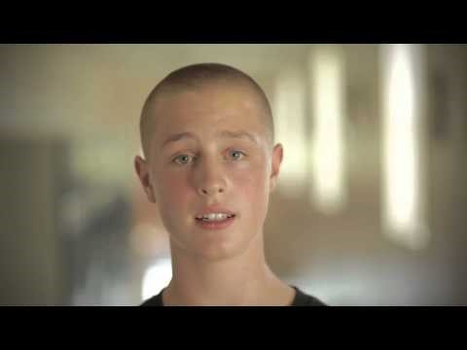
Stand Against Bullying: Don’t Be A Bystander
Notes:
Point of slide: To provide students the opportunity to learn via a different medium – watching a video that emphasizes the importance of not being a bystander and also acknowledges how most of us are, at some point, a bystander to bullying and violence.
Speaking Notes:
Explain that they will be watching a short video that emphasizes the importance of not being a bystander and also acknowledges how most of us are, at some point, a bystander to bullying and violence.
Watch Video : Robert Land Academy. (October 16, 2012). Stand Against Bullying. Don’t be a Bystander https://www.youtube.com/watch?v=ruBqetaMd5g
Note: There are three videos provided for this part of the lesson plan. The facilitator can determine whether or not they have time for one, two or all three.

Slide 38
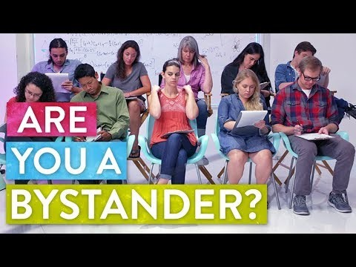
The Bystander Effect: The Science of Empathy
Notes:
Point of slide: To provide students the opportunity to learn via a different medium – watching a video about the science of empathy and some key factors that drive us to help other people. Although not directly related to relationships, it is interesting to think about the connections between the scenarios in this video and the social settings students may be exposed to around school and in their social lives more generally.
Speaking Notes:
Explain that they will be watching a short video about the science of empathy and some key factors that drive us to help other people.
Watch Video : SoulPancake. (November 16, 2017). The Bystander Effect | The Science of Empathy https://www.youtube.com/watch?v=Wy6eUTLzcU4
Note: There are three videos provided for this part of the lesson plan. The facilitator can determine whether or not they have time for one, two or all three.

Slide 39
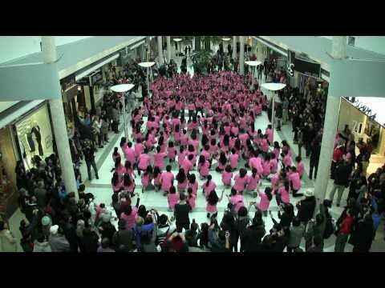
Anti-Bullying Flash Mob
Notes:
Point of slide: To provide students the opportunity to learn via a different medium – watching a video of Vancouver teens creating a flash mob against bullying and teen violence.
Speaking Notes:
Explain that they will be watching a short video of Vancouver teens creating a flash mob against bullying and teen violence
Watch Video : Boogaloo Academy (February 5, 2011). Anti-Bullying Flash Mob https://www.youtube.com/watch?time_continue=29&v=MhYyAa0VnyY&feature=emb_logo
Note: There are three videos provided for this part of the lesson plan. The facilitator can determine whether or not they have time for one, two or all three.

Slide 40
Discussion
What is the roll of a bystander in online forums and social media?
What are the steps we can take if we know someone is being bullied or harassed online?
Have you ever witnessed or been an active bystander?
Come up with creative ideas to engage your school or your community in an anti-violence campaign.
Notes:
Point of slide: To provide students with an opportunity to discuss the videos as they relate to the VIP curriculum topic of online safety
Activity: Small Group Discussion
Break up the class into small groups and spend some time discussing and sharing the topics and questions on the slide
Make absolutely clear that safety planning is at the forefront when considering the role of the bystander and utilizing trusted adults is suggested to ensure safety for all when youth are considering becoming active bystanders online, at home and in social situations.
What is the roll of a bystander in online forums and social media?
What are the steps we can take if we know someone is being bullied or harassed online? Review the safety plan and consider making a safety plan with students for how to navigate staying safe online.
Have you ever witnessed or been an active bystander?
Come up with creative ideas to engage your school or your community in an anti-violence campaign. Some examples you might suggest are making short films in support of healthy relationships, an art installation and/or spoken word poetry night at their school.

Slide 41
Thank You
Name:
Peace PROGRAM Counsellor:
ORGANIZATION Name:
Phone Number:
Email:
Office hours:
Notes:
Point of Slide: Recap the main messages of the VIP curriculum lesson plan and thank the class.
Speaking Notes:
Recap main messages.
Thank them for being a great class and acknowledge that you have now spent 3-4 hours discussing topics that are incredibly important for being safe and happy long term in our lives.
Let them know that sometimes topics like the ones we discussed today can make us sensitive and uncomfortable. Furthermore, relationships are complex and the issues we have discussed are ones we have to continue to be aware of as we grow and mature in our lives.
Remind them that abusive relationships are not uncommon and taking the time to self-reflect about what we want and need to be safe and happy in our relationships is important. Always reach out to a trusted adult if they feel unsafe or have questions about anything that doesn’t feel right in any of their relationships.
Remind students of what information you will be sending home with them, such as VIP post cards, VIP wallet cards, agency brochure, PEACE Program brochure, and any other additional resources.
Reiterate your contact information and office hours on the slide. Remind them to stay and ask any questions or share any concerns that may have arisen during the presentation.

