Slide 1



Day 1: SAFETY PLANNING & the three main messages
Grades 4-6
Notes:
Point of Slide: This slide introduces the Violence Is Preventable (VIP) Program, and why PEACE Program counsellors are in the classroom and informs the students of the purpose of the presentation.
Speaking Notes:
Introduce yourself:
Who you are
What organization you are from
What your role is
A brief overview of the presentation.
For example:
I am happy to be here today and I am looking forward to sharing this meaningful time together. In my work, I help kids of all ages stay safe in their friendships and homes. I also help kids who may have been scared, confused or upset because one adult in their home is hurting another adult. I work for a program called the PEACE Program and we are sharing this presentation today on the Violence is Preventable (VIP) Program. I am visiting all kinds of classrooms in BC for students of all ages in classrooms just like this one.
Acknowledge the traditional territory you are on.
Thank the teacher for having you in their classroom.

Slide 2


PEACE Program
Free.
Confidential program across BC.
For children and youth aged 3 to 18 who have experienced violence in their home.
Notes:
Point of the Slide: To explain what the PEACE program does.
You might wish to share the PEACE Program PSA to help explain the PEACE Program to the class: https://youtu.be/ZWt_6uUQq90?si=XQDUy_-VSHIbtmkZ
The PEACE Program offers free, confidential support to children and youth aged 3-18 in BC who have experienced violence in their homes.
There are 87 PEACE Programs located across BC.
PEACE programs provide age-appropriate services that help Children and Youth to:
label and express the feelings they have experienced regarding the violence they have encountered;
understand healthy ways of dealing with anger and expressing anger;
understand that they are not at fault for the violent actions of others;
teach safety skills, strategies and develop safety plans;
encourage open communication;
acknowledge loss and separation issues;
facilitate understanding of abuse and myths about violence against women;
explore other violence issues such as violence in the media; and
encourage self-confidence.

Slide 3
VIP Outline for Grades 4-6
Safety Planning and The Three Main Messages.
Healthy Relationships.
Emotional Expression and Self Care
Notes:
Point of the Slide: To introduce the students to the key themes of the VIP curriculum and the number of presentations you will be doing. You could share that all Grade 4-6 classes in BC who are participating in VIP are receiving the same presentation.
Speaking Notes:
We are here to have a conversation with you about important topics including domestic violence, safety planning, healthy relationships, self-care and emotional expression.
Let students know what to expect during the presentation and advise them of the number of presentations you will be delivering (1-3).
Disclaimers:
Discussing sensitive topics;
Self-care e.g., stepping outside of the classroom for a few minutes, going to the bathroom or visiting the school counsellor
Have the class tell you what their “agreement” or “rules” are. Come up with a list together on the board or a flip chart so it’s visible throughout the presentation.
Talk about confidentiality and disclosures: Let the students know that if they feel uncomfortable talking about their own experiences that they can say “a friend that I know” or “I heard this happened” or talk to you after or outside of class.
Remind the class that you will be available after every session if anyone needs support or has questions. This includes wanting support because you know someone else is having this experience.

Slide 4


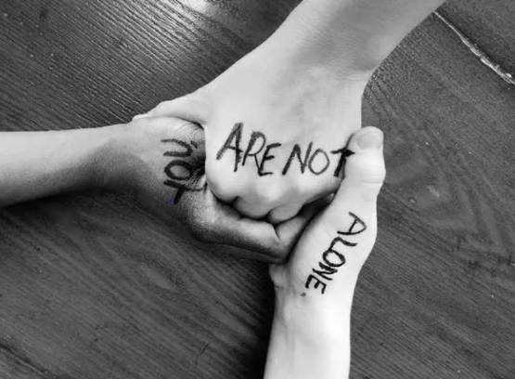
3 Things You Need to Know: 1. Violence is NOT your fault. 2. You are NOT alone. 3. There are people who can help.
Notes:
Point of slide: To discuss with the students these 3 main messages.
Speaking Notes:
I am visiting classrooms because my program wants every child in our community to know three main messages. If you forget anything I say today, my name, or where I am from, that’s okay, but I do want you to remember these three main messages.
1. Violence is not your fault: It is never a child’s fault if they are experiencing domestic violence.
Ask the class: Who is responsible for the violence?
2. You Are Not Alone
Discuss with the class: Children and youth often feel alone when there is fighting at home, and the violence may be scary. Explain that part of the reason the VIP Program is here today is to emphasize that they are not alone and to talk about safety.
3. There are people who can help.
Discuss with the class: Who are the safe adults in their lives? What is the safe thing to do when there is domestic violence? Brainstorm safe options (contact a safe adult, stay in your room, go to your neighbor or another safe place).
Have the class repeat the three main messages with you and explain that you are now going to spend a few minutes brainstorming about how to stay safe.
With grades 4-6 students, we can explain that sometimes we may be around other children who are not being safe. You can ask what this might look like in the classroom, on the playground or in the neighbourhood.
One thing we will create today is a safety plan. Safety plans can help us remember what to do if we find ourselves in a situation at home or at school where we do not feel safe.
Grounding Exercise: Assess the energy in the room as you may need to do a grounding exercise to help all children be present/focused during the presentation. See the VIP curriculum Appendix A for tip sheets on sample grounding exercises and techniques.

Slide 5

What is Violence and Abuse?
Violence and Abuse is when people use their body or words to control and hurt someone else.
Notes:
Point of Slide: To introduce the VIP curriculum topic of violence against women and safety planning and to help the students understand and define violence and abuse
Activity- Define Violence and Abuse:
It can be nice to start this conversation by asking the class what they think violence and abuse are before sharing your definition. You could make a list on the board of the class’s ideas and then share the definition on the slide.
Definition: Violence or abuse is when we use our body or words to control and hurt someone.
Discuss and explain the definition on the slide.

Slide 6
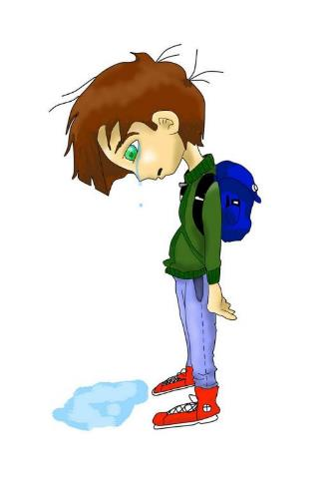
How do you think children who experience domestic violence feel?
Notes:
Point of slide: To engage students to think about what is means to experience domestic violence and violence against women and to live in a family where this occurs or occurred.
Activity:
Brainstorm with the class the following questions:
How do you think children who experience violence and abuse feel?
How might they respond?
What do you think children who experience violence understand?
Expand the brainstorm to include behaviours that can be characterized as bullying.
How do you think children and youth who experience bullying feel?
How do they respond?
What do you think children and youth who experience bullying understand?
Reaffirm that violence and abuse is never okay

Slide 7
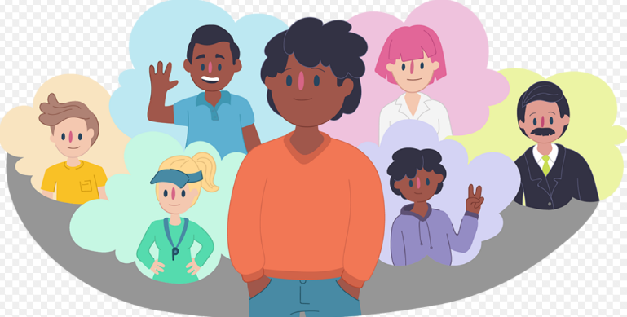
Safety Planning
Notes:
Point of the Slide: To explain to students what a safety plan is and its purpose and how they can think about and plan for safety.
Activity: Safety Planning Group Brainstorm
Brainstorm with the class ways to stay safe in potentially unsafe, dangerous or violent situations.
What is safety? (physical, emotional, mental, social, sexual)?
What are some ways you know that you are not safe?
What are the cues your body gives you when you don’t feel safe?
What are some things you already do to stay safe?
You may choose to include online safety as a part of this conversation if that suits the classroom you are presenting in.
How do we stay safe online?
What are some strategies you think are important to keep yourself safe online?
Why is this important?
What are the signs that something that is happening online is not safe?
Make a list on the board or a flip chart of all the suggestions from the class.
It is important to share with children and youth that safety planning is an ongoing thing. We may feel safe most of the time, but it is important to understand the ways we can recognize when we do not feel safe and have a plan to stay safe.
Activity: Safety Planning Worksheets
Hand out the Safety Planning Worksheets from the VIP curriculum. Tell them they can write the names, draw places and draw faces of people in their world who they can talk to if they have a problem or feel unsafe. Ask them how they can get in touch with their safe adult.
You can also look around the room and identify the classroom teacher, support staff, school counsellors, administrators etc. as possible safe people.
You may also introduce the idea of 911 here. If kids identify they have no one they can talk to, you can encourage them to put 911 on their globe.
An age-appropriate description of the Kid’s Help Phone can also be useful here. See the VIP curriculum for details about this service.

Slide 8
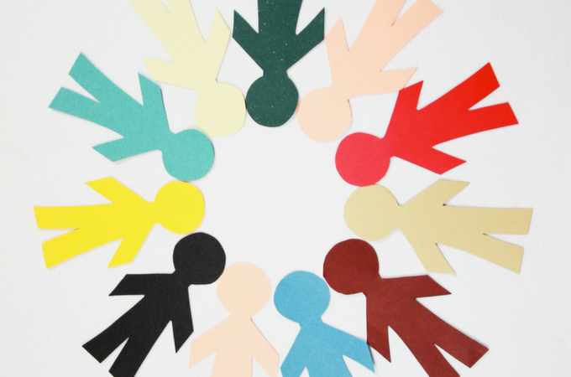
Who is in my Circle?
Notes:
Activity - Who Is in My Circle
Hand out the Who is in My Circle worksheet from the VIP Curriculum and ask the students to think about who is in their circle.
Who do they go to for support?
Who do they ask if they need help?
Ask the students to write down or draw the names of these people in their circle.

Slide 9
Thank You
Name:
Peace PROGRAM Counsellor:
ORGANIZATION Name:
Phone Number:
Email:
Office hours:
Notes:
Point of Slide: Recap the main messages with the class and thank them for their time and attention.
Speaking Notes:
Consider closing with another grounding exercise if necessary. Please refer to VIP Curriculum Appendix A for sample grounding exercises and techniques.
Recap main messages. Can anyone remember any of our three main messages?
Thank them for being a great class, and having you as a guest.
Let the class know what information you will be sending home with them such as VIP post cards and wallet cards. Agency brochure, PEACE Program brochure and any other additional resources.
Reiterate your contact information and office hours on the slide.

Slide 10
DAY 2: healthy relationships
Grades 4-6
Notes:
Point of Slide: This slide introduces the Violence Is Preventable (VIP) Program, and why PEACE Program counsellors are in the classroom and informs the students of the purpose of the presentation.
Speaking Notes:
Take a few minutes to remind the class who you are, where you are from and why you are in the classroom.
I am happy to be here today and I am looking forward to sharing this meaningful time together. In my work, I help kids of all ages stay safe in their friendships and homes. I also help kids who may have been scared, confused or upset because one adult in their home is hurting another adult. I work for a program called the PEACE Program and we are sharing this presentation today on the Violence is Preventable (VIP) Program. I am visiting all kinds of classrooms in BC for students of all ages in classrooms just like this one.
Acknowledge the traditional territory you are on.
Thank the teacher for the invitation to the classroom.

Slide 11
PEACE Program
Free.
Confidential program across BC.
For children and youth aged 3 to 18 who have experienced violence in their home.
Notes:
Point of the Slide: To explain what the PEACE program does.
You might wish to share the PEACE Program PSA to help explain the PEACE Program to the class: https://youtu.be/ZWt_6uUQq90?si=XQDUy_-VSHIbtmkZ
The PEACE Program offers free, confidential support to children and youth aged 3-18 in BC who have experienced violence in their homes.
There are 87 PEACE Programs located across BC.
PEACE programs provide age-appropriate services that help Children and Youth to:
label and express the feelings they have experienced regarding the violence they have encountered;
understand healthy ways of dealing with anger and expressing anger;
understand that they are not at fault for the violent actions of others;
teach safety skills, strategies and develop safety plans;
encourage open communication;
acknowledge loss and separation issues;
facilitate understanding of abuse and myths about violence against women;
explore other violence issues such as violence in the media; and
encourage self-confidence.

Slide 12
VIP Outline for Grades 4-6
Safety Planning and The Three Main Messages.
Healthy Relationships.
Emotional Expression and Self Care
Notes:
Point of the Slide: To introduce the students to the key themes of the VIP curriculum and the number of presentations you will be doing. You could share that all Grade 4-6 classes in BC who are participating in VIP are receiving the same presentation.
Speaking Notes:
We are here to have a conversation with you about important topics including domestic violence, safety planning, healthy relationships, self-care and emotional expression.
Let the children know what to expect. Is this the final presentation or are you returning again?
Disclaimers:
Discussing sensitive topics;
Self-care e.g., option to step outside of the classroom for a few minutes or going to the bathroom or visiting the school counsellor
Review group agreement from session 1 and keep visible throughout presentation.
Talk about confidentiality and disclosures: Let the students know that if they feel uncomfortable talking about their own experiences that they can say “a friend that I know” or “I heard this happened” or talk to you after or outside of class.
Remind the class that you will be available after every session if anyone needs support or has questions. This includes wanting support because you know someone else is having this experience.

Slide 13
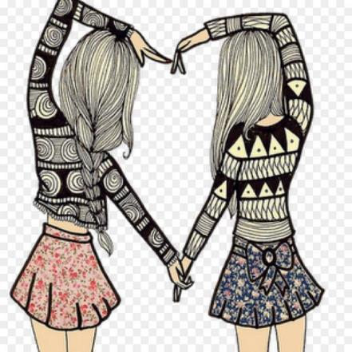
Healthy Relationships
Notes:
Point of slide: Introduce the VIP curriculum topic of healthy relationships.
Speaking Notes:
I was thinking about the last time I was here, and I am wondering if there are a few things we talked about that you remember?
Welcome input from the class to review the last session.
Today, we are going to spend some time talking about what the ingredients are for a healthy relationship and how that makes you feel. We will also explore and share some things we might not like in our relationships. Related to our conversation last time, are there any behaviours that make relationships and friendships not feel safe for you?”
Welcome input from the class
Today we are going to talk to you about RELATIONSHIPS.
R E-L-A-T-I-O-N-S-H-I-P-S….. Write it on the board.
This is a BIG word, does anyone have any idea what it means?
Discuss suggestions and definitions from the class and do a group brainstorm.
After writing the class suggestions on the board, discuss and define relationships for the class. You may use this sample definition as a start:
“Relationships are connections to other people, that could be your family, friends, etc. Relationships impact our daily lives. They can bring us support, joy and sometimes sadness. Today we want to explore ways in which you can develop and maintain positive relationships.”
Clarify that healthy relationships may include both friendships and romantic relationships. Children this age will be beginning to be curious about both types of relationships. VIP presentations can emphasize that when we talk about healthy relationships, we are talking about ALL types of relationships.
It may be helpful here to remind the class that when we share stories, to not use anyone’s name:
We are all here to learn together and we don’t share things that could hurt someone or share stories with people’s names in them. Thank you for your understanding.

Slide 14

Healthy Relationships
What feels good in a friendship?
What do we not want in a friendship?
Notes:
Point of Slide: Allow the students to learn via a different learning medium about healthy relationships – a video to spark ideas and conversation.
Speaking Notes:
Pre-Video Activity:
Remind the class that during the last presentation you spoke about different types of violence and ways to stay safe in unhealthy relationships, at home and online.
In addition to knowing how to stay safe, it is our goal to give you some tools to build and grow in healthy relationships and friendships. In the VIP Program, we believe that if young people know how to recognize healthy relationships, that can help us to avoid unhealthy relationships.
You could ask each person to share one thing that they think is an important part of being a good friend e.g., What are things that feel good for you in friendship?
You could write these things on the board.
Tell the class that you know they already probably know a lot of things about healthy relationships. You may ask the class about some of the things they do not want in a friendship, such as some things that make friendships feel unhealthy.
Often young people indicate that they do not want arguments in a relationship. This can be a timely moment to highlight that healthy relationships include the ability to have disagreements in a way that includes safe communication and listening and the ability to move through disagreements in a healthy way is an important part of being in a healthy relationship.

Slide 15
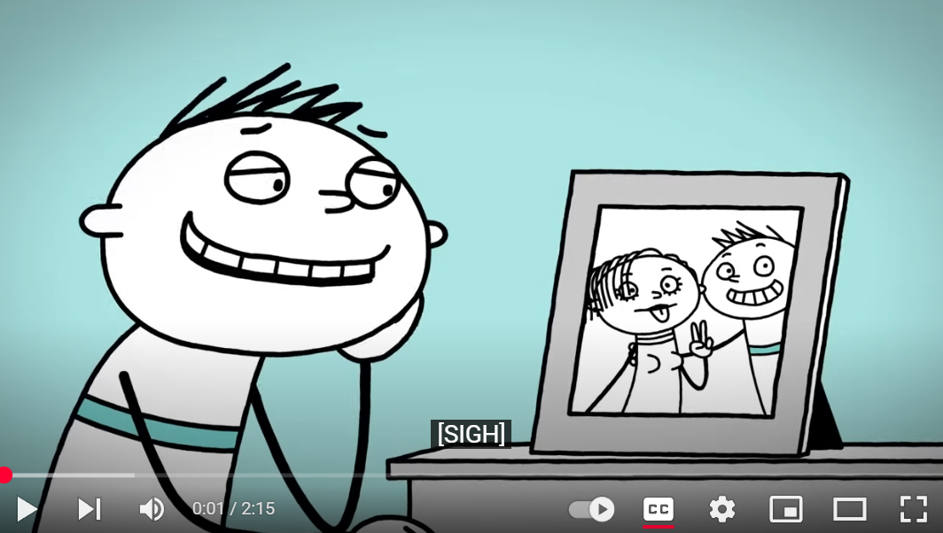
What Makes A Relationship Healthy?
Notes:
Point of slide: To allow students to learn about healthy relationships via a different medium
Speaking notes:
Explain that they are going to watch a short video that explores healthy relationships.
Watch a video:
**There are two video options for this activity. You may choose to use one or both videos depending on how much time you have. Rather than rushing to show both videos, it is more important that each video is followed by a conversation to connect the themes of the video with the overall messages of the presentation.
Video options:
What Make A Relationship Healthy? https://youtu.be/UB9anEZx9LU?si=s6cPfRdNUtk6E80X
Why Do Some Friendships End? https://youtu.be/F1-4MqdnPIw?si=p30DhU0MV_5VocD2
These videos explore some qualities and truths that young people around this age might experience in friendships and in their first intimate relationships. After watching each video, it is helpful to take some time to refer back to the list you made in the previous exercise and see if the children have anything to add or if anything from the video did not make sense to them.

Slide 16
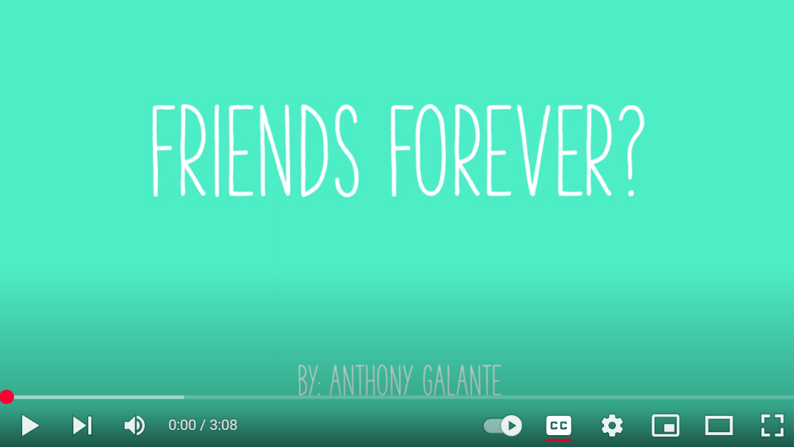
Why Do Some Friendships End?
Notes:
Point of slide: To allow students to learn about healthy relationships via a different medium
Speaking notes:
Explain that they are going to watch a short video that explores healthy relationships.
Watch a video:
**There are two video options for this activity. You may choose to use one or both videos depending on how much time you have. Rather than rushing to show both videos, it is more important that each video is followed by a conversation to connect the themes of the video with the overall messages of the presentation.
Video options:
What Make A Relationship Healthy? https://youtu.be/UB9anEZx9LU?si=s6cPfRdNUtk6E80X
Why Do Some Friendships End? https://youtu.be/F1-4MqdnPIw?si=p30DhU0MV_5VocD2
These videos explore some qualities and truths that young people around this age might experience in friendships and in their first intimate relationships. After watching each video, it is helpful to take some time to refer back to the list you made in the previous exercise and see if the children have anything to add or if anything from the video did not make sense to them.

Slide 17
Thank You
Name:
Peace PROGRAM Counsellor:
ORGANIZATION Name:
Phone Number:
Email:
Office hours:
Notes:
Point of Slide: Recap the main messages and thank the class.
Speaking Notes:
Recap main messages of the Healthy Relationships lesson plan.
Thank them for being a wonderful class.
Let them know what information you will be sending home with them, such as VIP post cards, VIP wallet cards, agency brochure, PEACE Program brochure, and any other additional resources.
Ask them to review the three main messages of the VIP Program:
Violence is not your fault.
You are not alone.
There are people who can help.
Reiterate your contact information and office hours on the slide.

Slide 18
DAY 3: Emotional expression and self care
Grades 4-6
Notes:
Point of Slide: This slide reminds students about the Violence Is Preventable (VIP) Program, why PEACE Program counsellors are in the classroom and informs them of the purpose of the presentation.
Speaking Notes:
Take a few minutes to remind the class who you are, where you are from and why you are back in the classroom.
I am happy to be here today and I am looking forward to sharing this meaningful time together. In my work, I help kids of all ages stay safe in their friendships and homes. I also help kids who may have been scared, confused or upset because one adult in their home is hurting another adult. I work for a program called the PEACE Program and we are sharing this presentation today on the Violence is Preventable (VIP) Program. I am visiting all kinds of classrooms in BC for students of all ages in classrooms just like this one.
Acknowledge the traditional territory you are on.
Thank the teacher for the invitation to the classroom.

Slide 19
PEACE Program
Free.
Confidential program across BC.
For children and youth aged 3 to 18 who have experienced violence in their home.
Notes:
Point of the Slide: To explain what the PEACE program does.
You might wish to share the PEACE Program PSA to help explain the PEACE Program to the class: https://youtu.be/ZWt_6uUQq90?si=XQDUy_-VSHIbtmkZ
The PEACE Program offers free, confidential support to children and youth aged 3-18 in BC who have experienced violence in their homes.
There are 87 PEACE Programs located across BC.
PEACE programs provide age-appropriate services that help Children and Youth to:
label and express the feelings they have experienced regarding the violence they have encountered;
understand healthy ways of dealing with anger and expressing anger;
understand that they are not at fault for the violent actions of others;
teach safety skills, strategies and develop safety plans;
encourage open communication;
acknowledge loss and separation issues;
facilitate understanding of abuse and myths about violence against women;
explore other violence issues such as violence in the media; and
encourage self-confidence.

Slide 20
VIP Outline for Grades 4-6
Safety Planning and The Three Main Messages.
Healthy Relationships.
Emotional Expression and Self Care
Notes:
Point of the Slide: To introduce the students to the key themes of the VIP curriculum and the number of presentations you will be doing. You could share that all Grade 4-6 classes in BC who are participating in VIP are receiving the same presentation.
Speaking Notes:
We are here to have a conversation with you about important topics including domestic violence, safety planning, healthy relationships, self-care and emotional expression.
Let the children know what to expect. Is this the final presentation or are you returning again?
Disclaimers:
Discussing sensitive topics;
Self-care e.g., option to step outside of the classroom for a few minutes or going to the bathroom or visiting the school counsellor
Review group agreement from last time and keep visible through presentation.
Talk about confidentiality and disclosures: Let the students know that if they feel uncomfortable talking about their own experiences that they can say “a friend that I know” or “I heard this happened” or talk to you after or outside of class.
Remind the class that you will be available after every session if anyone needs support or has questions. This includes wanting support because you know someone else is having this experience.

Slide 21
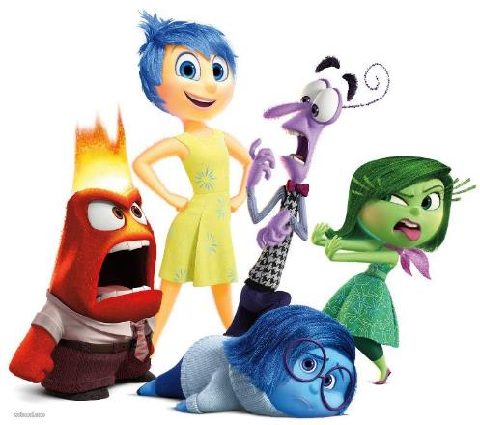
Emotional Expression and Self Care
Notes:
Point of the Slide: Introduce the VIP curriculum topic of emotional expression and self care.
Speaking Notes:
Today we are going to talk about F-E-E-L-I-N-G-S.
What are feelings?
Can anyone list some feelings?
Everyone has feelings and all feelings are okay. Feelings are a message from our body to our brain to pay attention to what is happening. It is healthy and sometimes challenging to put our feelings into words. Today we might practice talking about some of our feelings.
Feelings can create energy in our bodies, like being excited, scared, sad, and they can make us feel different. It is important to allow this feeling energy to move and to get this energy out in a safe way that makes us feel better and isn’t hurtful to anyone. Sometimes big feelings are uncomfortable, and they can result in our bodies having big and even unsafe behaviours. Part of learning to be in healthy and safe relationships is learning to be with our feelings in a way that is safe for us and for the people around us. They can bring us support, joy and sometimes sadness. Today we want to explore ways in which you can develop and maintain positive relationships.
Activity
Let’s make a list of all the feelings we have felt in our body before.
Consider sharing with the class that there are no bad feelings, however, certain feelings are more uncomfortable than others and that can feel hard.
Feelings do not equate to certain behaviours. For example, there are many things we can do if we feel happy or sad or frustrated. What are some safe things we can do if we feel frustrated? And what might be some unsafe behaviours you have seen, or experienced, when people are frustrated, angry or sad?
Grounding Exercise: Shifting to a grounding exercise can help keep kids engaged and listening. See Appendix A of the VIP curriculum for sample grounding exercises.
Note: Three videos are included in this lesson plan and the facilitator can determine which video is appropriate for the class.

Slide 22
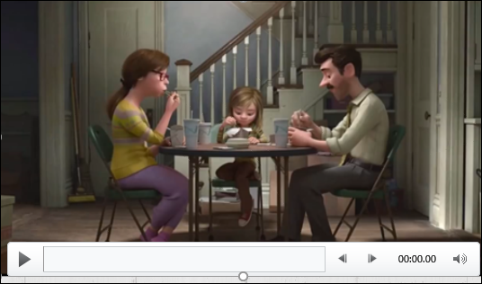
Emotional Expression and Self Care
Notes:
Option A
Point of Slide: To introduce the video that addresses the VIP curriculum topic, emotional expression.
Speaking Notes:
This clip is from the movie Inside Out. This video clip explores the feelings of the three main characters in “Inside Out”, Riley and her parents. It illustrates how feelings and emotions can affect behaviour.
Who here has watched the movie “Inside Out”? We are going to watch a clip from it today to introduce and explore the topic of feelings.
Watch Video: Inside Out- Riley Argues with her parents: https://youtu.be/flMJHyrUI4M?si=eBUmwXT1GQeu1MPw

Slide 23

Emotional Expression and Self Care
Notes:
Option B
Point of Slide: To provide an alternative video option for the VIP curriculum topic. emotional expression, for the facilitator to determine what is appropriate for the class.
Speaking Notes:
This video explores our emotions and what can happen when a person loses control of their emotions. It also helps to teach us about our brains so that we can understand what happens when big feelings are present. Let’s watch the short video and we will have a discussion afterwards.
Watch Video: Why do we lose control of our emotions https://www.youtube.com/watch?v=3bKuoH8CkFc

Slide 24
Discussion
Small Group Discussion:
What do you think are the main messages in the video?
How do emotions impact our behaviours?
What are some examples of this in the video ?
Does age and puberty have anything to do with emotions?
What are some strategies you use to manage your emotions ?
Notes:
Point of Slide: To discuss the emotional expression messages in the videos with the class.
The questions relate to video options A or B.
Activity - Small Group Discussion:
Break up the class into small groups and ask them to discuss and answer the questions on eth slide that are also listed below.
What do you think are the main messages in the video?
How do emotions impact our behaviours?
What are some examples of this in the video ?
Does age and puberty have anything to do with emotions?
What are some strategies you use to manage your emotions?
Report Back to Class
Ask the class to come back together and ask each group to answer one of the questions. You can ask popcorn style, randomly selecting students, or ask groups to volunteer by raising their hands or have the small groups identify a spokesperson to report back.
Closing:
Remind the class that all emotions are healthy to feel. It’s what we do with them that counts.
Thank the class for being so great and participating in today’s session.

Slide 25
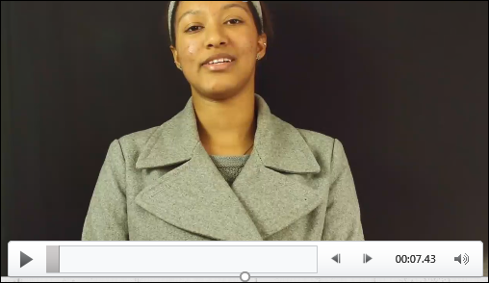
Emotional Expression and Self Care
Notes:
Option C
Point of Slide: To provide an alternative video option for the VIP curriculum topic. For the facilitator to determine what is appropriate for the class.
Speaking Notes:
This video is about different identities and the assumptions we might make about what it means to be, to behave or to act in a certain way.

Slide 26
Discussion
Small Group Discussion
What do you think are the main messages in the video?
What is self-identity?
Did you relate to any of the identities in the video?
What factors do you think influence self-identity and how can it change?
Notes:
Point of the Slide: To discuss and debrief the I am…I am Not video.
The questions relate to video option C.
Activity - Small Group Discussion:
Break up the class into small groups and ask them to discuss and answer the questions on the slide that are also listed below.
What do you think are the main messages in the video?
What is self-identity?
Did you relate to any of the identities in the video?
What factors do you think influence self-identity and how can it change?
Ask them to come up with a list of things that are important to them and factors that have positively influenced their mental well-being and self- identity. If possible, provide the class with a poster board they can use to illustrate their small group message. They can draw, write, or use magazine cut-outs to illustrate their message for the class. Ask each group to share what factors they illustrated that have positively influenced their mental well- being and self-identity.
Report Back to Class:
Ask each group to share the factors they included on their poster boards.

Slide 27
Thank You
Name:
Peace PROGRAM Counsellor:
ORGANIZATION Name:
Phone Number:
Email:
Office hours:
Notes:
Point of Slide: Recap the main messages of the VIP curriculum lesson plan and thank the class.
Speaking Notes:
Remind the class that with practice all emotions can be safe to have in our bodies. It’s what we do with feelings when they happen in our bodies that matters.
Thank them for being a wonderful class.
Let them know what information you will be sending home with them, such as VIP post cards, VIP wallet cards, agency brochure, PEACE Program brochure, and any other additional resources.
Ask them to review the three main messages of the VIP Program:
Violence is not your fault.
You are not alone.
There are people who can help.
Reiterate your contact information and office hours on the slide.

