Slide 1



DAY 1: SAFETY PLANNING and the three main messages
Grades 7-9
Notes:
Point of Slide: This slide introduces the Violence Is Preventable (VIP) Program, and why PEACE Program counsellors are in the classroom and informs the students of the purpose of the presentation.
Speaking Notes:
Introduce yourself:
Who you are
What organization you are from
What your role is
A brief overview of the presentation.
For example:
I am happy to be here today and I am looking forward to sharing this meaningful time together. In my work, I help kids of all ages stay safe in their friendships and homes. I also help kids who may have been scared, confused or upset because one adult in their home is hurting another adult. I work for a program called the PEACE Program and we are sharing this presentation today on the Violence is Preventable (VIP) Program. I am visiting all kinds of classrooms in BC for students of all ages in classrooms just like this one.
Acknowledge the traditional territory you are on.
Thank the teacher for having you in their classroom.

Slide 2


PEACE Program
Free.
Confidential program across BC.
For children and youth aged 3 to 18 who have experienced violence in their home.
Notes:
Point of the Slide: To explain what the PEACE program does.
You might wish to share the PEACE Program PSA to help explain the PEACE Program to the class: https://youtu.be/ZWt_6uUQq90?si=XQDUy_-VSHIbtmkZ
The PEACE Program offers free, confidential support to children and youth aged 3-18 in BC who have experienced violence in their homes.
There are 87 PEACE Programs located across BC.
PEACE programs provide age-appropriate services that help Children and Youth to:
label and express the feelings they have experienced regarding the violence they have encountered;
understand healthy ways of dealing with anger and expressing anger;
understand that they are not at fault for the violent actions of others;
teach safety skills, strategies and develop safety plans;
encourage open communication;
acknowledge loss and separation issues;
facilitate understanding of abuse and myths about violence against women;
explore other violence issues such as violence in the media; and
encourage self-confidence.

Slide 3


VIP Outline for Grades7-9
Safety Planning and The Three Main Messages
Healthy Relationships
Online Safety and The Bystander Effect
Notes:
Point of the Slide: To introduce the students to the key themes of the VIP curriculum. You could advise them that all Grades 7-9 classes in BC who are participating in VIP are receiving the same presentation.
Speaking Notes:
We are here to have a conversation with you about important topics including domestic violence, safety planning, healthy relationships, online safety and the bystander effect.
Let students know what to expect during the presentation and advise them of the number of presentations you will be delivering (1-3).
Disclaimers:
Discussing sensitive topics;
Self-care e.g., stepping outside of the classroom for a few minutes, going to the bathroom or visiting the school counsellor
Address any housekeeping, such as one person speaking at a time, raising hands for questions and comments, self-care and cellphone use.
You may wish to invite the class to share some “community agreement” or “rules”. Come up with a list together on the board or a flip chart so it’s visible throughout the presentation.
Talk about confidentiality and disclosures: Let the students know that if they feel uncomfortable talking about their own experiences that they can say “a friend that I know” or “I heard this happened” or talk to you after or outside of class.
Remind the class that you will be available after every session if anyone needs support or has questions. This includes wanting support because you know someone else is having this experience.
If you are offering more than one presentation, let students know that they will have the opportunity to share anonymous questions and comments at the end of the first presentation and these will be addressed in subsequent presentations in a way that maintains anonymity but gives space for the issues that are relevant for the individuals in the classroom.

Slide 4
Safety Planning and The Three Main Messages
Objectives:
Raise awareness about violence against women and domestic violence.
Share resources to support students with experiences of violence and strategies for staying safe.
Define violence and abuse.
Explain the PEACE and VIP Programs.
Answer any questions.
Notes:
Point of Slide:
To inform students of the objectives of the presentation and help them understand how to connect with the PEACE Program .
Speaking Notes:
Start the conversation by telling students that education is prevention and you are going to support them by:
sharing strategies for staying safe by creating a safety plan;
sharing media and statistics about domestic violence;
sharing tools and resources that support children and youth with experiences of domestic violence; and
increasing awareness about violence against women and domestic violence.
Inquire if they remember receiving the VIP presentation in past years. If so, ask them what they remember.
Remind students of the definition of violence and abuse: Violence or abuse is when we use our body or words to control and hurt someone.
Explain the VIP and PEACE Program goals locally and around the province
Answer any questions.

Slide 5
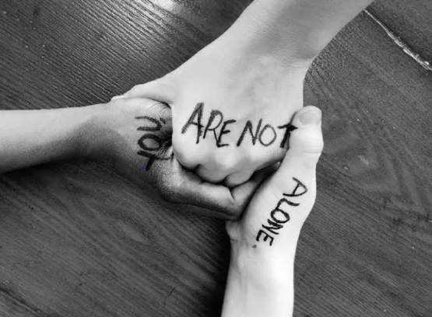
3 Things You Need to Know: 1. Violence is NOT your fault. 2. You are NOT alone. 3. There are people who can help.
Notes:
Point of slide: To introduce the VIP curriculum topic of Safety Planning and The Three Main Messages.
Speaking Notes:
I am visiting classrooms because my program wants every child in our community to know three main messages. If you forget anything I say today, my name, or where I am from, that’s okay, but I do want you to remember these three main messages.
1. Violence is not your fault: It is never a child’s fault if they are experiencing domestic violence.
Ask the class: Who is responsible for the violence?
2. You Are Not Alone
Discuss with the class: Children and youth often feel alone when there is fighting at home, and the violence may be scary. Explain that part of the reason the VIP Program is here today is to emphasize that they are not alone and to talk about safety.
3. There are people who can help.
Discuss with the class: Who are the safe adults in their lives? What is the safe thing to do when there is domestic violence? Brainstorm safe options (contact a safe adult, stay in your room, go to your neighbor or another safe place).
Have the class repeat the three main messages with you and explain that you are now going to spend a few minutes brainstorming about how to keep themselves safe.
With students in grades 7-9, we can explain that sometimes we might also be around other youth who are not being safe. You can ask what this might look like in the classroom, on the playground, in their neighbourhoods or online?
One thing we will create today is a safety plan. Safety plans can help us remember what to do if we find ourselves in a situation at home or at school where we do not feel safe.

Slide 6
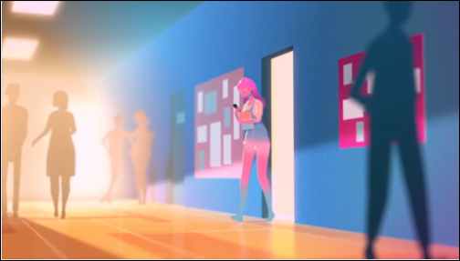
Sunshine – Don’t Confuse Love and Abuse
Notes:
Point of Slide: Allow the students to learn via a different medium about healthy relationships by watching a video to spark ideas and conversations.
Speaking Notes:
We are talking about violence in relationships today. Many people get into their first romantic relationship in their teen years. Romantic relationships can be fun, supportive and meaningful. Students like yourself may also have negative, hurtful and violent experiences in their romantic relationships.
Activity: Watch and Discuss Videos
Introduce the video: Today we are going to be watching a couple of short videos. The first one is called ‘Don’t Confuse Love and Abuse’. This video depicts the difference between love and abuse and the specific ways this may look in a real-life relationship. Please pay attention to the behaviours and feelings of the two main characters who are in a relationship. This video illustrates a couple in a romantic relationship. Notice the behaviours and think about whether or not the actions of the characters are healthy or unhealthy while you are watching. We will have an opportunity to discuss the video afterwards.
Watch video: Sunshine- Don’t confuse Love and Abuse https://www.youtube.com/watch?v=1L6HB97lbrQ
Introduce the next video: The next video is called ‘How to Leave an Abusive Relationship’, It shares some warnings signs that a relationship could be abusive and tools to help leave an abusive relationship safely.
Watch video: How to Leave an Abusive Relationship https://youtu.be/lwNr0eQmmuI?si=IRgkUdt4LGFxsWP8

Slide 7
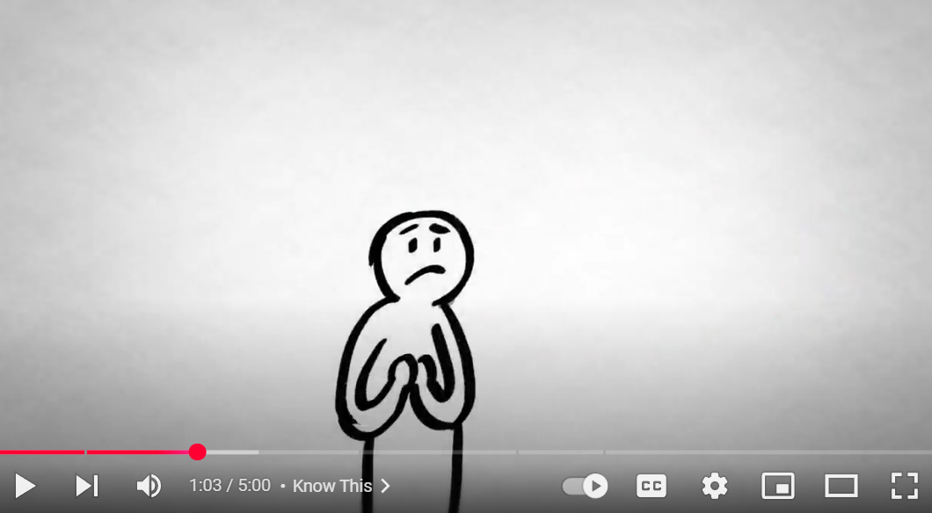
How to Leave an Abusive Relationship
Notes:
Point of Slide: Allow the students to learn via a different medium about healthy relationships by watching a video to spark ideas and conversations.
Speaking Notes:
Introduce the next video: The next video is called ‘How to Leave an Abusive Relationship’, It shares some warnings signs that a relationship could be abusive and tools to help leave an abusive relationship safely.
Watch video: How to Leave an Abusive Relationship https://youtu.be/lwNr0eQmmuI?si=IRgkUdt4LGFxsWP8

Slide 8
Discussion
What are the main messages in the videos?
What are some strategies you can use to keep yourself safe?
Did you see any abusive or violent behaviour in the videos?
Can we brainstorm the types of violence and abuse that can occur in a relationship?
Notes:
Point of Slide: Allow the students an opportunity to discuss the videos as they relate to the VIP curriculum topic of safety planning and the three main messages.
Speaking Notes:
Discuss the video with the class using the questions in the slide and they are also listed below with one additional question that the facilitator can decide if it is appropriate.
What are the main messages in the video?
What are some strategies you can use to keep yourself safe?
Did you see any abusive or violent behaviour in the videos?
Can we brainstorm the types of violence and abuse that can occur in a relationship? Such as physical, emotional, verbal, sexual, financial, technology-facilitated gender-based violence, etc.
Define abuse: You can share the definitions on page 36 of the VIP curriculum after the group brainstorm to provide students with examples of some types of abuse. Highlight that the examples are not comprehensive, and that abuse comes in many other forms.

Slide 9
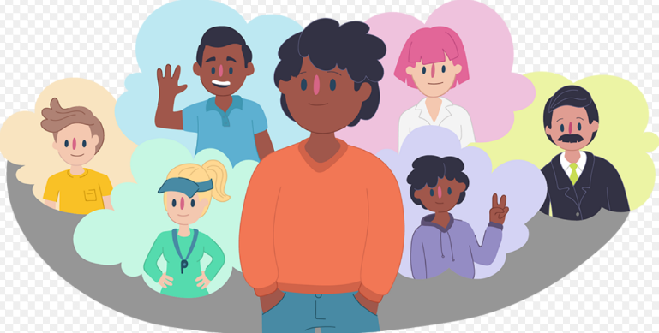
Safety Planning
Notes:
Point of the Slide: To explain to students what a safety plan is and its purpose and how they can think about and plan for safety.
Activity – Safety Planning Brainstorm: Direct the class in a brainstorming session about how to stay safe in abusive or violent situations. This activity can be done in small groups or as a whole class.
What is safety? (physical, emotional, mental, social, sexual)?
What are some ways you know that you are not safe?
What are the cues your body gives you when you don’t feel safe?
What are some things you already do to stay safe?
You could ask students to write out their individual safety plans, one for at home, one for at school and one for online. Use the Safety Planning worksheet on page 38 of the VIP Curriculum to assist with this conversation.
It is important to share with children and youth that safety planning is an ongoing thing. We may feel safe most of the time, but it is important to understand the ways we can recognize when we do not feel safe and have a plan to stay safe.
An age-appropriate description of the Kid’s Help Phone can also be useful here. See the VIP curriculum for details about this service.

Slide 10

Anonymous Question or Comment
Notes:
Point of the Slide: To allow students an opportunity to ask anonymous questions or comments. This can be a powerful tool for seeing what is relevant for the classroom you are presenting to.
Activity – Anonymous Question or Comment
Provide all students with a blank piece of paper and a pen.
Request that each student take the time to write something on the paper related to the presentation. They can write a comment about something that was interesting or a question about something they might be wondering about.
Be clear that these comments and questions are totally anonymous and request that no real names are used. If they have a question about a scenario, they can use pseudonyms.
Let students know that you will begin your next session by addressing themes and questions that emerge through their anonymous comments and questions.

Slide 11
Thank You
Name:
Peace PROGRAM Counsellor:
ORGANIZATION Name:
Phone Number:
Email:
Office hours:
Notes:
Point of Slide: Recap the main messages of the lesson and thank the class.
Speaking Notes:
Recap the main messages from this lesson.
Thank them for being a wonderful class.
Let them know what information you will be sending home with them, such as VIP post cards, VIP wallet cards, agency brochure, PEACE Program brochure, and any other additional resources.
If you are returning for another presentation, let the class know when you will be back and remind them to stay and ask any questions or share any concerns that may have arisen during the presentation.
Reiterate your contact information and office hours on the slide and and encourage students to reach out if they have any questions or concerns about the presentation.

Slide 12
DAY 2: healthy relationships
Grades 7-9
Notes:
Point of Slide: This slide introduces the Violence Is Preventable (VIP) Program, and why PEACE Program counsellors are in the classroom and informs the students of the purpose of the presentation.
Speaking Notes:
Introduce yourself:
Who you are
What organization you are from
What your role is
A brief overview of the presentation.
For example:
I am happy to be here today and I am looking forward to sharing this meaningful time together. In my work, I help kids of all ages stay safe in their friendships and homes. I also help kids who may have been scared, confused or upset because one adult in their home is hurting another adult. I work for a program called the PEACE Program and we are sharing this presentation today on the Violence is Preventable (VIP) Program. I am visiting all kinds of classrooms in BC for students of all ages in classrooms just like this one.
Acknowledge the traditional territory you are on.
Thank the teacher for having you in their classroom.

Slide 13
PEACE Program
Free.
Confidential program across BC.
For children and youth aged 3 to 18 who have experienced violence in their home.
Notes:
Point of the Slide: To explain what the PEACE program does.
You might wish to share the PEACE Program PSA to help explain the PEACE Program to the class: https://youtu.be/ZWt_6uUQq90?si=XQDUy_-VSHIbtmkZ
The PEACE Program offers free, confidential support to children and youth aged 3-18 in BC who have experienced violence in their homes.
There are 87 PEACE Programs located across BC.
PEACE programs provide age-appropriate services that help Children and Youth to:
label and express the feelings they have experienced regarding the violence they have encountered;
understand healthy ways of dealing with anger and expressing anger;
understand that they are not at fault for the violent actions of others;
teach safety skills, strategies and develop safety plans;
encourage open communication;
acknowledge loss and separation issues;
facilitate understanding of abuse and myths about violence against women;
explore other violence issues such as violence in the media; and
encourage self-confidence.

Slide 14
VIP Outline for Grades7-9
Safety Planning and The Three Main Messages
Healthy Relationships
Online Safety and The Bystander Effect
Notes:
Point of the Slide: To introduce the students to the key themes of the VIP curriculum. You could advise them that all Grades 7-9 classes in BC who are participating in VIP are receiving the same presentation.
Speaking Notes:
We are here to have a conversation with you about important topics including domestic violence, safety planning, healthy relationships, online safety and the bystander effect.
Let students know what to expect during the presentation and advise them of the number of presentations you will be delivering (1-3).
Invite the class to remember their “community agreement” or “rules” from Day 1. Review the previous list together on the board or a flip chart so it’s visible throughout the presentation.
Address any housekeeping, such as one person speaking at a time, raising hands for questions and comments, self-care and cellphone use.
Disclaimers:
Discussing sensitive topics;
Self-care e.g., stepping outside of the classroom for a few minutes, going to the bathroom or visiting the school counsellor
Talk about confidentiality and disclosures: Let the students know that if they feel uncomfortable talking about their own experiences that they can say “a friend that I know” or “I heard this happened” or talk to you after or outside of class.
Remind the class that you will be available after every session if anyone needs support or has questions. This includes wanting support because you know someone else is having this experience.

Slide 15
Questions from Last Time
Notes:
Point of the Slide: To address the themes from the anonymous questions or comments shared at the end of the previous presentation.
Speaking notes:
Today we are going to begin by reviewing the anonymous questions from the last presentation. Following that, we will talk about healthy relationships.
Activity – Answer Anonymous Questions from Previous Presentation
Acknowledge with the class that you are not an expert, but rather you are facilitating a conversation about topics that are sometimes hard to talk about.
Before beginning, thank the class for their contributions to the anonymous questions and comments that were shared at the end of the previous presentation.
Ensure that they know you are addressing themes shared and that you are grateful for the time they took to ask such real and relevant questions.
This activity may take 10-15 minutes if students bring up meaningful questions and engage in dialogue.
You can finish this activity by letting students know you are available after class if any questions do not feel resolved or if they want more specific support on a particular topic.

Slide 16
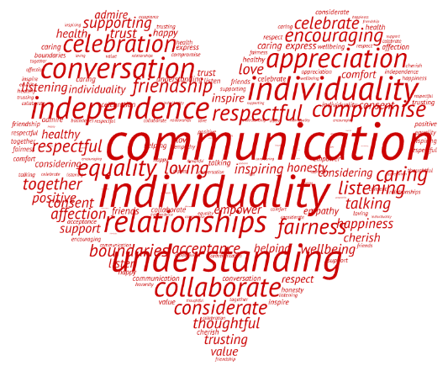
Healthy Relationships
Notes:
Point of slide: Introduce the VIP curriculum topic of healthy relationships.
Speaking Notes:
Healthy relationships may be different for everyone, however, they have some common elements. Today we are going to discuss qualities and elements that make up healthy relationships, and why they are important.
Activity – Brainstorm Healthy Relationships
Encourage the students to think about a close relationship in their life that is NOT romantic, such as parents, siblings and friends. Ask the class to think about attributes or qualities that are important to these relationships. For example:
How do you treat your parents, your siblings and friends?
How do you want to be treated by them?
What is a quality of this relationship that you like?
What is one thing that you do or say in this relationship that feels healthy?
Conduct a group brainstorm with the class and write their ideas down on the board or a flipchart and remind students that there is no wrong answer.
Consider requesting to hear from everyone with the option for students to pass if they wish not to contribute. This can help engage and make space to hear from everyone in the class and gather more diverse ideas.
Emphasize that the qualities they listed are all important in all relationships.
Some ideas that may emerge:
Mutual respect
Love
Trust
Open and honest communication (you may ask youth, what does good communication mean?)
Boundaries

Slide 17
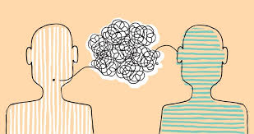
Listening Exercise
Notes:
Point of the Slide: Students can practice and reflect on their communication styles
Activity – Listening Exercise in Partners
Introduce the exercise
Ask students to find a partner. Each partner gets one minute to talk and one minute to listen. Pick a simple topic that is easy to share about such as: ‘what are you going to do after school?’ or ‘what type of food do you like to eat?’
Be clear that the job of the listener is to simply listen.
After everyone has had an opportunity to be in both roles, ask students to reflect on the exercise. Things that they might notice:
Some of us are better at talking than listening
Some of us have a hard time finding words
Communication is hard and sometimes awkward. Like any skill, it requires practice.
It helps to feel patience, support and a smile from the person we are communicating with. Body language, pacing and tone of voice influence how we communicate.

Slide 18
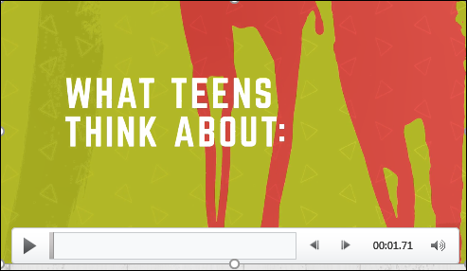
What Teens Think About: Healthy Relationships
Notes:
Point of Slide: Allow the students to learn via a different medium about healthy relationships by watching a video to spark ideas and conversations.
Speaking Notes:
Introduce the videos: Today we are going to be watching a couple of short videos about healthy relationships and then we will have some small group discussions about them. While watching these videos, think about the list of qualities that are important in all healthy relationships from the brainstorming activity we did earlier.
Watch Video A: What Teens Think About Relationships: https://youtu.be/DPb_B0pTBoQ?si=F9LhjZVwLfs1_qVN

Slide 19
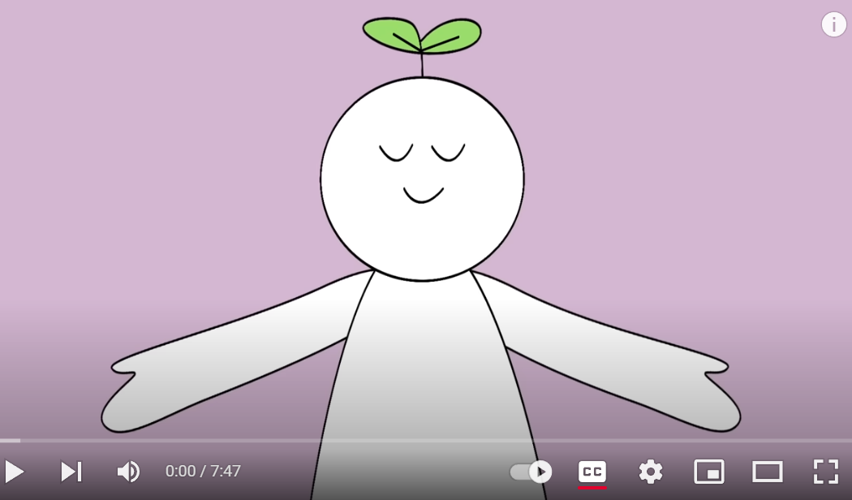
12 Signs A Relationship Won’t Last
Notes:
Point of Slide: Allow the students to learn via a different medium about healthy relationships by watching a video to spark ideas and conversations.
Watch Video B: 12 Early Signs That A relationship Won’t Last https://youtu.be/jCZdN_PL0f4?si=O_y3tcJUmOT529Wg

Slide 20
Discussion
Are there any themes from the videos that we can add to our list of qualities of a healthy relationship?
What is the difference between a healthy and unhealthy relationship?
What does it mean to have open and honest communication?
Notes:
Point of Slide: Allow the students an opportunity to discuss the video as it relates to the VIP curriculum topic of healthy relationships.
Speaking Notes:
Break the class into small groups.
Ask each group to discuss the videos using the questions on the slide:
Are there any themes from the videos that we can add to our list of qualities of a healthy relationship?
What is the difference between a healthy and unhealthy relationship?
What does it mean to have open and honest communication?
Ask the class to come back together.
Have each group relay their answer to one of the questions to the class. You may have them answer by randomly selecting students, popcorn style, asking them to raise their hands or by identifying a group spokesperson.
Emphasize the importance of asking what we do and do not want in a relationship because it is important to know what you value in a relationship, and what the other person values.
Remind the class that personal boundaries are helpful as they help to define the elements of a healthy relationship.
Emphasize that it is important to know, trust and love yourself in order to allow yourself to be in a healthy relationship.
You may choose to ask students about the things they do to be in a good relationship with themselves. For example, you can ask them: What are some activities that help you take care of you?
Once the class has shared their list of things they want and do not want in a healthy relationship, you may choose to add a few of your own ideas. Additionally, you may want to expand on some of the ideas the class brought up through questions and conversations.

Slide 21
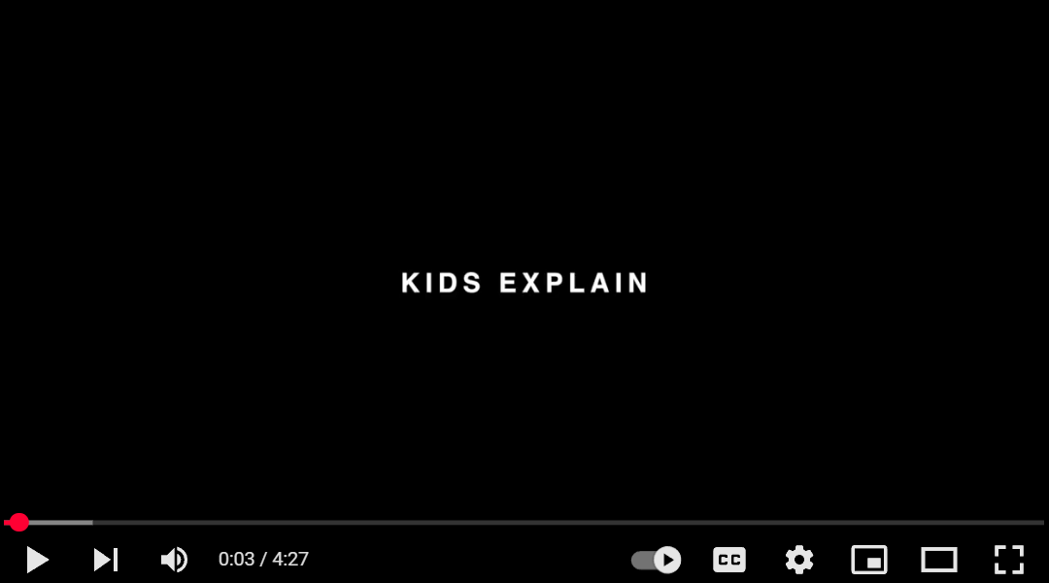
Kids Explain Relationships
Notes:
Point of Slide: Allow the students to learn via a different medium about healthy relationships by watching a video to spark ideas and conversations.
Depending on how long the previous parts of the presentation take, these videos may have to be left out or used in a later session.
Speaker Notes: This video shows that the ways we think about relationships is very individual and that relationships will mean different things to different people.
Watch Video: Kids Explain Relationships https://youtu.be/72VJBgOglmU?si=QOKw0fXIU4OL1HwF

Slide 22
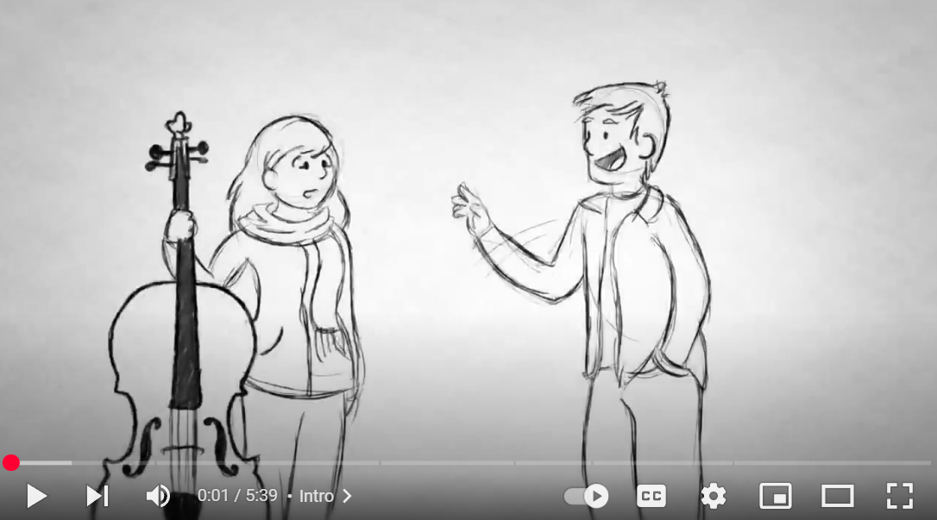
How To Break Up
Notes:
Point of Slide: Allow the students to learn via a different medium about healthy relationships by watching a video to spark ideas and conversations.
Depending on how long the previous parts of the presentation take, these videos may have to be left out or used in a later session.
Speaker Notes: This video shares tools to communicate if you want to end a relationship in a respectful way.
Watch Video: How To Break Up https://youtu.be/XpXpHjT2ACo?si=cM5g9ssdnlMBFy_H

Slide 23
Thank You
Name:
Peace PROGRAM Counsellor:
ORGANIZATION Name:
Phone Number:
Email:
Office hours:
Notes:
Point of Slide: Recap the main messages of the VIP curriculum lesson plan and thank the class.
Speaking Notes:
Recap main messages. Let the class know that even though a topic like healthy relationships may seem straight forward, violent relationships are common and it is important to take the time to reflect on what is needed to be safe in a relationship.
Thank them for being a wonderful class and let the students know your contact information and what information you will be sending home with them, such as VIP post cards, VIP wallet cards, agency brochure, PEACE Program brochure, and any other additional resources.
If you are returning for another presentation, let the class know when you will be back and remind them to stay and ask any questions or share any concerns that may have arisen during the presentation.
Reiterate your contact information and office hours on the slide and and encourage students to reach out if they have any questions or concerns about the presentation.

Slide 24
DAY 3: online safety and the bystander effect
Grades 7-9
Notes:
Point of Slide: This slide introduces the Violence Is Preventable (VIP) Program, and why PEACE Program counsellors are in the classroom and informs the students of the purpose of the presentation.
Speaking Notes:
Introduce yourself:
Who you are
What organization you are from
What your role is
A brief overview of the presentation.
For example:
I am happy to be here today and I am looking forward to sharing this meaningful time together. In my work, I help kids of all ages stay safe in their friendships and homes. I also help kids who may have been scared, confused or upset because one adult in their home is hurting another adult. I work for a program called the PEACE Program and we are sharing this presentation today on the Violence is Preventable (VIP) Program. I am visiting all kinds of classrooms in BC for students of all ages in classrooms just like this one.
Acknowledge the traditional territory you are on.
Thank the teacher for having you in their classroom.

Slide 25
PEACE Program
Free.
Confidential program across BC.
For children and youth aged 3 to 18 who have experienced violence in their home.
Notes:
Point of the Slide: To explain what the PEACE program does.
You might wish to share the PEACE Program PSA to help explain the PEACE Program to the class: https://youtu.be/ZWt_6uUQq90?si=XQDUy_-VSHIbtmkZ
The PEACE Program offers free, confidential support to children and youth aged 3-18 in BC who have experienced violence in their homes.
There are 87 PEACE Programs located across BC.
PEACE programs provide age-appropriate services that help Children and Youth to:
label and express the feelings they have experienced regarding the violence they have encountered;
understand healthy ways of dealing with anger and expressing anger;
understand that they are not at fault for the violent actions of others;
teach safety skills, strategies and develop safety plans;
encourage open communication;
acknowledge loss and separation issues;
facilitate understanding of abuse and myths about violence against women;
explore other violence issues such as violence in the media; and
encourage self-confidence.

Slide 26
VIP Outline for Grades7-9
Safety Planning and The Three Main Messages
Healthy Relationships
Online Safety and The Bystander Effect
Notes:
Point of the Slide: To introduce the students to the key themes of the VIP curriculum. You could advise them that all Grades 7-9 classes in BC who are participating in VIP are receiving the same presentation.
Speaking Notes:
We are here to have a conversation with you about important topics including domestic violence, safety planning, healthy relationships, online safety and the bystander effect.
Let students know what to expect during the presentation and advise them of the number of presentations you will be delivering (1-3).
Invite the class to remember their “community agreement” or “rules” from Day 1. Review the previous list together on the board or a flip chart so it’s visible throughout the presentation.
Address any housekeeping, such as one person speaking at a time, raising hands for questions and comments, self-care and cellphone use.
Review briefly the topics discussed during the previous sessions.
Disclaimers:
Discussing sensitive topics;
Self-care e.g., stepping outside of the classroom for a few minutes, going to the bathroom or visiting the school counsellor
Talk about confidentiality and disclosures: Let the students know that if they feel uncomfortable talking about their own experiences that they can say “a friend that I know” or “I heard this happened” or talk to you after or outside of class.
Remind the class that you will be available after every session if anyone needs support or has questions. This includes wanting support because you know someone else is having this experience.

Slide 27

Online Safety and The Bystander Effect
Notes:
Point of slide: Introduce the VIP curriculum topic of Online Safety and The Bystander Effect.
Speaking Notes:
Today we are going to talk about online safety and the bystander effect. Similar to the topic of healthy relationships, these issues can relate to intimate relationships, social networks and friendships. This topic can be upsetting for those who have experienced bullying online or in person and for anyone who has had their trust violated online. As a reminder, please take care of yourselves and remember I will be available after class.

Slide 28
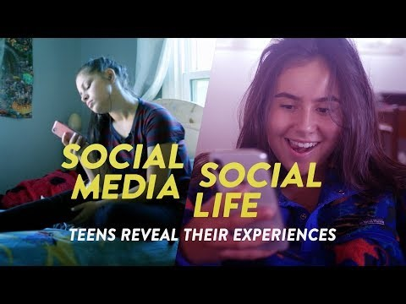
Social Media, Social Life: Teens Reveal Their Experiences
Notes:
Point of slide: Allow the students to learn via a different medium about Online Safety by watching a video to spark ideas and conversations.
Speaking notes:
The culture of online communication and social networking has changed rapidly in the last decade, and we are only just coming to understand some of the widespread impacts.
We are going to watch four short videos about online safety then have a group discussion.
These videos do not imply that we think social media and online communication is fundamentally bad, rather, the conversation is about developing tools to stay safe online.
Activity - Watch and Discuss Videos:
Introduce video: This video reveals both the positive and negative impacts of social media on the lives of teenagers.
Watch Video: Social Media, Social Life: Teens Reveal Their Experiences https://youtu.be/GGGDfciqyvw?si=DegpBhnc1zRCY05B

Slide 29
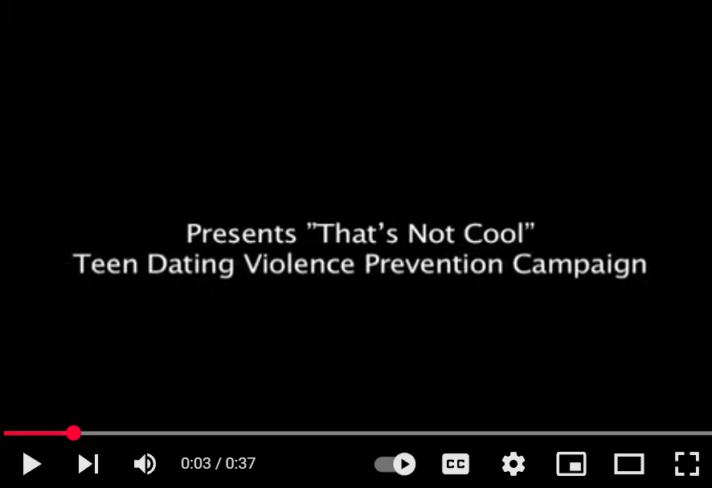
THAT’S NOT COOL
Notes:
Point of slide: Allow the students to learn via a different medium about Online Safety by watching a video to spark ideas and conversations.
Activity - Watch and Discuss Videos:
Introduce video: This short video demonstrates how some online relationships can start out harmless and become unhealthy and abusive
Watch Video: That’s Not Cool https://youtu.be/GB8XCOu1-dQ?si=Qz7JM9m4u9wsV8c5

Slide 30
Discussion
What are some pros and cons of social media and online communication?
How can they contribute to healthy relationships? and cons of social media and online communication
Notes:
Point of slide: Allow the students an opportunity to discuss the videos as they relate to the VIP curriculum topic of Online Safety
Speaker notes:
Split the class into small groups to discuss the pros and cons of social media and online communication, including their capacity to contribute to healthy relationships.
Activity – Grounding Exercise - Before watching the final two videos, consider pausing for a grounding exercise – See Appendix A of the VIP Curriculum for Sample Grounding Exercises.

Slide 31
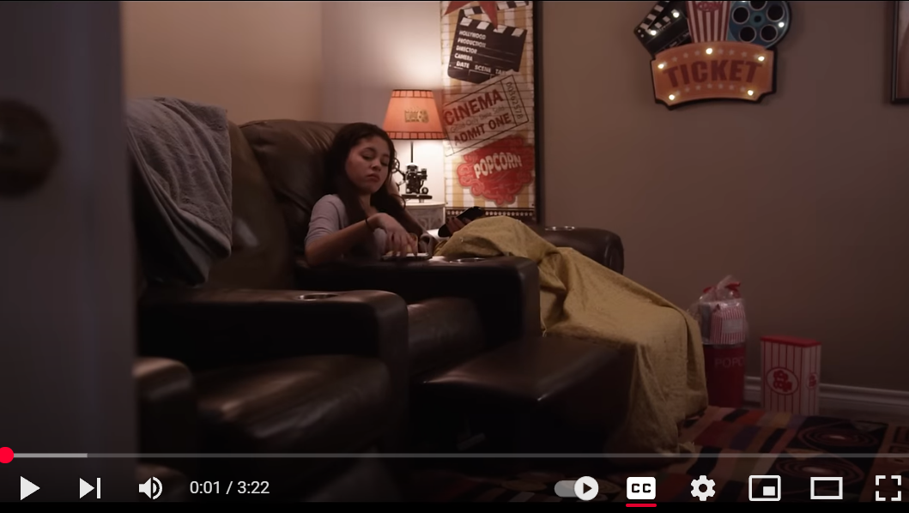
B4 U CLICK
Notes:
Point of slide: Allow the students to learn via a different medium about Online Safety by watching a video to spark ideas and conversations.
Activity - Watch and Discuss Videos:
Introduce video: This short video demonstrates how an unsafe online relationship might begin.
Watch Video: B4UClick https://youtu.be/IUjwHPah72o?si=T3-HMq5hBXttpIlk

Slide 32
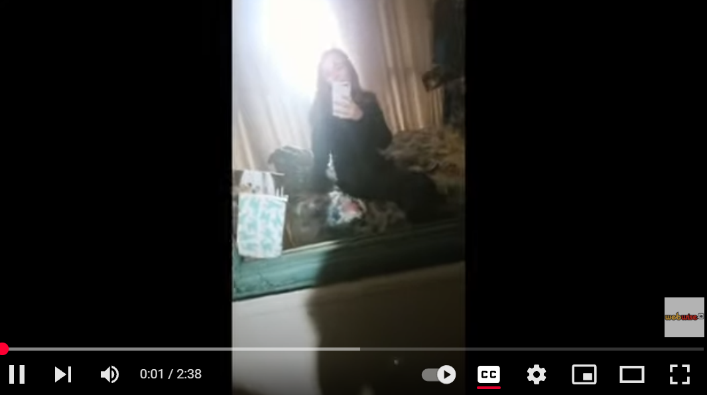
#BeInCtrl
Notes:
Point of slide: Allow the students to learn via a different medium about Online Safety by watching a video to spark ideas and conversations.
Activity - Watch and Discuss Videos:
Introduce video: This two-minute film demonstrates the risk of sharing photos with people you don’t know and the importance of being safe online.
Watch Video: #BeInCtrl https://youtu.be/BjLgCuvWiJk?si=XxuFJNE6I-uAXcGC

Slide 33
Discussion
What does staying safe online look like in real life?
How does the ease of online communication prevent or enhance our ability to develop healthy communication skills?
Notes:
Point of slide: Allow the students an opportunity to discuss the videos as they relate to the VIP curriculum topic of Online Safety
Speaker notes:
Split the class into small groups to discuss what the students do to stay safe online.
In their groups, invite students to create a list of the ways that they can stay safe in their relationships online. Consider asking:
What does this look like in real life?
How does the ease of online communication prevent or enhance our ability to develop healthy communication skills?
Remind students about the listening exercise from Day 2 and come back together as a class and invite the groups to share their ideas with the rest of the class.

Slide 34
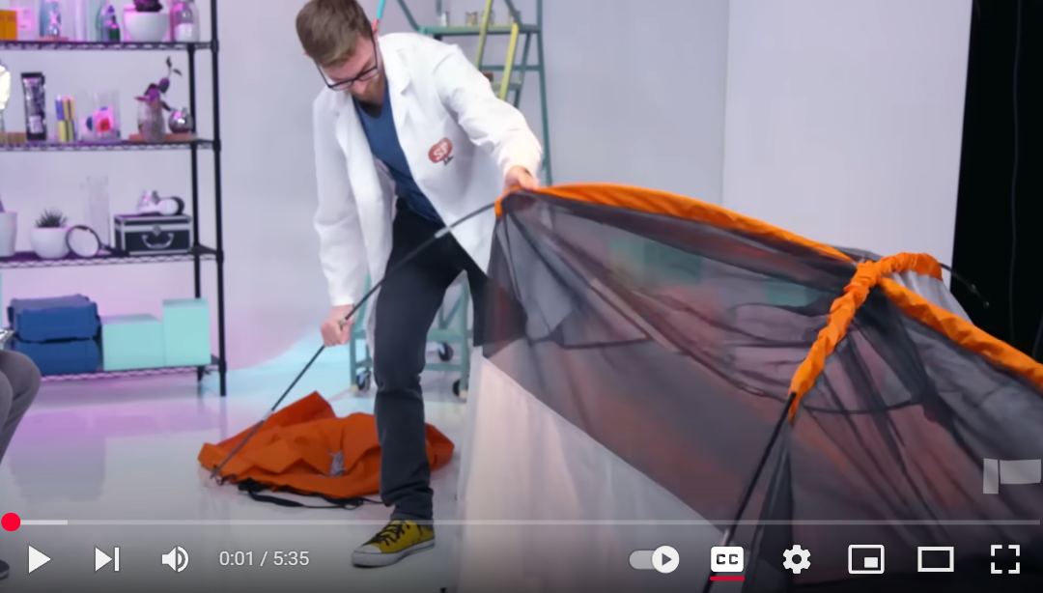
The Bystander Effect – The Science of Empathy
Notes:
Point of slide: Allow the students to learn about The Bystander Effect by watching a video to spark ideas and conversations.
Speaker notes:
Introduce Video: This video is about the science of empathy and some key factors that drive us to help other people.
Watch Video: The Bystander Effect – The Science of Empathy https://youtu.be/Wy6eUTLzcU4?si=m_LBHtva07cveJDd

Slide 35
Discussion
What is the roll of the bystander on social media and online forums?
What steps can we take if we know someone is being bullied or harassed online?
Have you ever witnessed someone at school being an active bystander?
Notes:
Point of slide: Allow the students an opportunity to discuss the videos as they relate to the VIP curriculum topic of The Bystander Effect
Speaker notes:
After watching the video, break the students into small groups to spend some time discussing the following questions:
What is the roll of the bystander on social media and online forums?
What steps can we take if we know someone is being bullied or harassed online?
Have you ever witnessed someone at school being an active bystander?
Remind students that safety planning is at the forefront when considering the role of the bystander. You may also consider making a safety plan with students focused on navigating online safety. Students are also encouraged to talk to trusted adults for safety when they are considering becoming active bystanders online, at school or otherwise.

Slide 36
Thank You
Name:
Peace PROGRAM Counsellor:
ORGANIZATION Name:
Phone Number:
Email:
Office hours:
Notes:
Point of Slide: Recap the main messages of the VIP curriculum lesson plan and thank the class.
Speaking Notes:
Recap main messages and remind them that abusive relationships are not uncommon and taking the time to self-reflect about what we want and need to be safe and happy in our relationships is important. Remind them to reach out to a trusted adult if they feel unsafe or if they have questions about anything that does not feel right in their relationships.
Acknowledge that they have now spent a total of three to four hours discussing incredibly important topics for staying safe. Let them know that the topics covered may make them feel sensitive and uncomfortable, and that relationships are complex, making it important to be aware of the issues discussed as they grow and mature.
Thank them for being a wonderful class and let the students know your contact information and what information you will be sending home with them, such as VIP post cards, VIP wallet cards, agency brochure, PEACE Program brochure, and any other additional resources.
Reiterate your contact information and office hours on the slide and and encourage students to reach out if they have any questions or concerns about the presentation. Remind them to stay and ask any questions or share any concerns that may have arisen during the presentation.

