Slide 1


BELIEVE
Grade 7-9
Creating a Culture of Consent
A Provincial Response to Violence in BC Schools
Notes:
This is a good slide to begin to share your introduction.
Who are you?
Where are you from? Territorial acknowledgement.
What are your goals for today’s presentation?
Where do you work?
Maybe share a story about why this work feels meaningful to you?
The VIP facilitator’s guide is a great resource to support communication and delivery of all VIP curriculum, including the BELIEVE project. Please reference this guide for tips on presentation delivery and creative ideas for classroom presentations.
Presenters could share some background about the BELIEVE project, as quoted below from the BCSTH website.
‘Since 2004, PEACE Programs have been partnering with educators of grades K through 12 in schools in their community to increase awareness about domestic violence and the impact domestic violence has on children and youth. In classrooms, PEACE Programs are faced with questions about experiences of sexual violence happening to girls in BC schools and the community.
As an extension of the Violence Is Preventable Program, in 2017-2018 30 PEACE programs piloted the BELIEVE project for one year as a coordinated provincial response to sexual violence in BC schools. This project was funded by a Civil Forfeiture Grant distributed by the Ministry of Public Safety and Solicitor General.
Through presentations in schools, this project is focused on helping students in grades 6-8 understand healthy relationships and sexual violence specifically on topics such as consent, sexting, sexual harassment and how one can access support.

Slide 2
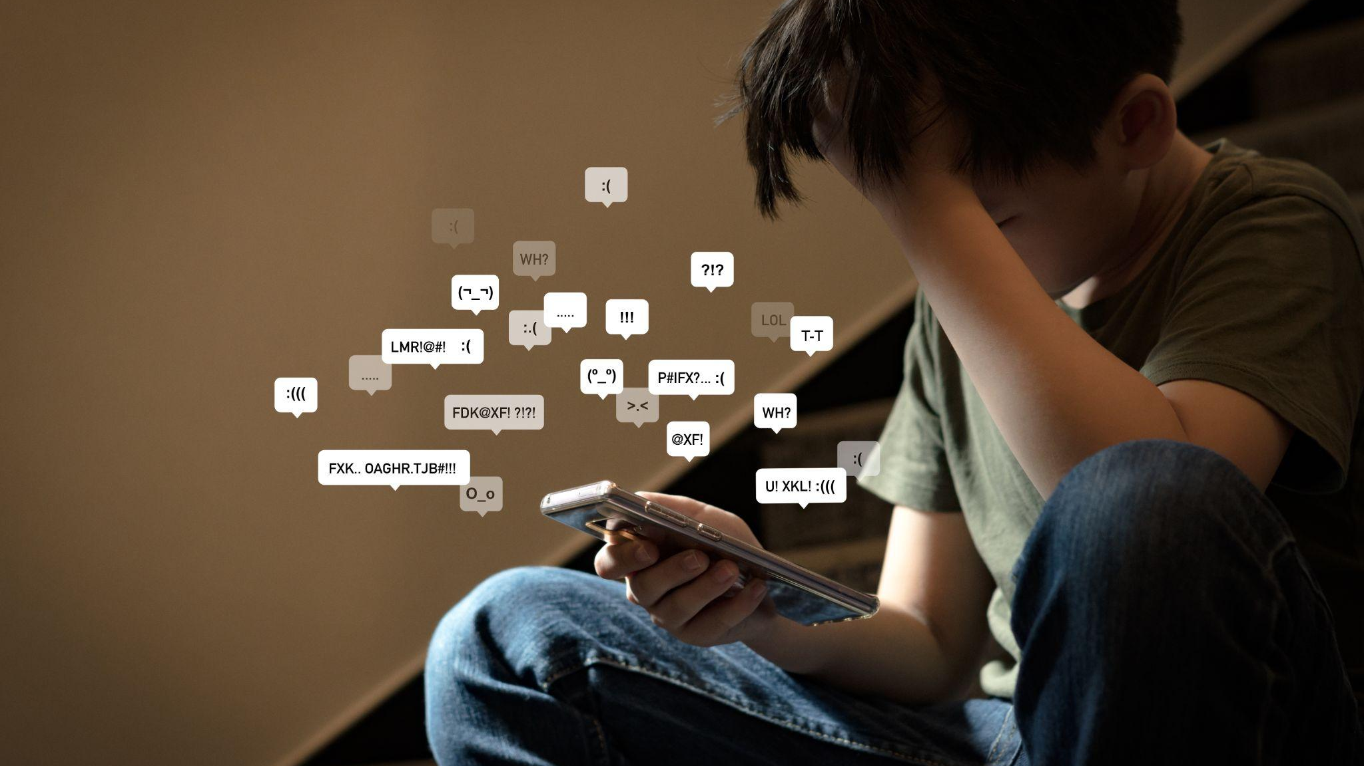
Notes:
This slide can be used for part of your introduction.
Perhaps you could ask the classroom what they think this individual is feeling, with the reminder that there are no wrong answers.

Slide 3

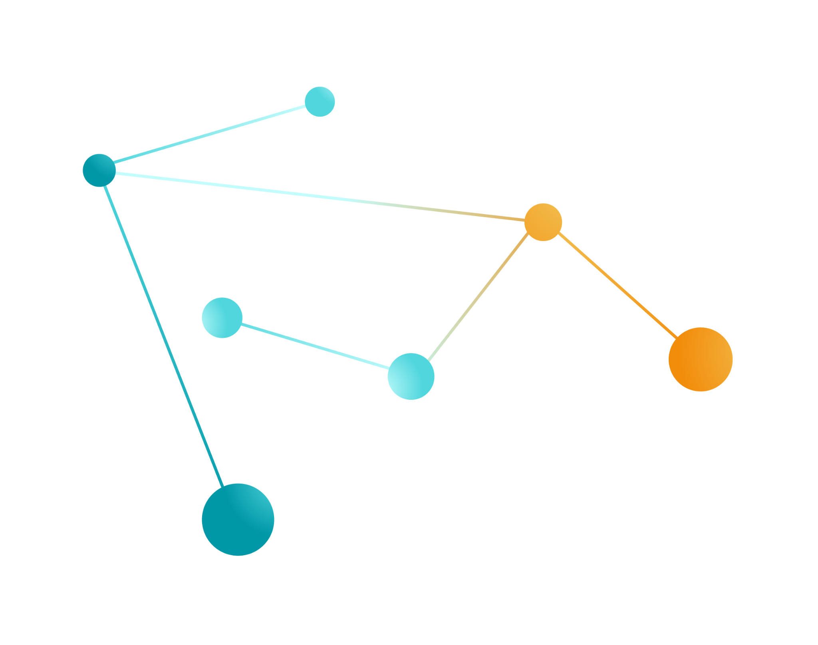
What will we be talking about today?
Healthy relationships & unhealthy relationships
Verbal consent
Digital consent
Why is consent important?
What do we need consent for?
Resources
Notes:
This would be a good place to discuss confidentiality and create some basic expectations for the presentation. Specifically, it can be helpful to name for students that we can share stories during the presentation, but when we share stories it is best to respect people’s privacy by not using names.
Perhaps share how long the presentation will be, what youth can expect (videos, questions, scenarios).

Slide 4
What are we talking about when we say healthy relationships?
Friends
Boyfriend/girlfriend/partner
Parents and other family members
Community members (coaches, leaders, friends’ parents, etc)
Can be between you and your:
Notes:
Engage students in a conversation about what makes a relationship healthy. Some questions you could lead with are listed below.
What are some things that you have experienced in relationships that feel safe and secure?
What are some things that make a relationship feel unhealthy for you?
These lists could be written down on a classroom whiteboard for reference and/or additions throughout the class.

Slide 5
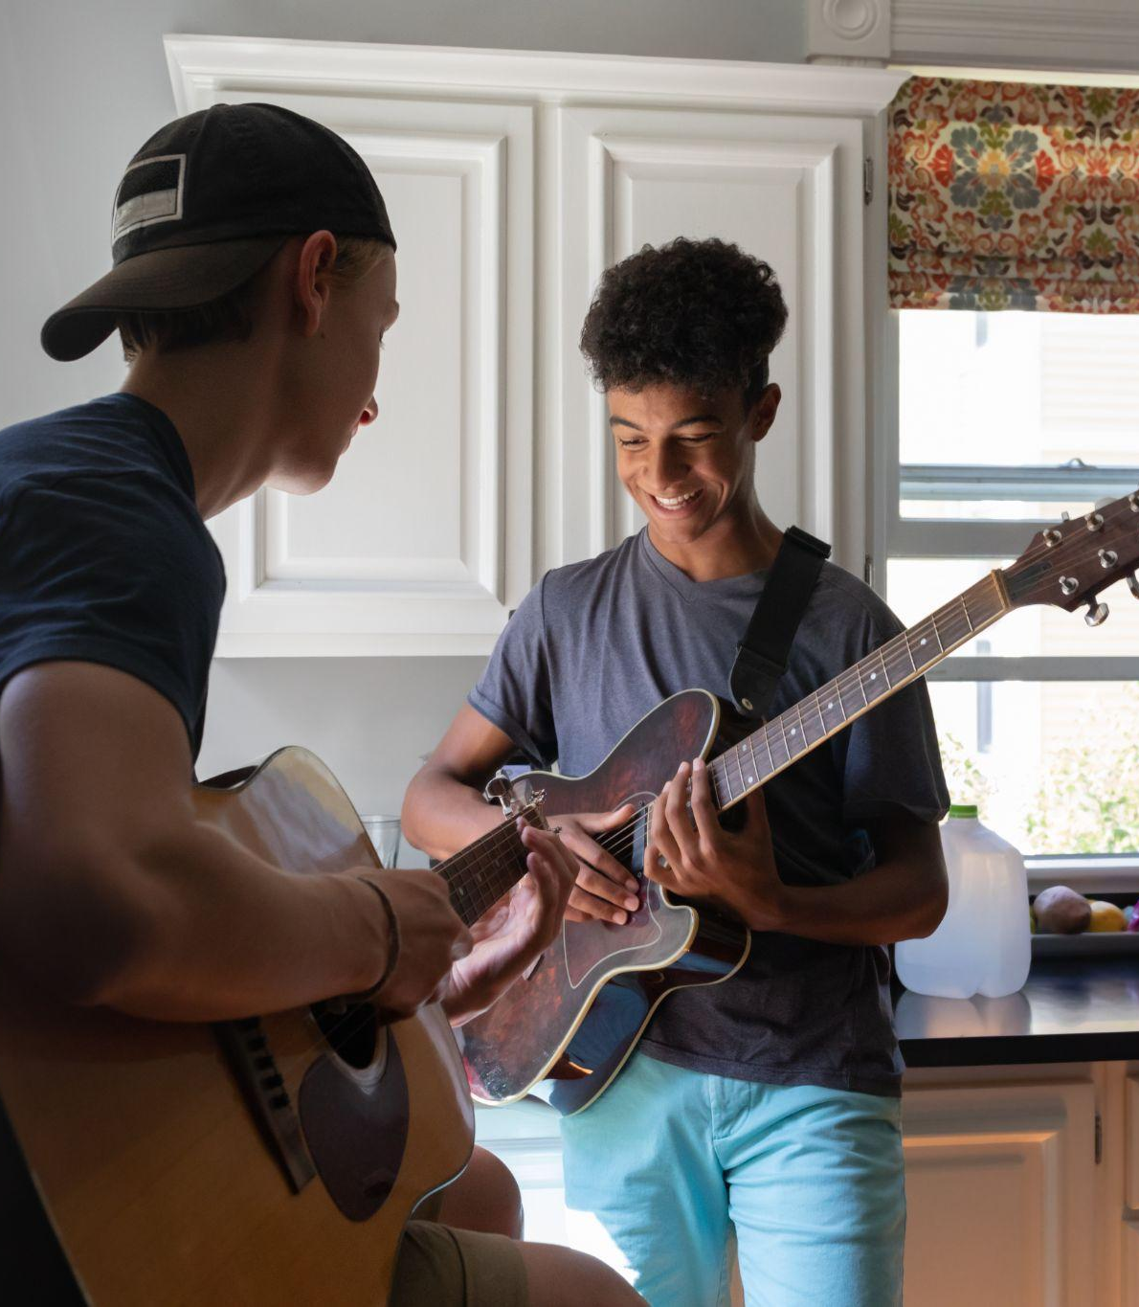
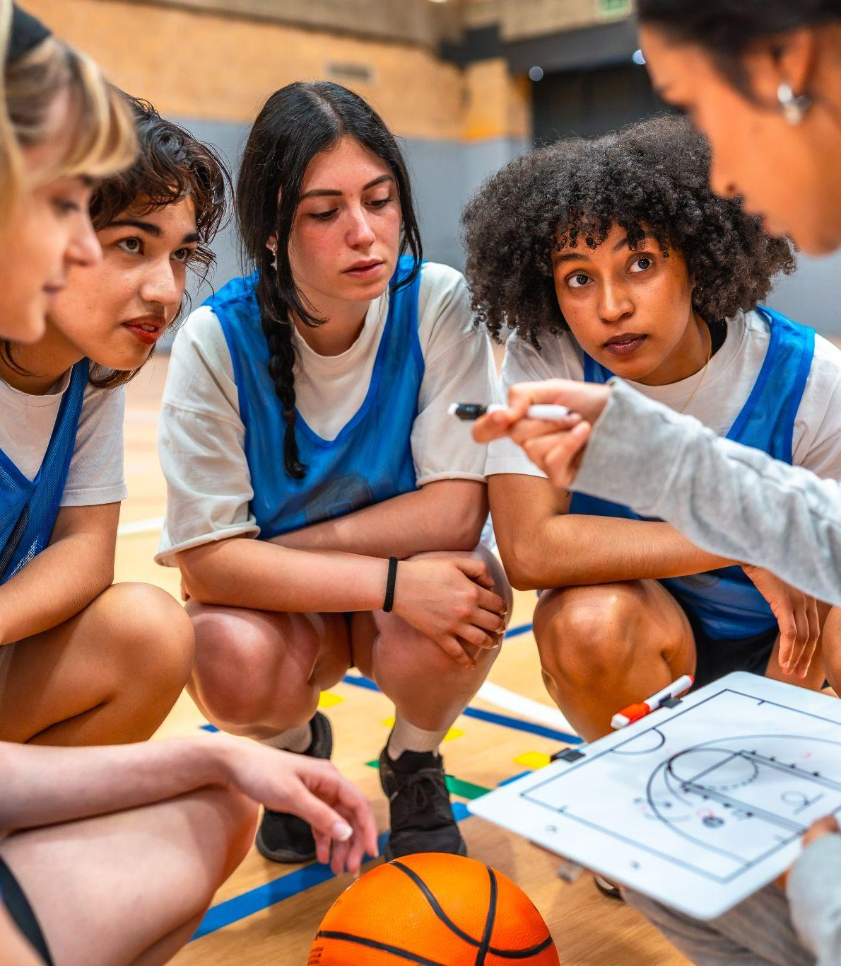


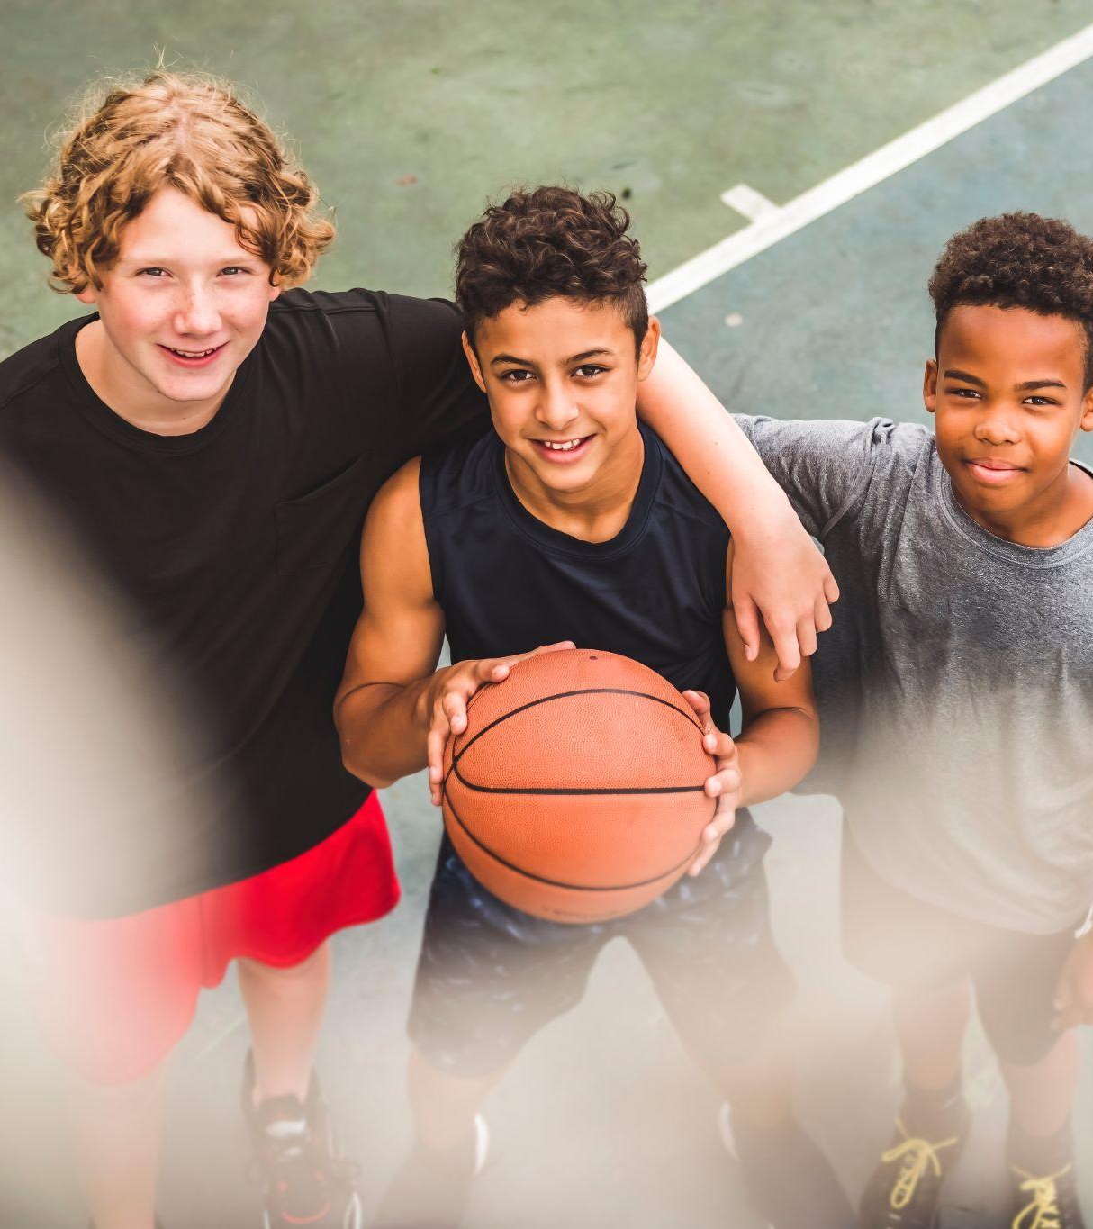
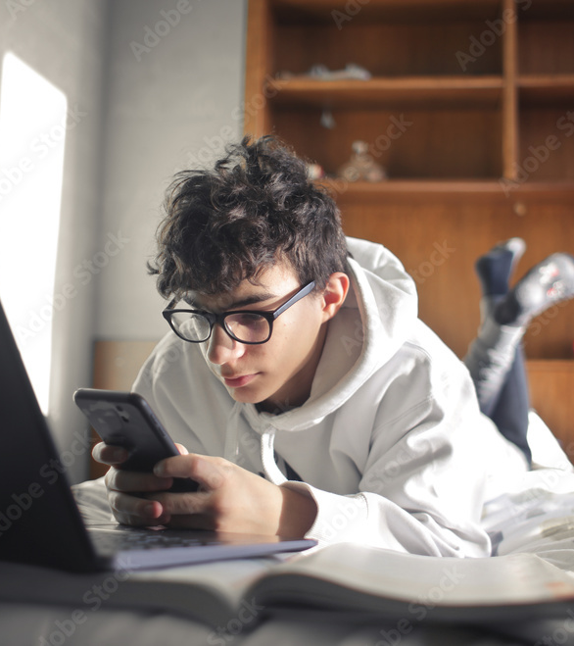
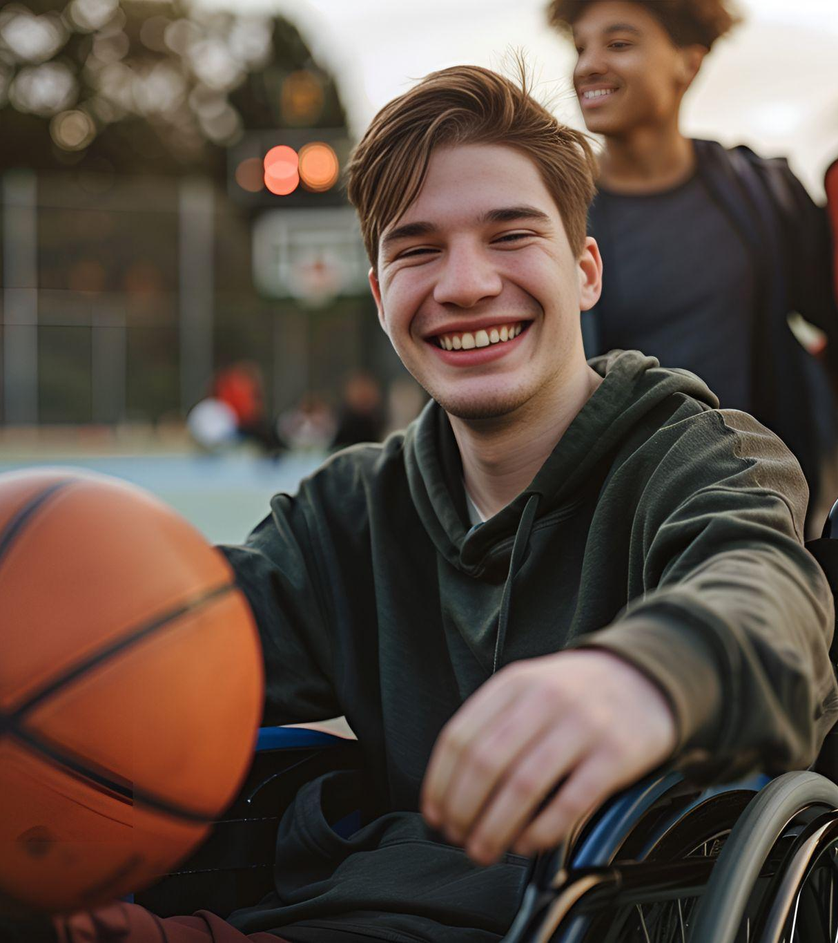

Notes:
This slide demonstrates different types of relationships
Ask Students:
Who are all the people you have relationships with in your life?
(brainstorm)
Presenter could make notes of different types of relationships we might have with peers, IE friends, peers, acquaintances, classmates, intimate partners,

Slide 6
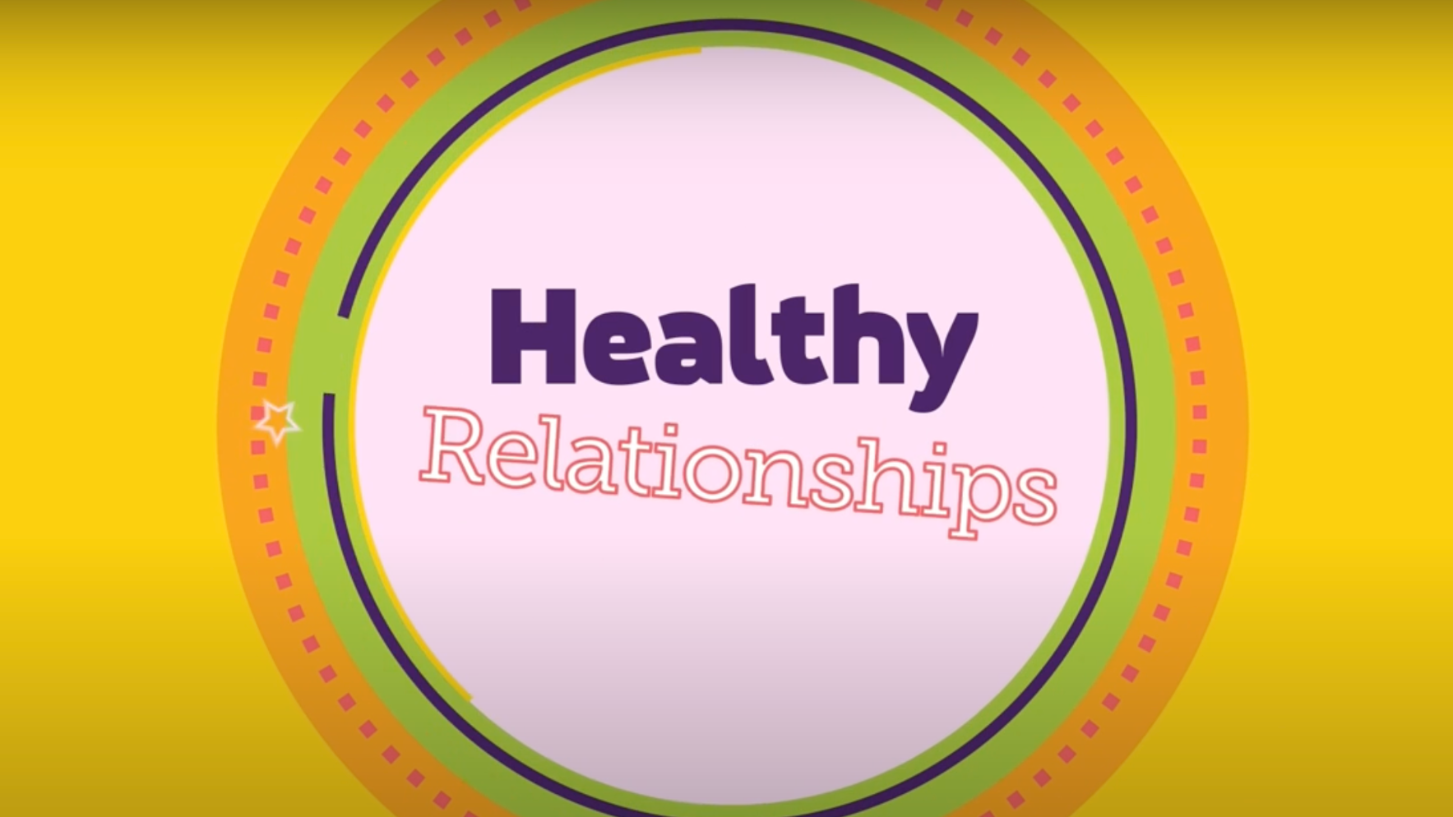

What makes a relationship healthy?
Notes:
Option to discuss the video or let it speak for itself.
Perhaps ask the class what they think of the video?
Was there anything missing that they feel is important for them in a healthy relationship?

Slide 7
Warning signs of an unhealthy relationship?
Checking your phone, asking for passwords.
Being upset for not getting a reply on messages, snapchat, or IG.
Constantly putting you down.
Explosive temper.
Isolating you from family or friends.
Physically hurting you in any way.
Telling you what to do, who to hang out with, what to wear, etc.
Unable to talk about things that matter to you.
Dishonesty.
Unable to admit when we make a mistake.
Making false accusations.1
Notes:
If you have already made a list of things your class doesn’t want in a relationship, you could revisit it here and see if there is anything that needs to be added.

Slide 8
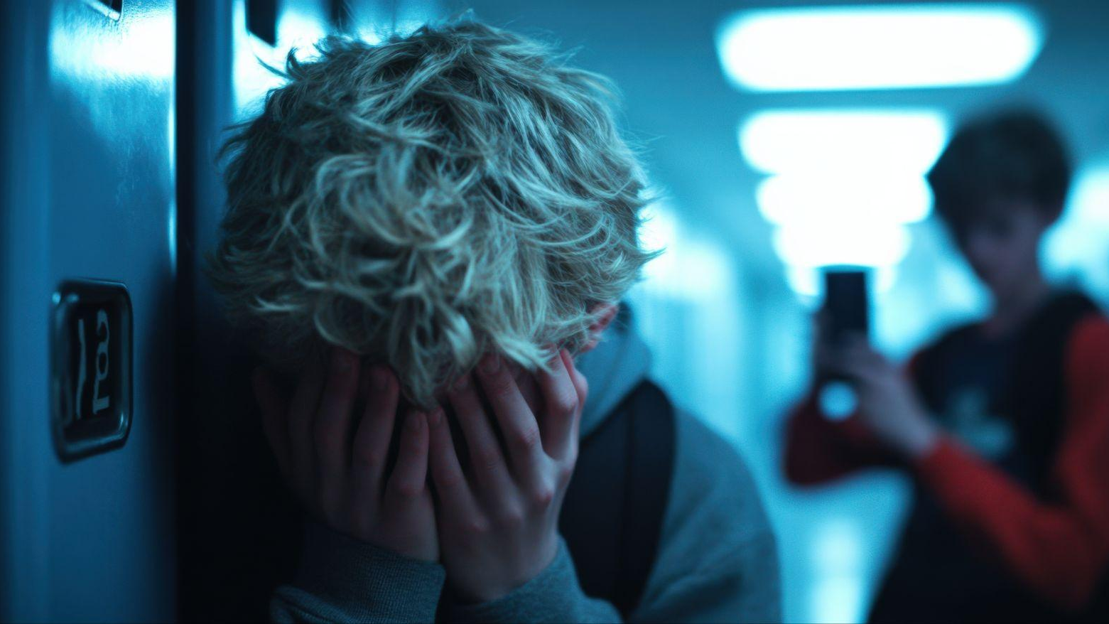
Notes:
Presenters could use this slide as a Scenario with the class:
Prompts could include:
“what do think could be happening here?”
“what are some of the feelings you think this person could be having?”
As mentioned earlier, the main topic we are going to talk about today is CONSENT. Presenters could invite the class to share their thoughts on how this picture might relate to consent?
Remind them that there are no wrong answers!

Slide 9
Let’s begin our conversation about consent.
What do you think consent is?
Notes:
Welcome some input from the class about what consent is.
It might be helpful to create a brainstorm list together of things we already know about consent.

Slide 10

Why does consent matter?
What are some reasons to ask for consent?
Notes:
2 different reasons that consent is important. Both are important to acknowledge.
There are legal reasons to ask for consent. Not asking for consent may lead to legal consequences in all types of relationships.
Engaging in consent culture is about choosing to actively participate healthy relationships that value respect, communication and healthy boundaries.

Slide 11
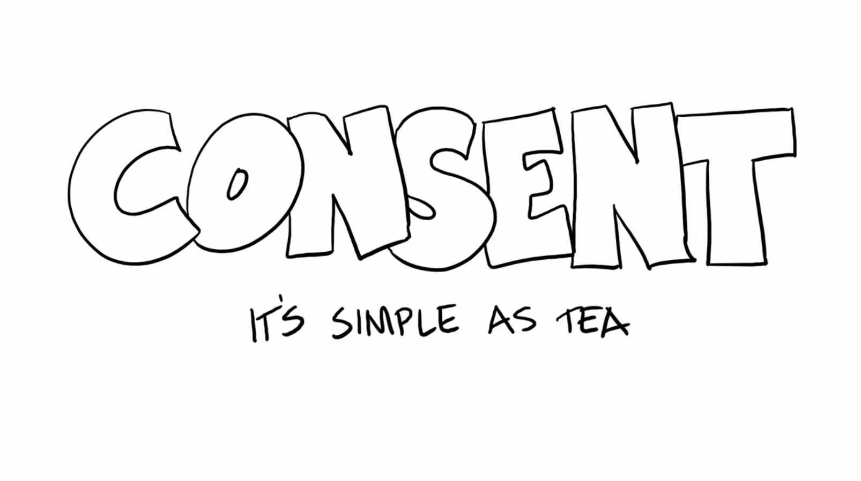
Let’s watch a few videos about consent.
1
Notes:
Presenters should watch the short films and decide which they would like to use in their presentation. If the class’s attention span allows, you might choose to watch 2 or 3 of the videos, as each video has a different approach to the conversation of consent. It is important to gauge the class’s capacity and ensure you are having some conversations about consent between videos to support youth digesting and reflecting on the material being shared.
Tea and Consent video.
A simplified message about consent using the metaphor of a cup of tea to help make an uncomfortable conversation more accessible.
Acknowledging that the humour serves a purpose, and ensuring students understand that the topic of consent has real consequences if we don’t take it seriously.

Slide 12

2
Notes:
Set around a film shoot featuring Victorian era socialites, this video clip focuses on consent in relationships.
Through the film dialogue, and ‘real-life’ conversations between the actors and crew, it reinforces an important message about consent between couples.
It is not just about the fact that “no” means “no”, but that not saying “yes” also means “no”.

Slide 13
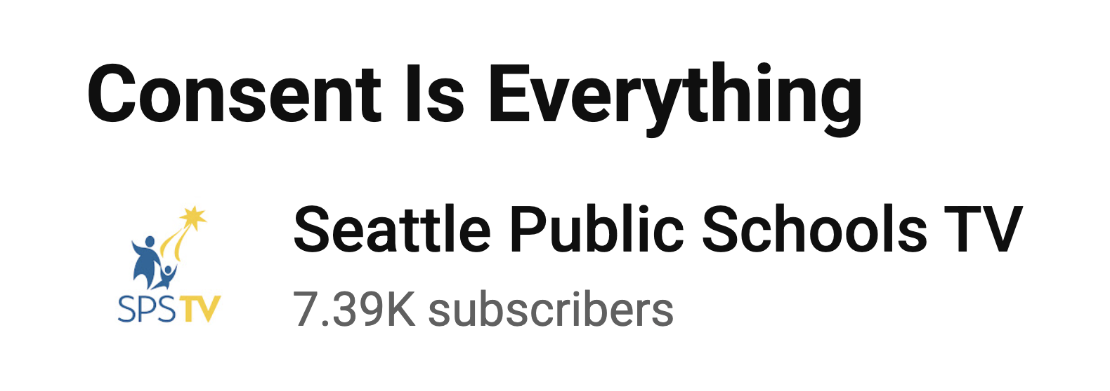
3
Notes:
This video shows youth sharing what they already know about consent. It highlights youth voices and clarifies all the various ways consent culture may show up in their world and the importance of understanding how consent might look and feel different for each unique individual.

Slide 14


4
Notes:
NOTE: this video would be most ideal for grades 9 and up. For students in grades 7-9, it would be good to clarify that the videos use of the term sex can apply to any part of intimacy (kissing, touching, etc.)
This is a video made my NYU about consent and sex.

Slide 15
Let’s Define Consent.
Consent is an informed, sober, freely given, ongoing enthusiastic
‘yes!’
Notes:
After watching these videos, this slide is about clarifying the definition of consent.
Important to note that consent takes place in advance of an action. It cannot be given after the event.

Slide 16
What are some things we might ask consent for?
?
Notes:
Class brainstorm about what we might need consent for. Ultimately there are no wrong answers.
If we think we need consent for something, we do.

Slide 17
What do I need to ask or give consent for?
Physical Contact - Physical contact is not just sexual. It includes hugging and touching someone else’s body. It includes all forms of intimacy (snuggling, kissing, making out, removing clothing, having sex).
Taking photographs
Share things online (or other people sharing things about you)
Calling people names (nicknames and romantic names included)
Notes:
This is a list of some things that we need consent for – it is not complete or exclusive

Slide 18
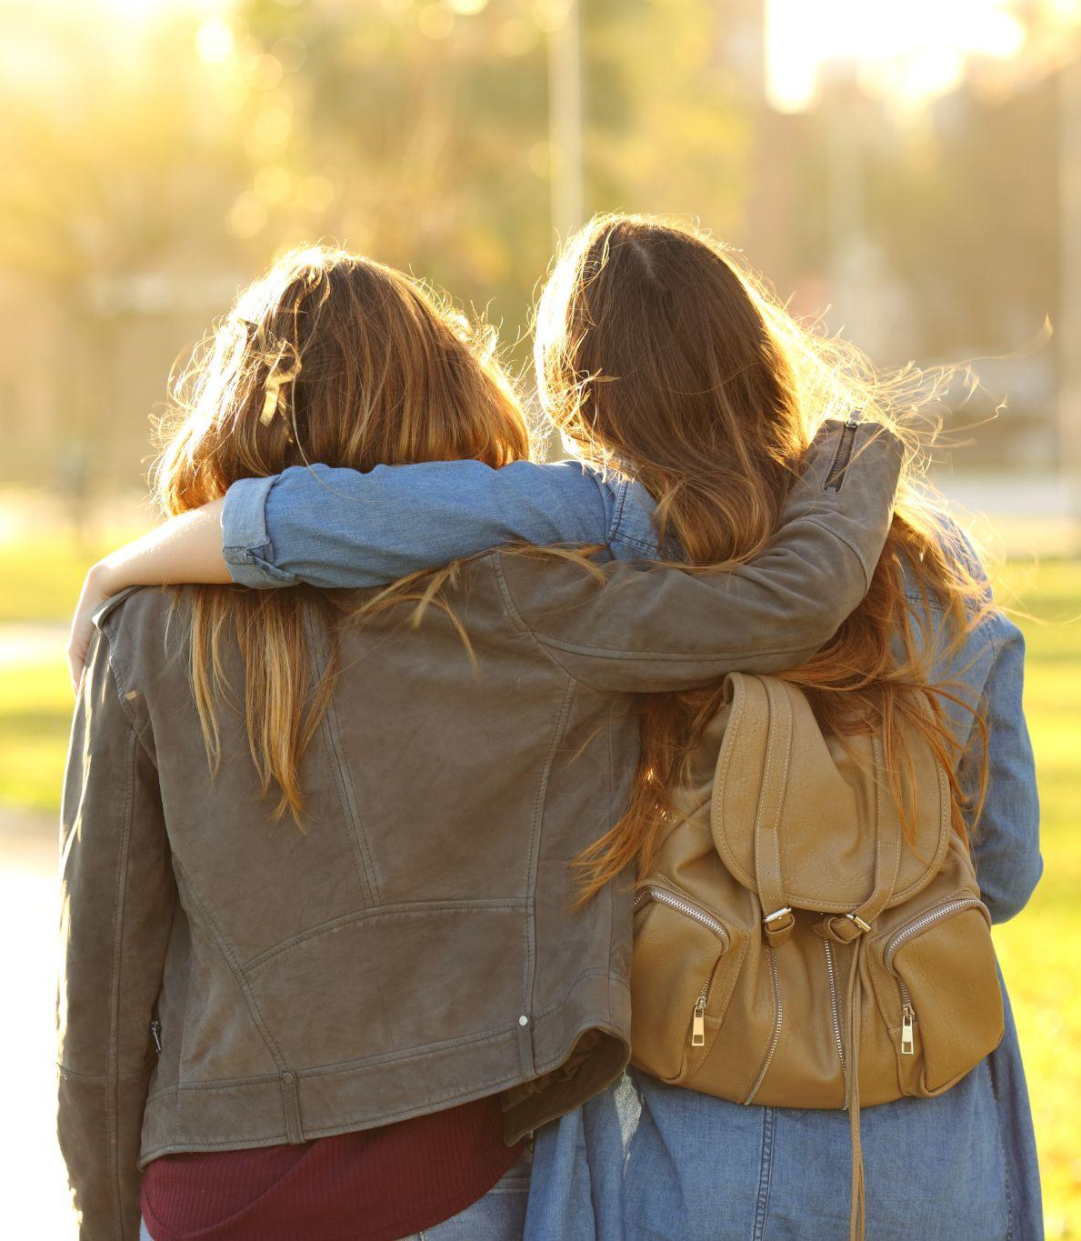
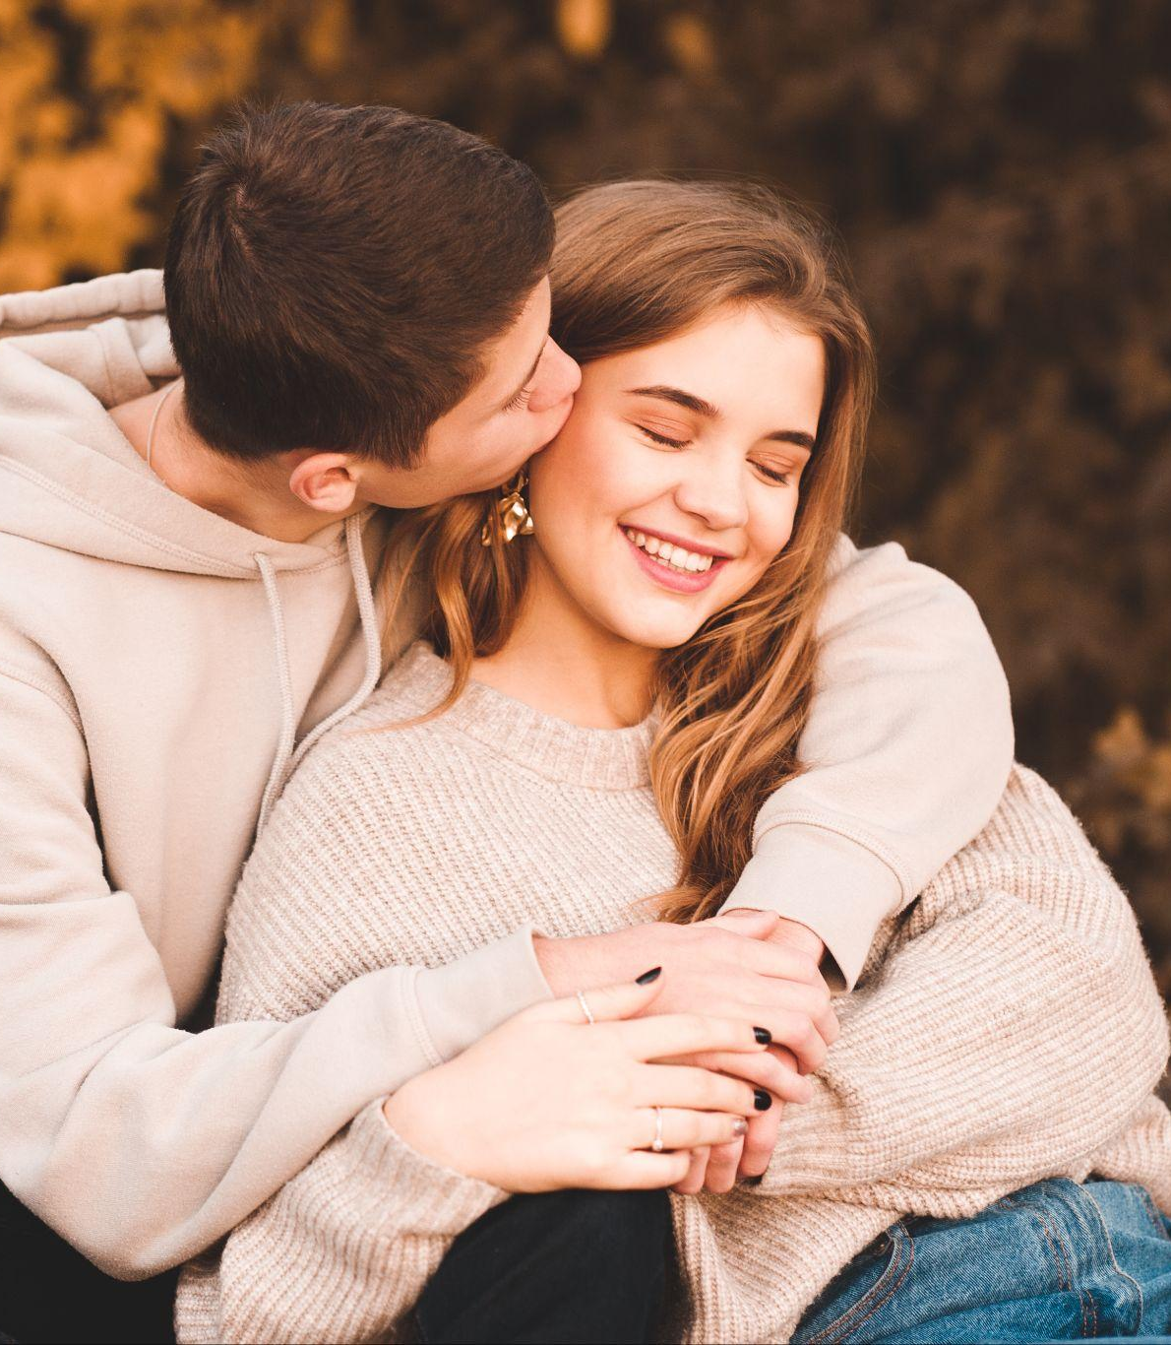

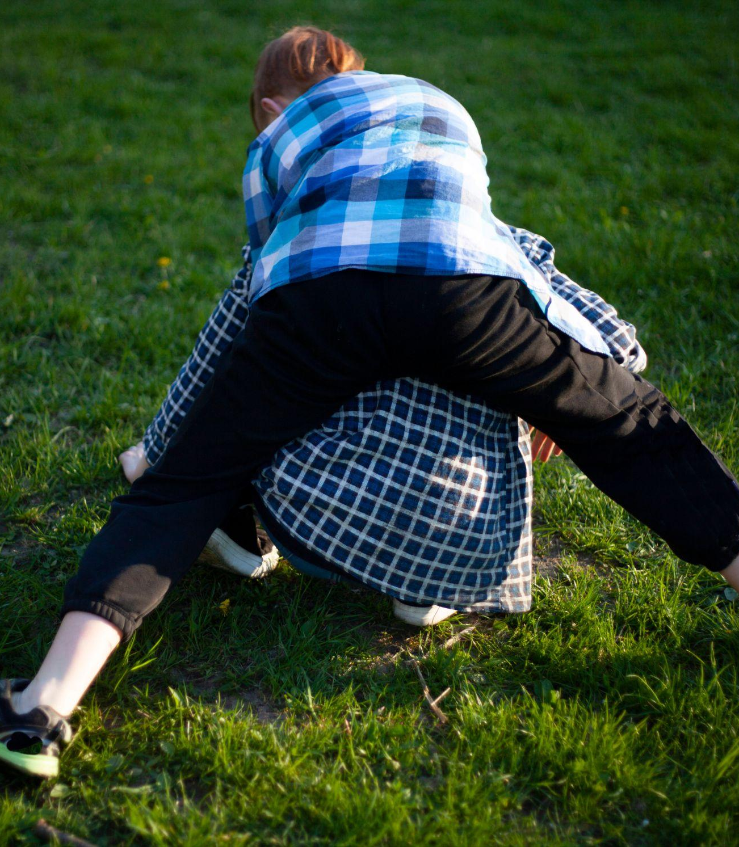
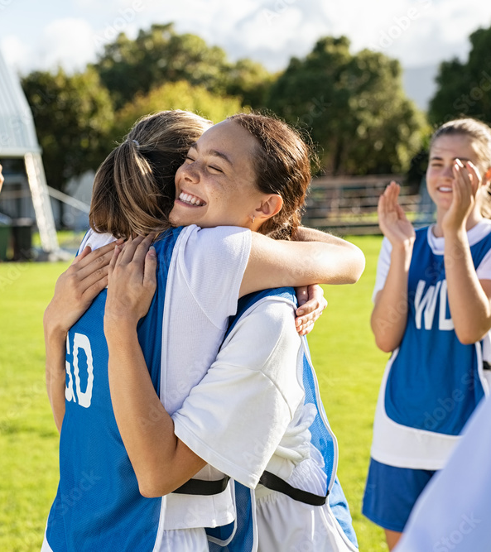

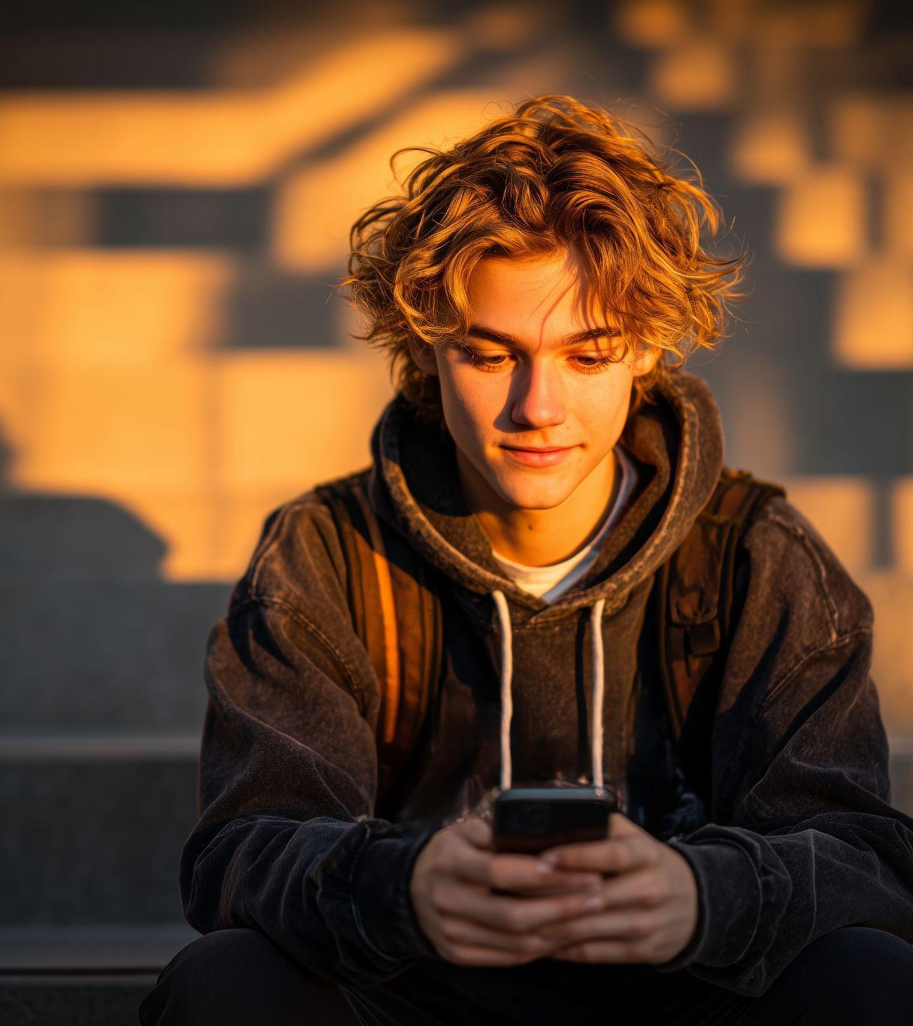

Notes:
This slide can be a chance to check-in with the class. Are there any questions? Does it feel like a grounding exercise might be helpful?
Grounding exercises can be found in the VIP facilitators guide.
To foreshadow the next presentation topic, (Digital Consent), presenters could ask students to reflect on all the different ways they might GIVE or RECEIVE consent. Specifically, highlight that sometimes consent is given verbally and sometimes it may be given digitally.

Slide 19
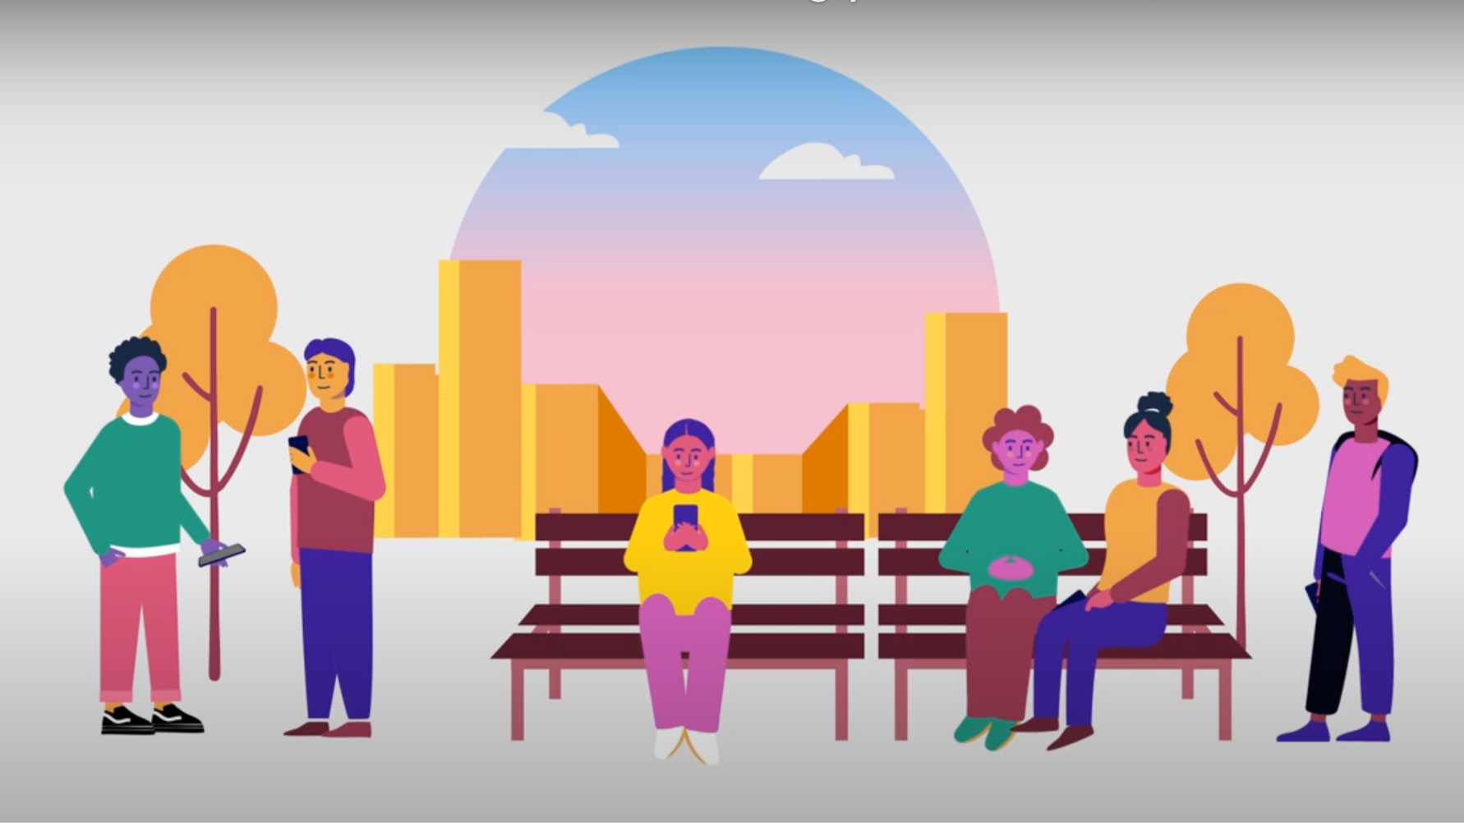
Digital Consent. Let’s start with a video.
Notes:
This video was created by BCSTH to support conversations with youth around Digital Consent and Tech Safety
Perhaps ask the class what they think of the video? Was there anything missing that they feel is important for them in a healthy relationship?

Slide 20

Let’s think of some
examples together.
Digital consent
?
Notes:
VIP presenters can choose to discuss digital consent before or after the video.
It can be helpful to acknowledge how common and normal digital communication has become. Within a culture of digital communication, we can lose sight of individuals (especially youth) right to privacy and the importance of getting consent.
Some examples to encourage conversation:
Asking before posting a picture of someone else.
Not pressuring someone to send personal information.
Thinking about how your actions might affect others.
Some questions you might use to encourage some discussions are:
Ask the class for some examples of healthy and unhealthy digital behaviours (Page 6 in BCSTH – Navigating Unhealthy Digital Relationships Curriculum)
You could name a few digital behaviours and ask the class what they think about those behaviours. Are they healthy or unhealthy?

Slide 21
Digital consent is:
Giving permission for others to use or share your information, photos or messages.
Setting boundaries for how people interact with you online.
Respecting other people’s boundaries online.
Choosing what you share and who can see it.
An ongoing process of making sure everyone feels safe and respected in digital spaces.
Notes:
This slide is a summary and definition of Digital Consent – it is not exclusive or exhaustive (complete)
Presenters can acknowledge class ideas and additions that came up in the brainstorm, and thank them for their participation in sharing their thoughts and ideas!
It can be good to acknowledge that the digital world is changing so quickly, and students may have ideas and thoughts that we haven’t thought of or included, so their participation is really helpful and important

Slide 22
Scenario Activity
Digital consent
?
Notes:
More information about these scenarios can be found on pp14-20 of the Navigating Unhealthy Digital Relationships Curriculum.
Based on the group dynamics – choose one of these options:
Divide the class into small groups and assign each a scenario related to consent. Ask them to decide how they would handle it. Each group should discuss if consent is needed and what respecting consent might look like.
Select one or two consent scenarios and ask the class to decide as a group how they would handle it.

Slide 23

You and your partner (or friend) take a cute photo together at a party, but you are not sure they would want it posted.
What do you do?
1
Notes:
Facilitation Tip: (pg. 14-15)
Emphasize key aspects of digital consent, respect, and communication. Here are some key responses to look out for:
Ask for permission
Respect their decision
Discuss beforehand
Considering privacy and context
Asking about tagging or captions
Delay the decision – not posting right away and waiting for consent to be given

Slide 24

Your partner asks for your phone password
“to build trust”. You are not comfortable giving it to them.
How might you respond?
2
Notes:
Key responses to highlight include:
Set clear boundaries
Reframe the idea of trust
Offer an alternative
Share feelings
Recognize red flags
Suggest a broader conversation
Encourage empathy and understanding to help students understand the importance of digital consent in maintaining respectful relationships.
If a student’s response involves assuming consent or dismissing the partner’s feelings, gently challenge these ideas by asking: “how would you feel if someone posted a photo of you without asking?” or “what would happen if they were uncomfortable and saw the post later?”

Slide 25

Your partner sends many texts asking you where you are every time you go out with other friends. This behavior has unsettled you.
What do you do?
3
Notes:
Key responses include:
Express feelings honestly
Set boundaries
Ask about their concerns
Recognize unhealthy behavior
Limit communication temporarily
Talk to a trusted adult
Facilitator Strategy:
- If students suggest ignoring the behavior entirely (e.g., “I’d just keep responding to avoid upsetting them”), guide reflection with questions like:
- “How might this behavior affect your feelings about the relationship in the long run?”
- “What could happen if this behavior continues or gets worse?”
Encourage students to recognize the importance of their own boundaries, promote open communication, and identify when a situation might require further support.

Slide 26
What if I don’t get consent?
STOP! And Do No Proceed
Respect the decision of the other person
Make sure they get home safely if you are out.
Notes:
Presenter could review the definition of consent here from slide #15– ‘an informed, sober, freely given, ongoing enthusiastic yes is consent.’
In some ways consent is quite simple. If you don’t get consent you must stop.
What happens if you don’t get consent and you don’t stop? Whatever is happening can be considered a type of violence, bullying or harassment. This is serious and against the law.

Slide 27

Notes:
This slide is to remind class that silence is not consent

Slide 28
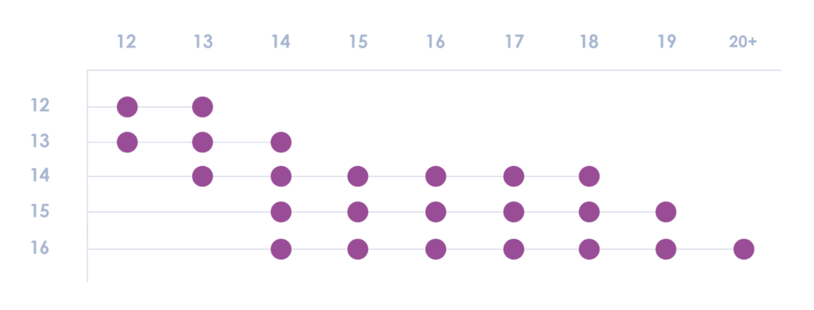
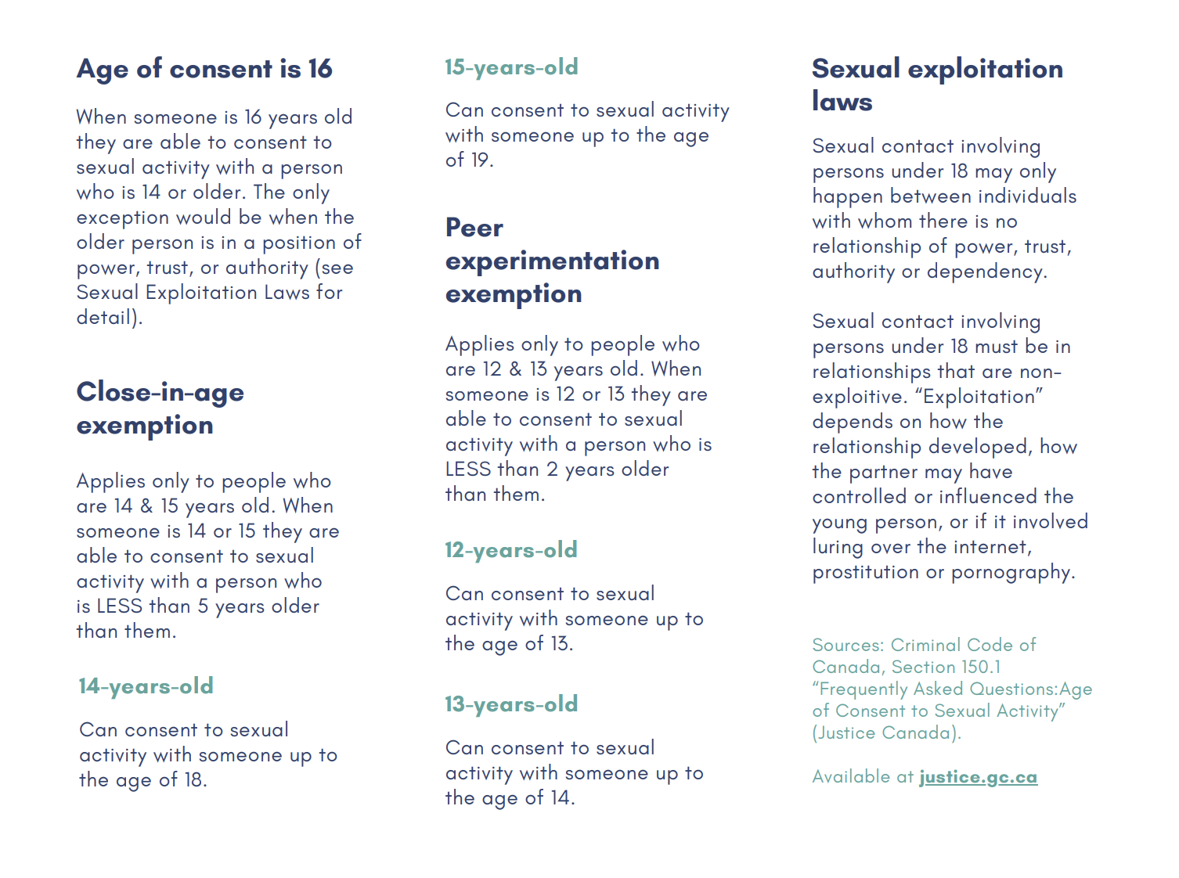
What does the law say about age of consent?
Notes:
Youth often ask about the age of consent laws. This chart shares the age of consent laws in an easy to digest way.
It’s important to acknowledge this curiosity and emphasize that the purpose of consent isn’t just to obey the law, but to ensure we are building safe and trusting and healthy relationships.

Slide 29
Without consent, actions might be:
Harmful, hurtful & damaging to your friendships & intimate relationships.
Violent to another person. (types of violence include: physical, sexual, emotional, online)
Include Sexual Harassment
A form of Child Pornography
Notes:
This conversation is meant to help clarify that there are serious consequences for what can sometimes be ‘considered acceptable’ behaviours.
As a reminder, these topics are covered in detail as a part of the Violence is Preventable curriculum. Please see session outlines in that curriculum if you would like to add more details to this section of this presentation.

Slide 30


Why can I do if an image is shared of me ?
bcsth.ca/project/the-compass-tool/
Notes:
This conversation is meant to help clarify that there are serious consequences for what can sometimes be ‘considered acceptable’ behaviours.
As a reminder, these topics are covered in detail as a part of the Violence is Preventable curriculum. Please see session outlines in that curriculum if you would like to add more details to this section of this presentation.
This is a QR code and link to the Compass tool designed by BCSTH for students to use to navigate next steps after an image has been shared of them without consent.

Slide 31
PEACE Counselor Name: Agency Information: Phone number: Website: Email address: Additional resources: www.youthinbc.com www.kidshelpphone.ca www.loveisrespect.org www2.gov.bc.ca/gov/content/justice/criminal-justice/victims-of-crime/victimlinkbc
We are here to support and help.
Notes:
https://www.youthinbc.com
https://kidshelpphone.ca/
http://www.loveisrespect.org/
https://www2.gov.bc.ca/gov/content/justice/criminal-justice/victims-of-crime/victimlinkbc

Slide 32
Thank you for your attention and curiosity today!

