Slide 1
Note for Presenter:
This PPT slide deck is to be modified based on the lessons you are presenting – feel free to delete/move/edit slides.
Lesson titles are Highlighted.
Videos – there is an option to click on the video on the slide itself. Or you may choose to copy and paste video link in a new window. Video links are available in presenter notes.
Slides with a color triangle are optional activities that can be interchanged with another of the same color in a lesson.
Presenter notes includes page numbers of where you can find the information in the curriculum.

Slide 2



Navigating Unhealthy Digital Relationships
VIP Curriculum Grades 6-7
Notes:
Point of Slide: This slide introduces the Violence Is Preventable (VIP) Program, and why PEACE Program counsellors are in the classroom and informs the students of the purpose of the presentation.
Speaking Notes:
Introduce yourself:
Who you are
What organization you are from
What your role is
A brief overview of the presentation.
For example:
I am happy to be here today and I am looking forward to sharing this meaningful time together. In my work, I help kids of all ages stay safe in their friendships and homes. I also help kids who may have been scared, confused or upset because one adult in their home is hurting another adult. I work for a program called the PEACE Program and today we will explore healthy and unhealthy digital behaviors in a relationship.
Acknowledge the traditional territory you are on.
Thank the teacher for having you in their classroom.

Slide 3



VIP Outline for Grades 6-7
Digital Interactions
Digital Consent
Responding to Unhealthy Digital Behaviors
Practicing Safe Digital Breakup Strategies
Supporting Friends & Community Resources
Image Source: pngtree.com
Notes:
Note to Facilitator: This slide can be modified based on which lessons you will present. (pg.2)
Objective: To introduce the students to the key themes of the VIP curriculum and the number of presentations you will be doing.
Speaking Notes:
We are here to have a conversation with you about important topics including recognizing unhealthy online behaviors, practicing safe digital breakup strategies and ways to support friends and access community resources.
Let students know what to expect during the presentation and advise them of the number of presentations you will be delivering.
Disclaimers:
Discussing sensitive topics;
Self-care e.g., stepping outside of the classroom for a few minutes, going to the bathroom or visiting the school counsellor
Have the class tell you what their “agreement” or “rules” are. Come up with a list together on the board or a flip chart so it’s visible throughout the presentation.
Talk about confidentiality and disclosures: Let the students know that if they feel uncomfortable talking about their own experiences that they can say “a friend that I know” or “I heard this happened” or talk to you after or outside of class.
Remind the class that you will be available after every session if anyone needs support or has questions. This includes wanting support because you know someone else is having this experience.

Slide 4

Exploring Healthy vs. Unhealthy Online Behaviour
Notes:
Lesson Plan: Recognizing healthy and unhealthy digital behaviors in relationships (pg. 6)
Objective: to recognize healthy versus unhealthy online behaviors and identify its impact on emotional well-being and personal autonomy.
Presenter Notes:
(1) Group Discussion
Ask the class to take a minute to reflect on healthy or unhealthy online behavior. Invite them to think of a friend or a crush when using technology. Invite them to write it out on the whiteboard/flipchart. After each example, invite the volunteer to explain why the example is considered healthy or unhealthy.
Examples of healthy online behavior: allowing time or distance when messaging, supportive of different friendships and other outside interests etc.
Examples of unhealthy online behavior: intensity (constant texting), ultimatums (if you do/don’t do this then I’ll block you/unfriend you), publicly criticizing your friend social media or in a group chat etc.

Slide 5
POSSESSIVENESS:
A friend who does not want you to be friends with other people, gets upset when you text or hang out with others.
SPAMMING:
When one person sends another constant messages (maybe on the same or different online platforms) with the intention of staying in constant touch. At first it may feel nice, but overtime it can lead to feeling frustrated or pressured.
Notes:
Presenter Notes: (pg. 6-7)
(2) Class Poll – ask students to raise their hands if they think the behavior is ”healthy” or “unhealthy”. For a dynamic approach you would designate one side of the room as “healthy” and the other as “unhealthy” and have them physically move to the side they believe fits.
(3) Discussion – ask volunteers to explain why they believe the behavior is “healthy” or “unhealthy”. Invite them to share other examples that haven’t been shared yet.
(4) Reflection
Invite the group to think about how the behavior could impact someone’s feelings, trust, or safety in a friendship.
Use student comments to guide a discussion on why behaviours categorized as “unhealthy” can negatively impact a friendship or a relationship.

Slide 6
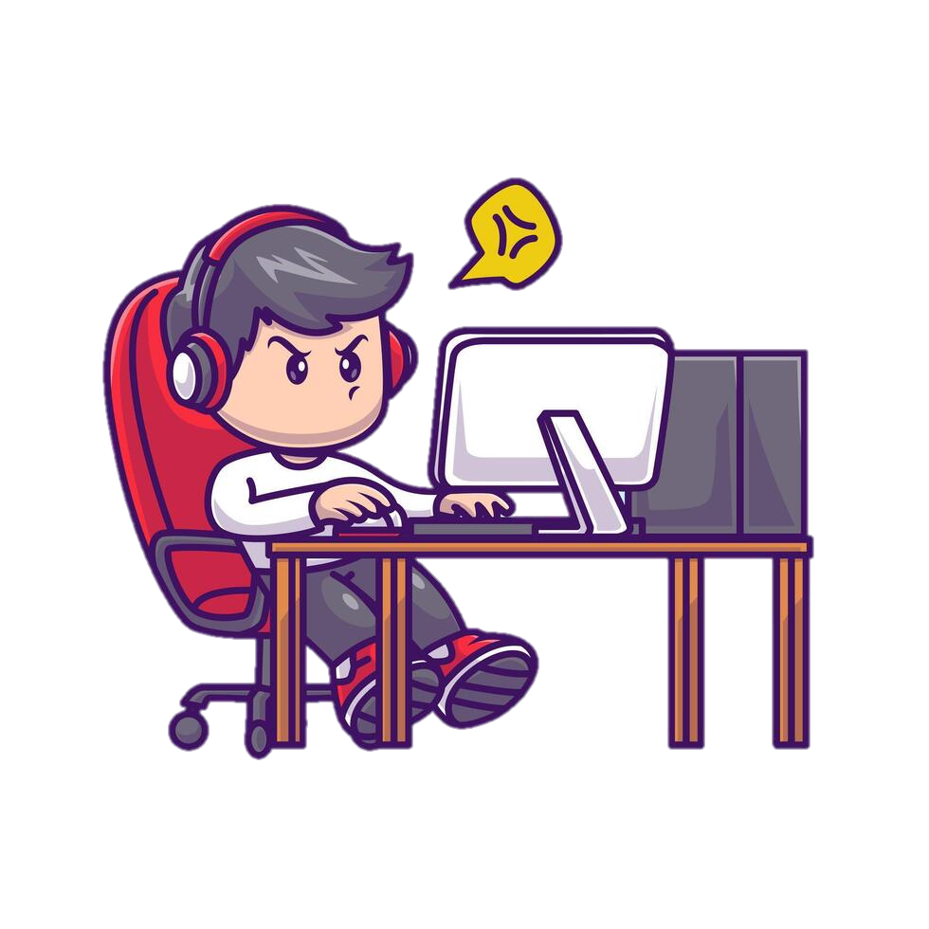
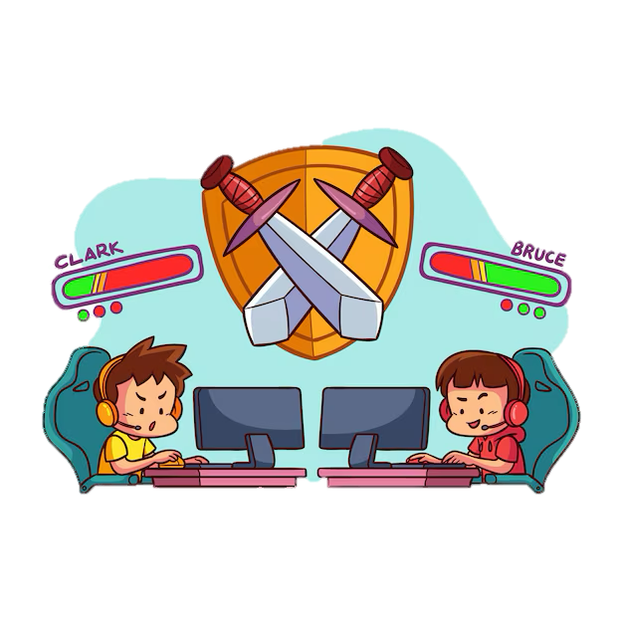
Unhealthy vs. Healthy Online Behavior
Notes:
Presenter Notes: (pg. 8)
Key Message: Even a small unhealthy behavior can have a long-term impact on a relationship, it can build up over time or occur alongside other harmful behaviors.
Conclusion: Wrap up the discussion by reminding students that healthy friendships or relationships are built on mutual trust, respect, and communication. Encourage them to think about how their actions, especially online, can impact others.

Slide 7
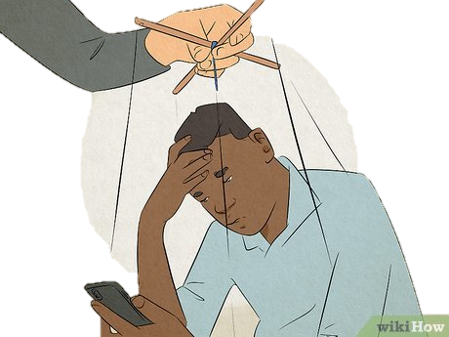
Exploring Unhealthy Digital Behaviors
Why might it be easy to overlook unhealthy behaviors in a digital space? (e.g. on social media, over texts etc.)
Image Source: wikihow.com
Notes:
Presenter Notes: (pg. 8)
Reflection: Have students reflect on why boundaries are important to respect online and offline. Have them remember that when pressured or uncomfortable with certain digital behaviours, a red flag may be going off about a boundary not being respected. Students can also connect this reflection to how they feel in their body when a boundary is not being respected (e.g., tension in the shoulders or feeling uneasy in your stomach).
Possible follow up reflection questions:
- Why might it be easy to overlook unhealthy behaviors in a digital space? (on slide)
How can a behavior like constant texting (spamming) or possessiveness seem caring but be unhealthy? When do these behaviors become unhealthy?

Slide 8
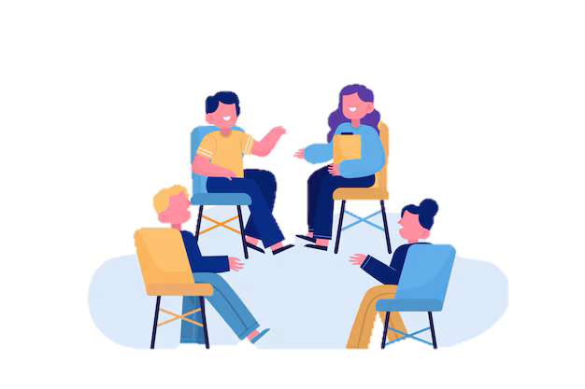
Scenario Activity
Notes:
Presenter Notes: Next few slides contain scenarios can be interchanged as they discuss the same challenging situation. Facilitator may choose the one that they prefer between the slides that have a triangle of the same colour.
Start of the Activity: (pg. 8-9) Read out the following scenarios and have students discuss how they might respond. Choose the scenarios that make sense for your group and timing.
End of the activity:
Debrief: Emphasize how setting boundaries and speaking up are important parts of healthy relationships. Ask students to practice telling their partner when they are uncomfortable in a respectful way and remind them that if they ever feel unsafe, they should seek help. Facilitators can acknowledge that establishing boundaries can be uncomfortable, but they are a way of sharing with others how we want to be treated. It may feel awkward in the beginning.

Slide 9
Scenario 1:
A friend keeps texting you a lot when you are hanging out with other people. They keep asking who you’re with and what you are doing. How might that make you feel? What would you do?
Notes:
Presenter Notes:
Next few slides contain scenarios can be interchanged as they discuss the same challenging situation. Facilitator may choose the one that they prefer between the slides that have a triangle of the same colour.
Key points to highlight during discussion:
Use of “I” statements to express personal discomfort
Acknowledge the other person’s feelings
Establish Boundaries
Propose an alternative

Slide 10
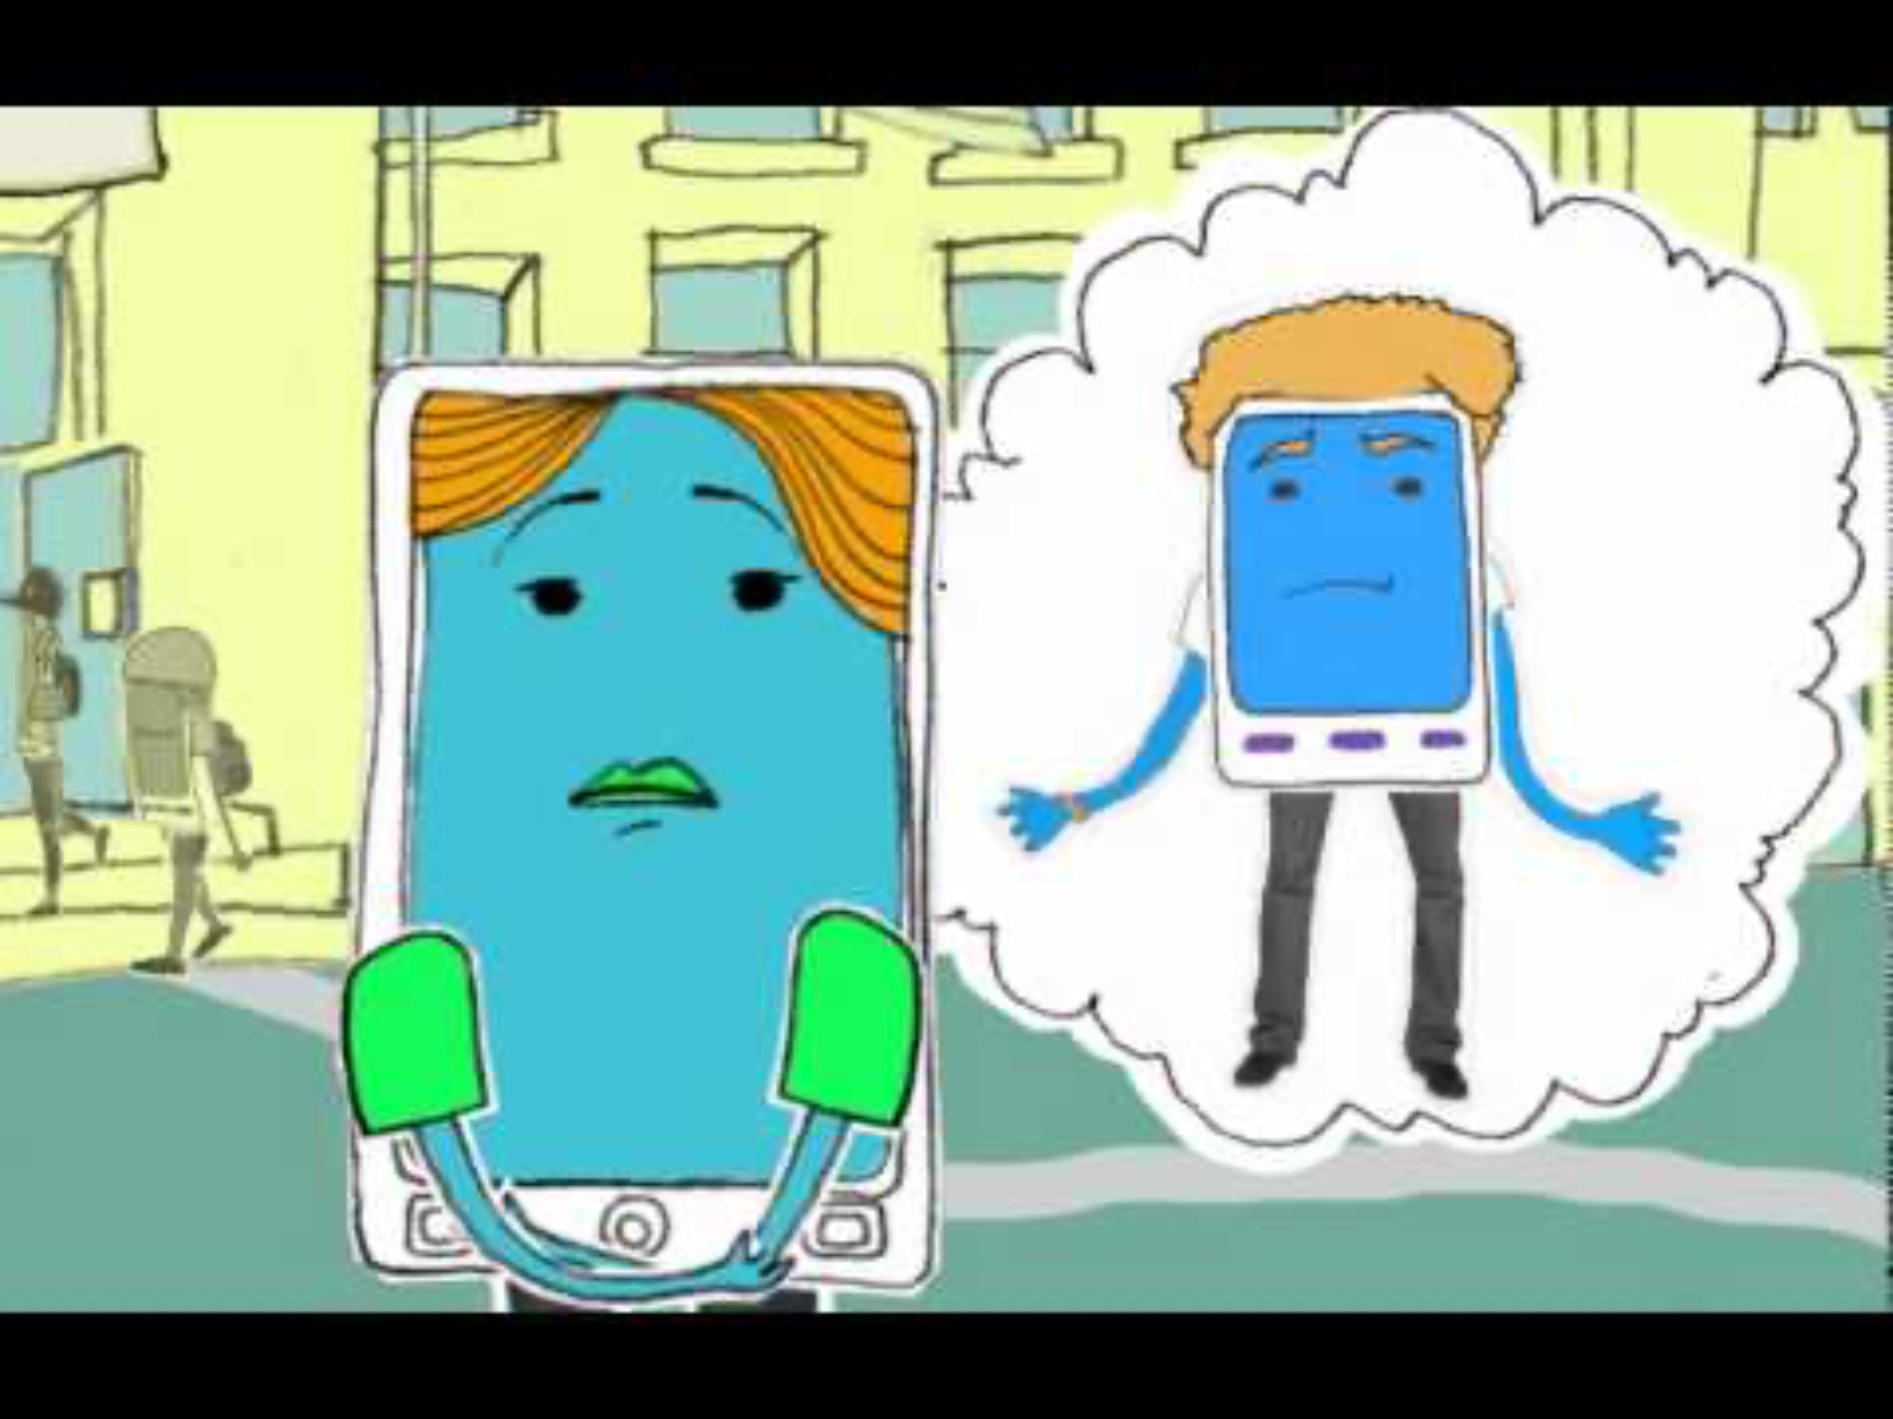
Scenario 1:
Notes:
Optional (alternative 1) : Consider using this video as your case scenario: click on the slide “play” button
Video for grade 6 and up: “Beeping from That’s not Cool”
https://www.youtube.com/watch?v=iJbYCYAVTjQ
Discussion Question:
- How might you respond to this situation?
Key points to highlight during discussion:
Use of “I” statements to express personal discomfort
Acknowledge the other person’s feelings
Establish Boundaries
Propose an alternative

Slide 11

Scenario 1:
Notes:
Optional (alternative to scenario 1): Consider using this video as your case scenario: click on the slide “play” button
Video for grade 6 and up: That’s Not Cool PSA from That’s Not Cool https://www.youtube.com/watch?v=hLvcSVgNqpk
Discussion Question:
- How might you respond to this situation?

Slide 12
Scenario 2:
Your friend says you should share your password because you are “best friends who don’t have any secrets”. You feel uncomfortable about it. How would you handle this?
Notes:
Presenter Notes:
Next few slides contain scenarios can be interchanged as they discuss the same challenging situation. Facilitator may choose the one that they prefer between the slides that have a triangle of the same colour.
Discussion Question:
- How might you respond to this situation?
Key points to highlight during discussion:
Use of “I” statements to express personal discomfort
Acknowledge the other person’s feelings
Establish Boundaries
Propose an alternative

Slide 13

Scenario 2:
Notes:
Optional (alternative to scenario 2): Consider using one of the videos below as your case scenario:
Video for grade 7: The Teens Discuss Password Sharing and Privacy from FX Networks https://www.youtube.com/watch?v=gFXY7UpW96U
Key points to highlight during discussion:
Use of “I” statements to express personal discomfort
Acknowledge the other person’s feelings
Establish Boundaries
Propose an alternative

Slide 14
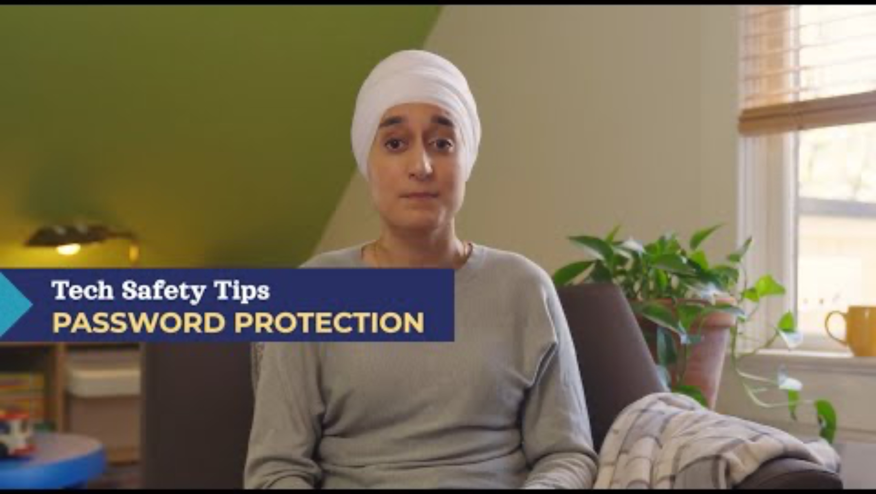
Scenario 2:
Notes:
Optional (alternative to scenario 2): Consider using this video as your case scenario:
Video for grade 7 and up: 3 Ways to Increase Password Security from BC Society of Transition Houses
https://youtu.be/qx4JpiL2fmw
Discussion Question:
- How might you respond to this situation?

Slide 15
Scenario 3:
You have spent time to customize your gaming profile with a cool username, after joining an online game with some classmates, you notice that one of them is making negative comments about your username and the others are joining in.
Notes:
Presenter Notes:
Optional Scenario –
Discussion Question:
How might you respond to this situation?
Key points to highlight during discussion:
Use of “I” statements to express personal discomfort
Acknowledge the other person’s feelings
Establish Boundaries
Propose an alternative

Slide 16
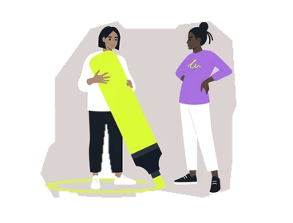
Setting Healthy Boundaries
Notes:
Debrief: Emphasize how setting boundaries and speaking up are important parts of healthy friendships. Ask students to practice telling their partner when they are uncomfortable in a respectful way and remind them that if they ever feel unsafe, they should seek help. Facilitators can acknowledge that establishing boundaries can be uncomfortable, but they are a way of sharing with others how we want to be treated. It may feel awkward in the beginning.

Slide 17

Journaling Reflection
Think about a time you felt comfortable or uncomfortable with a digital interaction with your friends or classmates.
How did you handle it?
What did you learn?
Notes:
Optional Activity: Journaling Reflection
Ask students to reflect on a time when they felt comfortable or uncomfortable with a digital interaction with their friends, classmates or a crush. How did they handle it, and what did they learn?

Slide 18
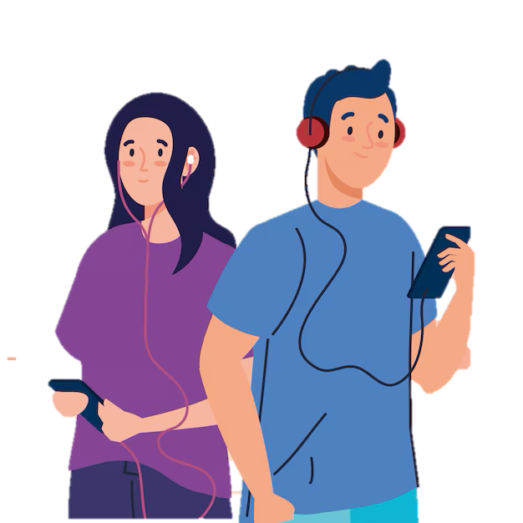
Wrapping Up
In this session we discussed…
Healthy vs. unhealthy digital behaviors
Unhealthy use of technology and its result
Technology should increase trust, respect but not fear
Notes:
Review Key Messages:
Recognize signs of healthy and unhealthy digital behaviours.
Understand how unhealthy use of technology can lead to manipulation, possessiveness or violence.
How using technology should increase trust, respect, and not fear
Ask class if they have any questions around today’s topic.
Provide local resources and websites for students who may want to learn more or seek help.
Distribute and collect evaluations.

Slide 19
Password Tips
Make it long
Avoid obvious terms
Mix it up
Something unique
Keep it a secret
Change it often
Notes:
Password Tips of Teens: (this page could also be printed out and shared with students – page 11 of curriculum)
Make it long – 8 to 12 characters, longer is better
Mix it up – using upper case and lowercase letters, numbers, and symbols like ! @ # $
Do not use obvious terms – stay away from easy to guess passwords like your name, 1234, or “password”
Create something unique – think of a full sentence or a phrase you will remember and change some letters for numbers or add symbols
Keep it a secret – do not share it with anyone except trusted adults
Change your password often – this is a great practice especially if you think someone may have access to your account or password.

Slide 20
Understanding Digital Consent
Notes:
Presenter Notes: (pg. 12)
Objective:
This lesson highlights the importance of digital consent, emphasizing respect, trust, and personal boundaries in online interactions. Students will learn how digital and verbal consent are similar, where they differ, and how practicing consent fosters healthier and safer connections in both digital and real-world spaces.

Slide 21
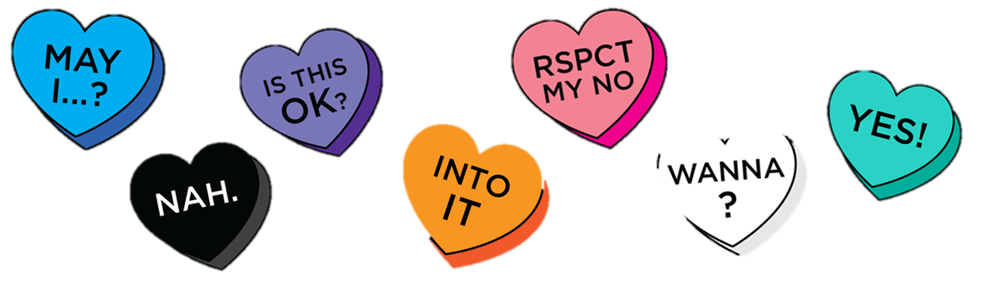
Digital Consent
Image Source: lgbt.wisc.edu
Notes:
Presenter Notes: (pg. 12)
Ask students if they are familiar with the term “digital consent”
Introduce the concept of: seeking permission before sharing or requesting personal information online
Explain why this is important in a dating relationship – privacy and respect are essential
Note: Before introducing the definition, you may choose to ask participants to share examples of what digital consent looks like in a friendship or between a person and their crush.
Digital Consent (Definition) – it means deciding what you are okay with sharing online and giving others permission to use or share information, photos, messages. It’s about setting boundaries for how people interact with you in the digital world. Even though social media and apps can feel out of your control, you have power over what you share, who can see it, and how others engage with you.

Slide 22
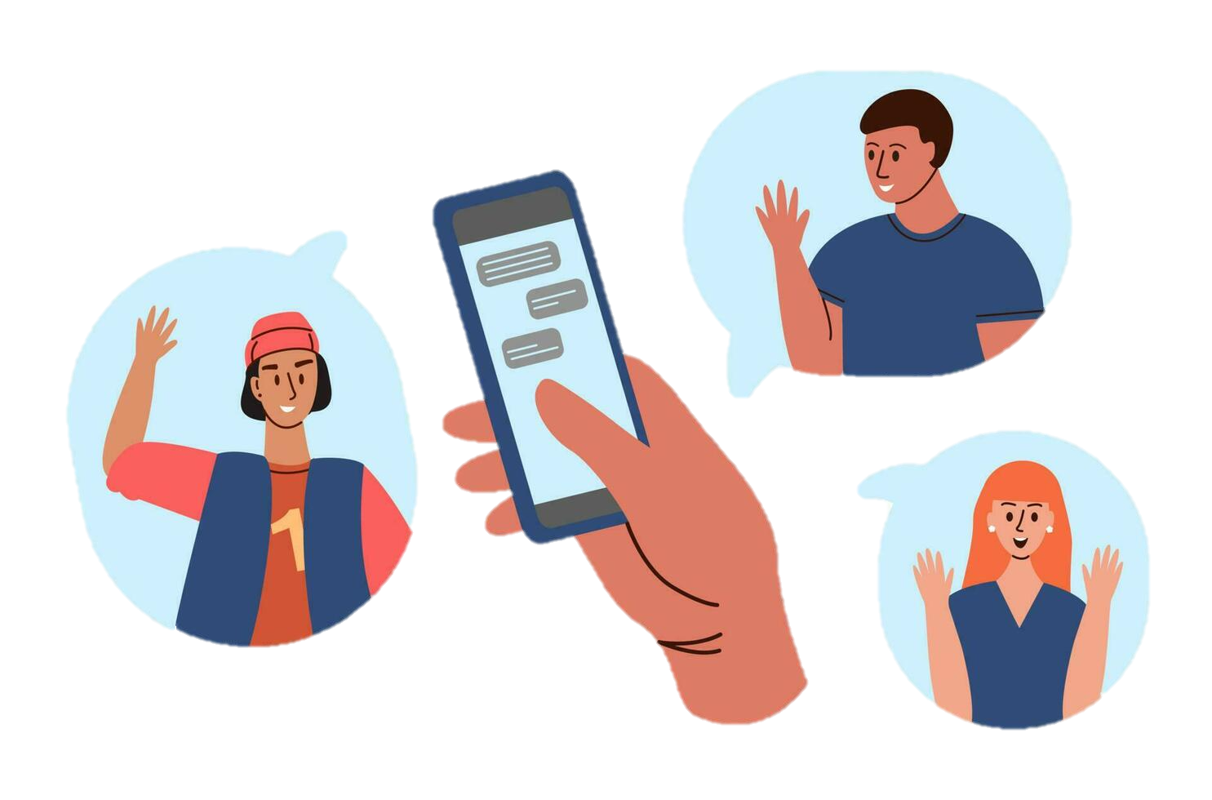
What does it look like… ?
Notes:
Examples in Friendship Context: (Helpful for grades 6/7 may be applicable for older grades depending on the group – you may choose to share both or one of the slides ie. slide 22-23)
Are you free to talk?
Want to FaceTime tonight at 6?
What time are you able to play Fortnite or Roblox after school?
Can I post this photo of us at the game?
Not forwarding their private message, photo or video sent to you without permission.
Can I use your phone, table, or account before logging in.
Confirm with them before adding to group chats.
Ask if it is ok to share their phone number, account with someone else.

Slide 23
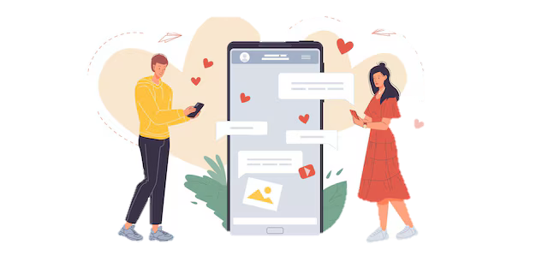
What does it look like… ?
Image Source: freepik.com
Notes:
Note to Presenter: This slide is intended for older grades. You may choose to show it or skip it for your grade 6-7 group.
Examples in Dating Contexts: Offer a few examples where digital consent is needed in dating:
Asking a partner before posting a picture of them.
Respecting a partner’s boundaries if they do not want to share their location.
Respecting a partner’s decision to take down a post even if they previously gave consent.
Checking before sharing relationship details, photos, videos, or conversations with others.
Respect that they may need time to respond to messages and not pressure them to reply right away.
Not pressure your partner to share their passwords, logins for social media, email, or other accounts.
Do not pressure or coerce someone to share a personal/intimate photo or video.

Slide 24
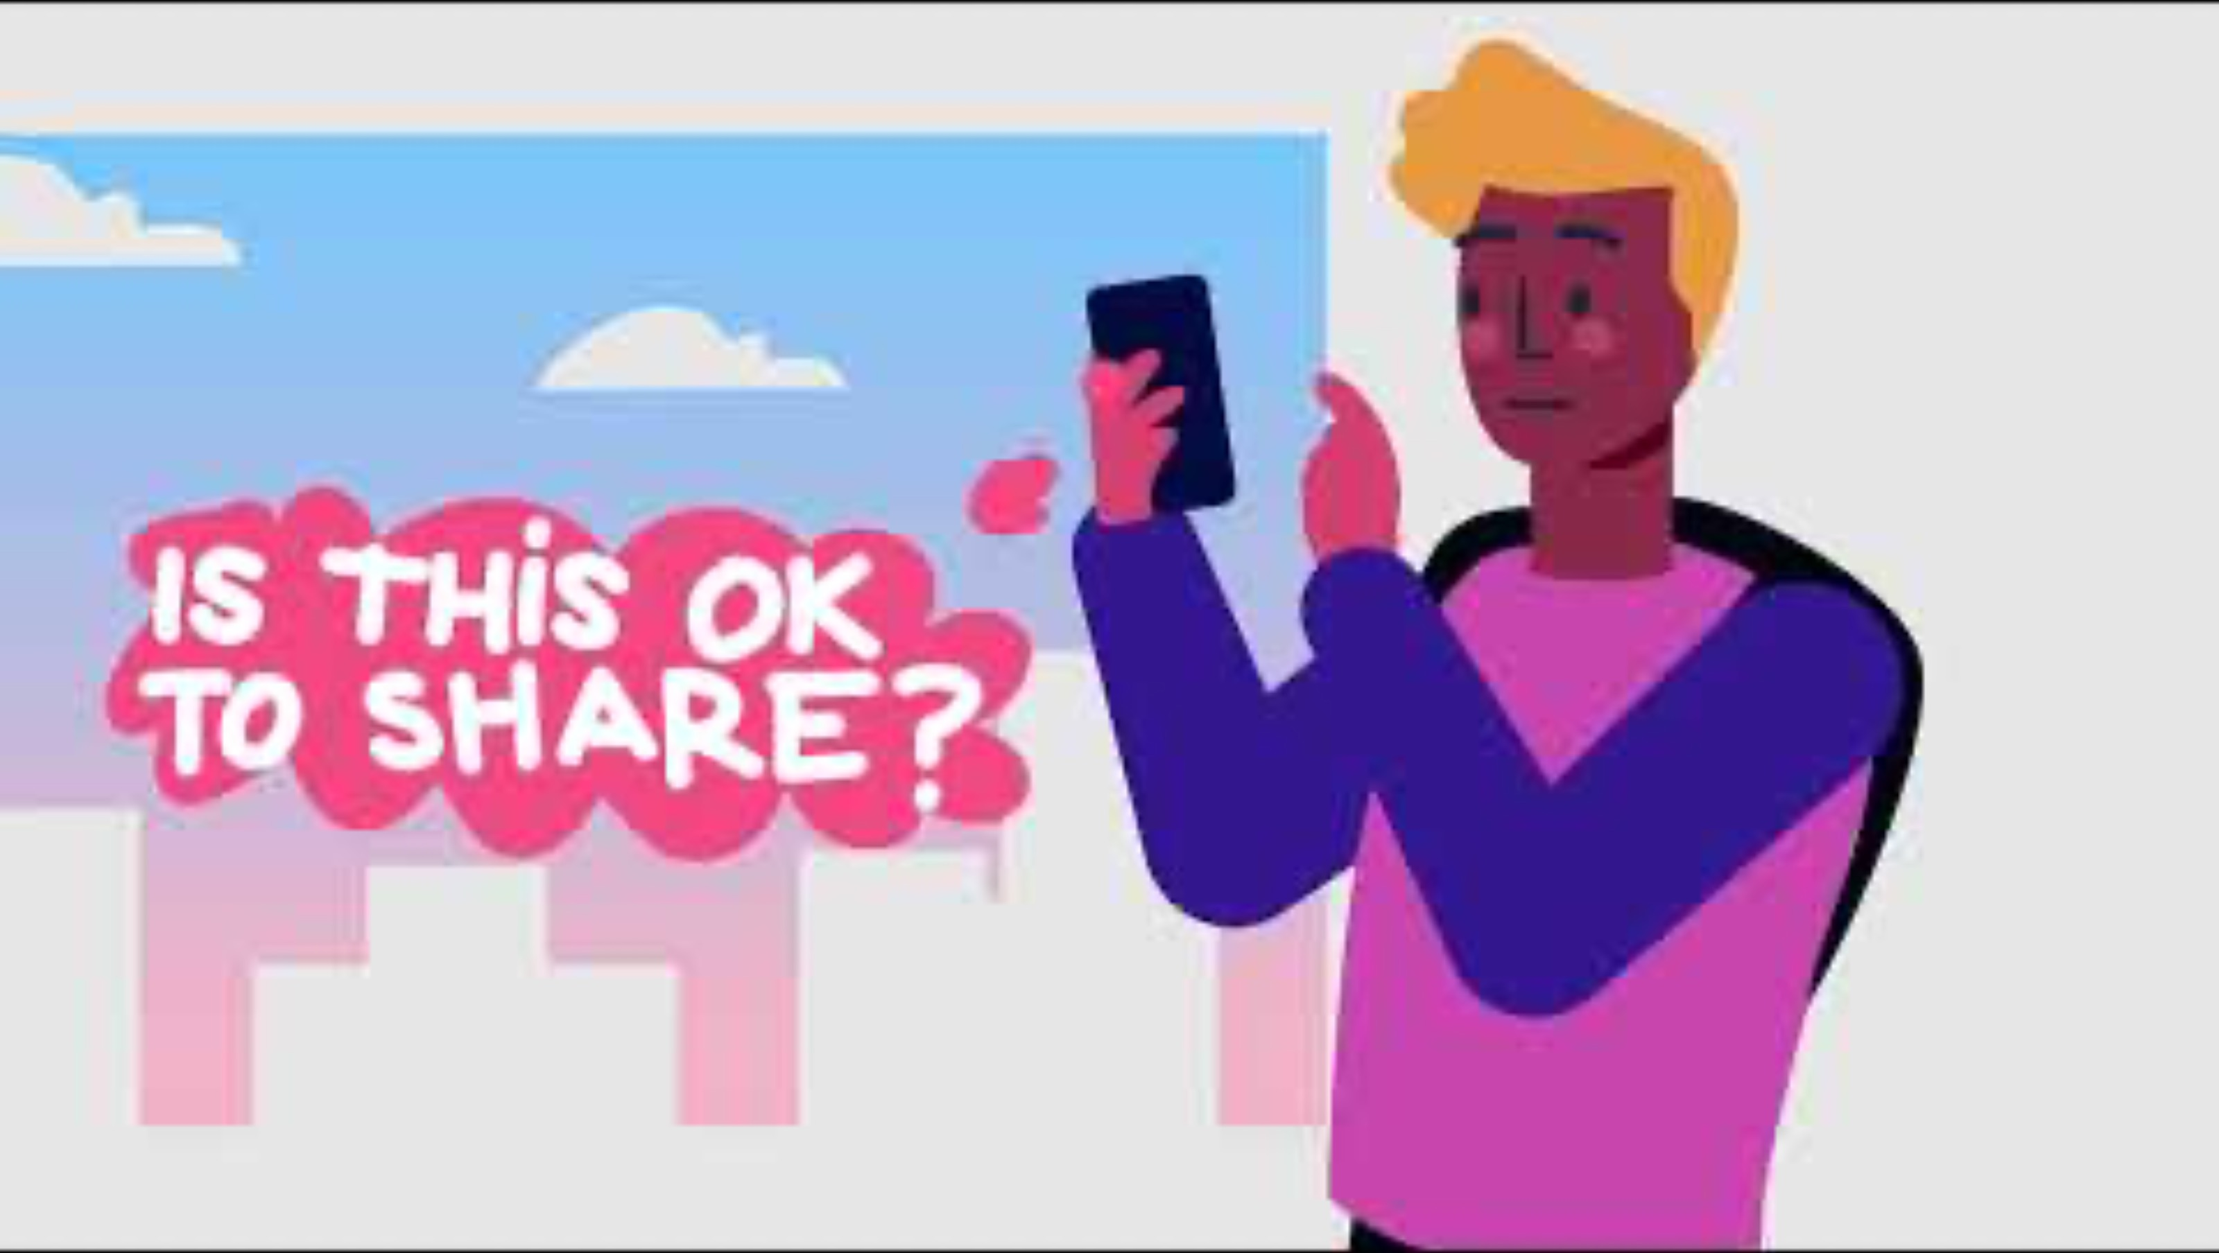
Notes:
Optional Video:
“Is this OK to Share? Ask before sharing photos, texts, or videos.” from BCSTH https://www.youtube.com/watch?v=ORWu8QZqzbw

Slide 25
Scenario Activity
Notes:
Presenter Notes:
Based on the group dynamics – choose one of the options:
Option A: Divide the class into small groups and assign each a digital consent scenario. Ask them to decide how they would handle it. Each group should discuss if consent is needed and what respecting consent might look like.
Option B: Select one or two digital consent scenarios and ask the class to decide as a group how they would handle it.

Slide 26
Scenario 1:
You and your friend take a cute photo together after school, but you are not sure they would want it posted. What do you do?
Notes:
Facilitation Tip: (pg. 14-15) Emphasize key aspects of digital consent, respect, and communication. Here are some key responses to look out for:
Ask for permission
Respect their decision
Discuss beforehand
Considering privacy and context
Asking about tagging or captions
Delay the decision – not posting right away and waiting for consent to be given
If a student’s response involves assuming consent or dismissing the partner’s feelings, gently challenge these ideas by asking: “how would you feel if someone posted a photo of you without asking?” or “what would happen if they were uncomfortable and saw the post later?”

Slide 27
Scenario 2:
Your friend asks for your online game password so they can log in as you and try to improve your scores, but you feel unsure and uncomfortable about it. How would you respond?
Notes:
Facilitation Tip: (pg. 16 - 17)
Key responses to highlight include:
Set clear boundaries
Reframe the idea of trust
Offer an alternative
Share feelings
Recognize red flags
Suggest a broader conversation
Encourage empathy and understanding to help students understand the importance of digital consent in maintaining respectful friendships.

Slide 28
Scenario 3:
Your friend sends many texts asking you where you are every time you go out with other friends. You are starting to feel very uncomfortable about this. What do you do?
Notes:
Facilitation Tip: (pg. 18)
Key responses include:
Express feelings honestly
Set boundaries
Ask about their concerns
Recognize unhealthy behavior
Limit communication temporarily
Talk to a trusted adult
Facilitator Strategy: (pg. 19)
- If students suggest ignoring the behaviour entirely (e.g., “I’d just keep responding to avoid upsetting them”), guide reflection with questions like:
- “How might this behavior affect your feelings about the friendship in the long run?”
- “What could happen if this behavior continues or gets worse?”
Note: Encourage students to recognize the importance of their own boundaries, promote open communication, and identify when a situation might require further support.

Slide 29
Scenario 4:
A student was messaging their friend last night, and the friend shared that they have a crush on someone in the class. Now the student is thinking about showing a screenshot of the conversation to other friends – should the student ask their friend’s consent?
Notes:
Facilitation Tip (pg. 20)
Key responses may include:
Ask for consent first
Consider their feelings
Understand the context
Respect their boundaries
Reflect on why you want to share
Offer an alternative
Facilitator Strategy: By focusing on empathy, consent, reflection, facilitator can help students understand the importance of privacy and respect in digital communication.
If students suggest sharing without asking for consent (eg. ”I’d show it because it’s just a text) guide reflection with questions like:
“How would you feel…”
”What might happen if your partner found out you had shared the screenshot without their permission?”

Slide 30
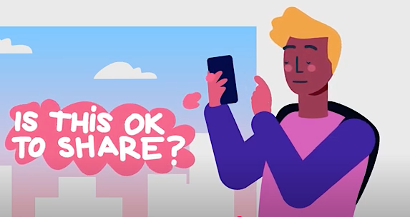
Digital vs. Verbal Consent
Notes:
Presenter Notes:
Guiding questions for the discussion (pg. 21)
What is verbal consent?
How is digital consent in dating relationships like verbal consent?
Why would someone be afraid to ask for digital consent in a friendship or a relationship?
Responses may reflect misunderstandings, insecurities, or unhealthy relationship dynamics. (pg. 22)
Fear of conflict – emphasize that some conversations are best kept between people involved, regardless of consent.
Fear of rejection – highlight that a healthy relationship allows both people to express their needs and boundaries without the fear of rejection.
Pressure to please their friend - Explain that trust is not about always saying yes but about respecting each other’s boundaries
Not Wanting to Seem Overly Serious - Point out that asking for consent is a simple and respectful habit, not something that has to feel formal or heavy.
Embarrassment or Awkwardness - Normalize that it is okay to feel awkward but emphasize that practicing consent gets easier with time and shows care for the other person’s feelings
Lack of Confidence or Knowledge - Offer simple examples of how to ask for digital consent in a natural way, like, “Is it okay if I share this picture?”
Responding to Negative or Dismissive responses:
Dismissive of consent – Encourage empathy and explain that consent is about respecting someone else’s comfort and privacy. (For ex: “How would you feel if…?”)
Fear of being seen as controlling – Clarify that consent is not about control – it’s about showing respect, it is a sign of a healthy and caring relationship.
Key Points to cover during this slide:
Digital consent – about respect and feeling safe for all involved.
Healthy relationship – open communication, freedom to say “yes” or “no” without fear.
Building trust around digital consent strengthens the relationship.

Slide 31
Scenarios: Practicing Digital Consent
Notes:
Presenter Notes:
Practice requesting and responding to digital consent in a friendship context by discussing the following scenarios as a class.

Slide 32
Scenario 1:
One friend wants to tag the other in a social media post. How they would ask for permission and how the other can respond if they are not comfortable.
Notes:
Presenter Notes: (pg. 23 - 25)
Facilitation Tip: for this scenario, guide the conversation to emphasize key aspects of digital consent, respect and communication.
Key responses: (refer to pg. 24 for detailed examples and context)
Examples reflecting – being direct and respectful along with a willingness to adjust.
Practical Tips to share with students:
Avoid making the other person feel guilty or pressured.
Emphasize that asking for and giving consent is a routine part of respecting boundaries.
If tagging is not an option, suggest ways to share the moment without breaching comfort, like sending the photo privately or sharing it without a tag.
- Teach students that tagging can make personal content more public, and asking for consent is part of protecting their partner’s privacy and safety.

Slide 33
Scenario 2:
One friend is uncomfortable about sharing their phone password and wants to say so without hurting the other’s feelings.
How would they ask for permission and how would the other friend express their feelings?
Notes:
Presenter Notes: (pg. 25-26)
Practical Solutions for expressing uneasiness about sharing a phone password:
Use of “I” statements to express personal discomfort
Reassure other person to avoid misunderstanding
Acknowledge the other person’s feelings
Propose an alternative
Practical Solutions for the Partner Who Wants the Password to Respond Respectfully
Acknowledge and accept the boundary
Share own feelings without pressuring
Appreciate the partner’s honesty
Reflect on the trust in their relationship
Practical Tips for Facilitators to Share with Students:
Model non-defensive and empathetic responses for both sides of the conversation.
Emphasize that it is okay to have boundaries in a relationship and that privacy does not mean a lack of trust.
Suggest other ways to build trust, like spending quality time together or openly discussing concerns.
Teach students that a healthy partner respects boundaries without pressuring or taking it personally.

Slide 34
Scenario 3:
A best friend asks to check the other’s messages or location, but the friend does not feel comfortable with this.
How can the best friend ask for permission and how can the friend respond?
Notes:
Presenter Notes: (pg. 26-27)
Key steps and examples to discuss:
How to ask for permission – (remind students to avoid framing the request as a demand or assuming consent is automatic)
Be honest about intentions
Acknowledge that it is a big ask
Express openness to alternatives
2) How to respond to the request respectfully –
Acknowledge the request
Politely decline the request
Reassure the partner
Propose alternatives
Practical tips to share:
Setting boundaries does not mean rejecting or hurting the other person
Encourage reflection on the underlying feelings behind the request, like insecurity or concern, instead of focusing solely on the action.
Trust grows through respectful actions and communication, not by monitoring or suggest alternatives like regular check-ins or setting agreed-upon times to update each other on plans

Slide 35

“No” is Normal
Image Source: lessonpix.com
Notes:
Debrief: Emphasize for the class that trusting someone enough not to do something if they say so, and simply saying “no”, is normal and part of good friendships and relationships. It is not an indication of no trust, nor an indicator that something must be hidden.

Slide 36
Wrapping Up…
In this session we discussed…
Digital consent
Practicing digital consent
Notes:
Presenter Notes:
Wrap-Up and Q&A: (pg. 28)
Review the importance of digital consent, how it builds confidence, strengthens trust in dating relationships, and how it is like in-person consent.
Have each student identify one action they might do to practice digital consent in their online interactions (passes are ok). If the group is quiet, ask the teacher to identify key take aways from the presentation.
Handout Digital Consent Tips in Relationships Handout (pg. 29-30) which includes reminders to check before sharing, options for respecting privacy, and ways to communicate boundaries. Provide students with community resources.
Distribute and collect evaluations.

Slide 37
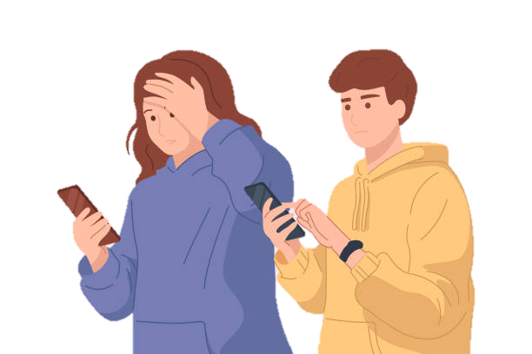
Unhealthy Digital Behaviors
Notes:
Lesson Plan: Digital Abuse (pg. 32)
(1) Presenter Notes:
Define Digital Abuse: a pattern of behaviors that uses technology such as social media, texting, and tracking apps to control, hurt, harm, or harass someone.
Facilitator Note: you may choose to emphasize that unhealthy behaviours are never the fault of the person experiencing them. These behaviours are not okay, and help is available.
(2) Group Discussion: (examples put on flipchart, board)
Ask class for examples of unhealthy digital behaviors between friends or examples they have seen in the media
Examples that may come up: (offer healthy alternatives)
Threats and harassment
Tracking without consent
Sharing private texts or images without permission

Slide 38

Scenarios: Recognizing Unhealthy Digital Behaviors
Notes:
Presenter Notes: (pg. 32-34)
Choose either to discuss scenarios as a class or divide students into small groups and give each group a few example scenarios (see below).
Instructions: Read or have each group read their scenario and answer:
What in this situation is unhealthy?
How might the person react?
Who might they reach out to for support?
After participants have finished discussing in groups: Each group will share their scenario and responses with the class. Reiterate it is okay to ask for help and revisit available resources, such as school counsellors or community helplines.

Slide 39
Scenario 1:
A friend repeatedly asks where you are and gets angry when you do not respond immediately.
Discussion Questions:
What in this situation is unhealthy?
How might the person react?
Who might they reach out to for support?
Notes:
Facilitation Tips: (possible responses to discussion questions)
1. What in this situation is unhealthy? It is unhealthy for someone to repeatedly ask where you are and get angry if you do not respond right away. This shows a lack of trust and respect for your boundaries.
2. How might the person react? The person being asked might feel stressed, scared, or overwhelmed. They could also start feeling guilty or like they always have to explain themselves, which is not fair.
3. Who might they reach out to for support? They might talk to a trusted friend, a family member, a teacher, or a school counsellor. If they feel unsafe, they could also reach out to a helpline or a support organization for advice.

Slide 40
Scenario 2:
Someone you are “talking to” shares a private picture without asking.
Discussion Questions:
What in this situation is unhealthy?
How might the person react?
Who might they reach out to for support?
Notes:
Facilitation Tips: (possible responses to discussion questions)
1. What in this situation is unhealthy? It is unhealthy and wrong for someone to share a private picture without your permission. This is a serious violation of trust and privacy.
2. How might the person react? The person whose picture was shared might feel embarrassed, betrayed, angry, or even scared. They could also feel like they cannot trust anyone.
3. Who might they reach out to for support? They could talk to a trusted adult like a parent, teacher, or school counsellor. They might also reach out to a helpline, a support organization, or even the police, since sharing private pictures without consent can be against the law.

Slide 41
Scenario 3:
A friend sends you dozens of messages after you do not respond, making you feel overwhelmed.
Discussion Questions:
What in this situation is unhealthy?
How might the person react?
Who might they reach out to for support?
Notes:
Facilitation Tips: (possible responses to discussion questions)
1. What in this situation is unhealthy? It is unhealthy for a friend to send dozens of messages when you do not respond. This shows they are not respecting your time or boundaries.
2. How might the person react? The person getting the messages might feel overwhelmed, stressed, or annoyed. They might also feel pressured to reply even if they are busy or not ready to talk.
3. Who might they reach out to for support? They could talk to another friend, a parent, or a teacher about how to handle the situation. If it keeps happening or makes them feel uncomfortable, they might need to ask for help setting boundaries or blocking the person.

Slide 42


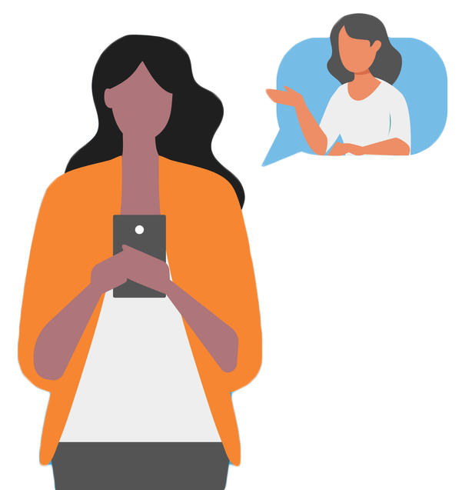
Strategies
Notes:
Presenter Notes: (pg. 34)
Discussion Questions -
- Discuss how would you safely respond to these behaviors?
What might a person need to feel or be safe?
What might you say or do if a friend was experiencing them?
Strategies:
Setting boundaries – explain that it’s okay to tell someone they are crossing a line, such as asking them not to track your location or message you all the time.
Getting Help – Talk about the benefits of seeking help from a trustworthy adult or counsellor. Let students know that they are not alone, and that help is available.
Documenting what happened and capture evidence – This can sometimes be helpful in taking action when seeking help. (See the Preserving Digital Evidence toolkit for more information)

Slide 43
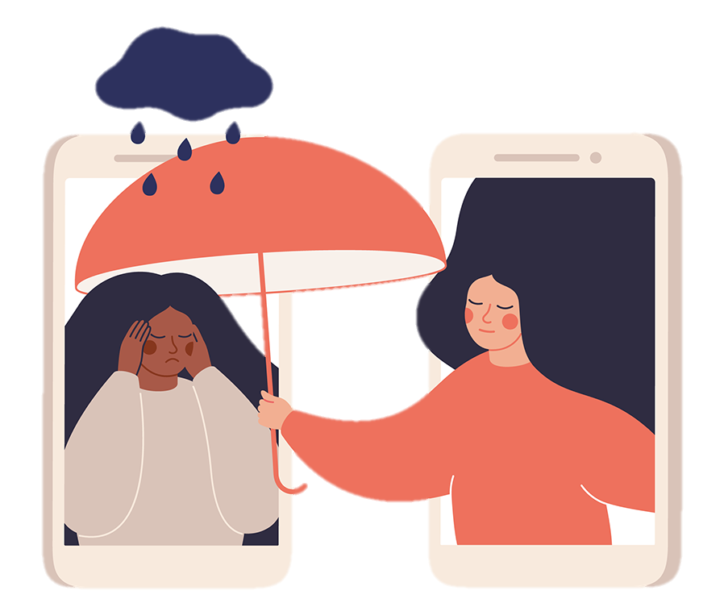
Scenario: Upstander Action
Notes:
Presenter Notes: (pg. 34-35)
Ask the class or explain the term - ”Upstander Action” is a term used to encourage people to move from passive observation to active support.
The next slide contains a scenario in which students witness a friend being abused online by another friend.
During the activity, emphasize that being a supportive friend includes listening, validating their feelings and encouraging them to seek help.
Key Discussion Points: (pg. 35)
When supporting a friend who is being made uncomfortable by another friend’s messages, it is important for the student to prioritize their own safety.
Avoid direct confrontations with the aggressive person.
Focus on offering emotional support to their friend by listening and validating their feelings.
Encourage the friend to set boundaries (muting or blocking the person can help).
If the situation escalates, suggest involving a trusted adult like a teacher or counsellor and save evidence of threats or harassment (eg., taking screenshots).
Explain that a trusted adult like a teacher or counsellor are trained to help and support.

Slide 44

Scenario:
You notice your friend is stressed because someone keeps messaging them in a way that makes them uncomfortable.
How might you ask them about it and encourage them to talk to someone?
Notes:
Optional Video: (pg. 35)
Beeping from That’s Not Cool https://www.youtube.com/watch?v=iJbYCYAVTjQ
(Or click on video icon in the bottom right corner for video to open in another window)
Example Student Response:
Student response: “Hey, I’ve noticed you seem really stressed lately. Is everything okay? I saw that someone keeps messaging you, and it seems like it is bothering you. Do you want to talk about it? I am here to listen if you need someone, and we can figure out a way to make it stop. If it is really upsetting you, it might help to talk to a teacher, counsellor, or someone you trust. I can even go with you if you want.”
Debrief: Process how being supportive can make a huge difference and that stepping in to help a friend does not have to mean you have to solve everything.

Slide 45
Wrapping Up…
In this session we discussed…
The warning signs of unhealthy digital behaviours
Your right to have boundaries, no one has the right to control or harass you
It’s okay to ask for help, people are there to listen and help
Notes:
Review Key Points:
Know the warning signs of digital abuse.
You have the right to boundaries, and no one has the right to control or harass you.
That it is okay to ask for help; people are there to listen and help.
- Share information about school counsellors, local helplines, and online resources where one student can seek help.
- Distribute and collect evaluations

Slide 46

Discussion: Upstander Action
Notes:
Optional Activity #1:
Discussion on Upstander Action: Extend the activity by discussing several ways in which students can intervene safely to support their friends facing digital abuse. Make sure they realize that they do not need to solve the problem but can encourage their friend to talk to a trusted adult.

Slide 47

Journaling Reflection
Notes:
Optional Activity #2:
Journaling Reflection: Have students reflect on one experience when they felt uncomfortable online or saw someone was being treated in a way that did not feel right. Have them write about how they responded to the situation, or how they wanted to respond to the situation and what they learned from that experience.

Slide 48
Practice Safe Digital Breakup Strategies
Notes:
Presenter Notes:
This lesson emphasizes the importance of respect, boundaries, and emotional awareness in digital interactions, particularly when ending relationships. Students will learn safe digital breakup strategies, how to minimize risks like harassment or privacy breaches, and ways to support their well-being and boundaries online.

Slide 49

Digital Boundaries
Notes:
Presenter Notes: (pg. 38)
Icebreaker: Ask students to share one boundary they value online.
Discussion Prompt: “Why might breakups online be more complicated than face-to-face breakups?
Note: the breakup can happen face-to-face, but the former partners may still be connected in online spaces.
Possible Responses:
It might be unclear (emotion and feelings may be more difficult to express over text)
It might lead to misunderstandings around the reason of a breakup etc.

Slide 50
Group Discussion:
Ending a short -term relationship with a classmate in a kind manner.
Notes:
Presenter Notes: (pg. 38-40)
- Offer the following suggestions to students to help them navigate ending relationships online in a healthy and respectful way, especially when they find themselves in unhealthy or uncomfortable situations:
Acknowledge your feelings and priorities – recognize when it is time to end it, self-reflection
Be direct, but respectful – clear communication, avoid mixed messages
Set boundaries – stop the constant messaging, respect the other person’s space
Make it private, if possible – avoid public drama, control your social media
Seek support – talk to a trusted adult, reach out to friends
Stay safe online – watch for retaliation, consider online safety
Be patient and compassionate with yourself – understand that breakups can be hard, do not feel guilty for ending the relationship
Discuss the importance of digital consent after a breakup – respect their privacy moving forward

Slide 51
Group Discussion:
Responding to a negative or emotional reaction with respect.
Notes:
Presenter Notes: (pg. 38-40)
- Offer the following suggestions to students to help them navigate ending relationships online in a healthy and respectful way, especially when they find themselves in unhealthy or uncomfortable situations:
Acknowledge your feelings and priorities – recognize when it is time to end it, self-reflection
Be direct, but respectful – clear communication, avoid mixed messages
Set boundaries – stop the constant messaging, respect the other person’s space
Make it private, if possible – avoid public drama, control your social media
Seek support – talk to a trusted adult, reach out to friends
Stay safe online – watch for retaliation, consider online safety
Be patient and compassionate with yourself – understand that breakups can be hard, do not feel guilty for ending the relationship
Discuss the importance of digital consent after a breakup – respect their privacy moving forward

Slide 52
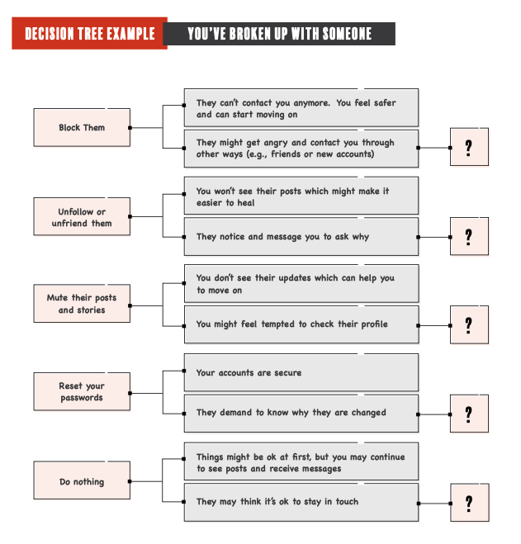
Decision Tree
Notes:
Presenter Notes: (pg. 40-41)
Note: Facilitator may choose to print out copies of decision tree (pg. 41 of curriculum) to give out to participants as a sample. And then encourage them to create their own in their notebook.
(1) Show a digital decision tree with choices to make in the event of a digital breakup
Facilitate a discussion of the various paths and consequences, guiding students in making purposeful choices for their own safety and well-being.
Note: Emphasize that every choice has different outcomes, encourage students to pick one that feels the safest and most comfortable. If they are unsure, suggest they talk to a trusted adult or friend for support.
(2) Discussion and Reflection –
What challenges do you think students face when they have gone through a breakup, but former partners are still digitally connected?
How would one respectfully set boundaries in digital spaces when ending a relationship, what are the consequences for them if it is not safe for them to, for instance, will violence escalate if they take away access to accounts, location, passwords etc.?
What are some safe responses if a person has a strong reaction to a breakup via technology?
Reflection: Ask students to respond to one thing learned or one action step that may help them stay safe online in relationships.

Slide 53

Wrapping Up…
In this lesson we discussed…
Respectful communication
How to be safe
Strategies to set boundaries
Notes:
Presentation Notes (pg. 42)
- Key point Review: Respectful communication, how to be safe, strategies to set boundaries.
Share Tech Safety Canada’s Digital Breakup Tool designed to raise awareness and understanding of the various digital platforms that a current or former partner might have access to and how to secure them against potential tech abuse ex-partner after a breakup.
click on computer icon at the bottom right of the slide to go to webpage during presentation OR: copy and paste URL to open in separate window: https://tools.techsafety.ca/digital-breakup/
Distribute and collect evaluations.

Slide 54
Supporting Friends & Accessing Community Resources
Notes:
Lesson Objective: To empower students to recognize unhealthy digital relationships, support friends in need with empathy and respect and understand their role in connecting others to trusted help. Students will learn how to set boundaries, communicate effectively, and access community resources to ensure safety and well-being.
Presenter Notes: (pg. 43)
Introduction: Define Digital Abuse – recap of unhealthy behaviors, why it can be mistaken for affection (eg. Possessiveness, spamming or text spamming etc)
Reinforce that digital abuse is never the victim’s fault, while friends can provide support, the onus is not on the friend and help from a professional or adult is often needed.

Slide 55

Digital Abuse = “Care”?
Notes:
Presenter Notes: (pg. 44)
Discussion Question – Why might someone think that constant check-ins, location tracking, or excessive messaging are signs of care, friendship or love?
Optional Videos: (or click on icons at the bottom of slide to open video in another window)
(1) Beeping from That’s Not Cool https://www.youtube.com/watch?v=iJbYCYAVTjQ
(2) That’s Not Cool PSA from That’s Not Cool https://www.youtube.com/watch?v=hLvcSVgNqpk
Facilitation Tips: (pg. 44)
Media influence
Lack of awareness
Normalizing technology
Validation
Peer Pressure
Fear of conflict
Key Points:
- Unhealthy behaviours like tracking and excessive messaging can be confusing and may feel like care or concern.
- Many people in abusive situations believe their friend or partner cares about them or loves them, and the behaviours are simply a way of showing affection.
- Explain that real care involves trust, respect, and personal freedom—not control.

Slide 56
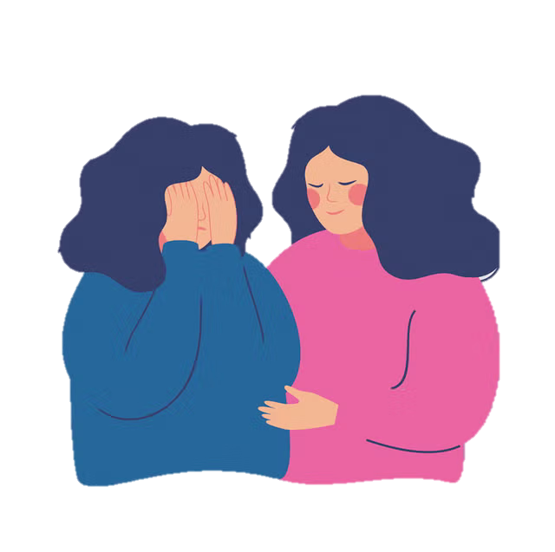
Scenarios: How to Be a Supportive Friend
Notes:
Presenter Notes: (pg. 45)
Setup: Split the class into small groups or decide if it is better to do this activity as a class discussion. If doing groups, each group is given a scenario where one friend notices that another friend is experiencing digital abuse.
Instructions for next 3 slides: contains scenarios along with discussion questions for groups.
- At the end of the discussion period, have groups share their responses highlighting how to offer support without judgement and how to encourage seeking help.

Slide 57
Scenario 1:
Your friend tells you their crush insists on having their social media passwords.
Discussion Questions:
How can you show your friend that you are there for them?
How would you start a conversation without making them feel ashamed or blamed?
Who else would you suggest they speak to for help?
Notes:
Presenter Notes: (pg. 46)
Key Points to highlight during discusion:
Let your friend share how they are feeling without judgment or interrupting.
Acknowledge their emotions and let them know it is okay to feel upset or confused.
Gently point out the behavior without blaming or pressuring them.
Suggest they create space from the person treating them poorly, if possible.
Encourage them to talk to a trusted adult, counsellor, or teacher. Offer to go with them if they are nervous.
Let them make their own decisions and move at their own pace. Respect their feelings and choices.
Let them know you will not share their story with others unless they are in danger, and only then with someone who can help.
If your friend is in danger (e.g., physical harm, threats, or stalking), encourage them to get help immediately and involve a trusted adult or authority figure.

Slide 58
Scenario 2:
Your friend receives negative comments in a common group chat by their best friend when they disagree or don’t do what is asked.
Discussion Questions:
How can you show your friend that you are there for them?
How would you start a conversation without making them feel ashamed or blamed?
Who else would you suggest they speak to for help?
Notes:
Presenter Notes: (pg. 46)
Key Points to highlight during discusion:
Let your friend share how they are feeling without judgment or interrupting.
Acknowledge their emotions and let them know it is okay to feel upset or confused.
Gently point out the behavior without blaming or pressuring them.
Suggest they create space from the person treating them poorly, if possible.
Encourage them to talk to a trusted adult, counsellor, or teacher. Offer to go with them if they are nervous.
Let them make their own decisions and move at their own pace. Respect their feelings and choices.
Let them know you will not share their story with others unless they are in danger, and only then with someone who can help.
If your friend is in danger (e.g., physical harm, threats, or stalking), encourage them to get help immediately and involve a trusted adult or authority figure.

Slide 59
Scenario 3:
Your friend’s partner has shared a personal photo without their permission and says it was a “mistake.”
Discussion Questions:
How can you show your friend that you are there for them?
How would you start a conversation without making them feel ashamed or blamed?
Who else would you suggest they speak to for help?
Notes:
Presenter Notes: (pg. 46)
Key Points to highlight during discusion:
Let your friend share how they are feeling without judgment or interrupting.
Acknowledge their emotions and let them know it is okay to feel upset or confused.
Gently point out the behavior without blaming or pressuring them.
Suggest they create space from the person treating them poorly, if possible.
Encourage them to talk to a trusted adult, counsellor, or teacher. Offer to go with them if they are nervous.
Let them make their own decisions and move at their own pace. Respect their feelings and choices.
Let them know you will not share their story with others unless they are in danger, and only then with someone who can help.
If your friend is in danger (e.g., physical harm, threats, or stalking), encourage them to get help immediately and involve a trusted adult or authority figure.

Slide 60
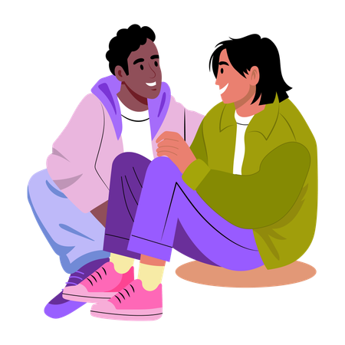
Group Discussion
Notes:
Presenter Notes: (pg. 46-47)
Class Discussion: Sometimes, a friend may be the one acting in a controlling or harmful way. Ask students to discuss:
- How could you help a friend who is experiencing poor treatment in a friendship or a relationship?
- What if your friend is the one acting in unhealthy ways—how might you talk to them?
Facilitation Tips (see pg. 47 for more details):
- If Your Friend is Being Abused: Listen to their words, encourage talking and talk with them about seeking help from a trusted adult or counsellor.
For the Friend Exhibiting Unhealthy Behaviours: Let them know a healthy relationship is based on mutual respect and boundaries, which one should consider when acting.
Re-establishing Boundaries: It is quite okay to encourage friends to get help, but at the same time, not to take on the responsibility of fixing or managing the situation alone.

Slide 61

Community Support & Resources
Notes:
Presenter Notes: (pg. 47)
Discuss Community Resources: Explain that schools have counsellors, teachers and there are also helplines like the Kids Help Phone and community organizations to provide support.
Bystander Discussion: Ask students to give examples of what they would say as a bystander to a friend experiencing digital abuse.
Challenges: Discuss any challenges they may encounter in offering help

Slide 62
Wrapping Up…
In this session we discussed…
Unhealthy behavior or violence is never the victim’s fault
There are people to help
Notes:
Wrap-Up and Q&A: (pg. 47)
- Reinforce that violence is never the victim’s fault and that there are people to help.
Provide students with resource list, including school counsellors, crisis lines, and websites for students needing support.
Distribute and collect evaluations.
Note: pg. 49-51 include helpful resources for each lesson in the curriculum that can be shared with the class.

Slide 63
Journaling Reflection
Notes:
Optional Activity:
Journaling Prompt: Encourage students to think about what they would do if a friend were in an unhealthy friendship or relationship or if they have ever felt responsible for someone’s happiness in a way that made them uncomfortable.

Slide 64
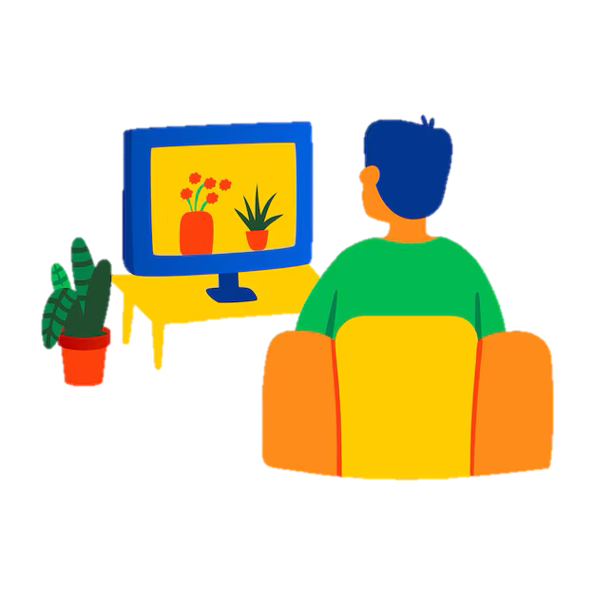
Media Analysis
Notes:
Optional Activity:
Media Analysis: Ask students to review a popular movie or social media scenario that includes relationships and discuss whether the digital interactions are healthy or unhealthy.

Slide 65
Thank You
Name:
Peace Program Counsellor:
Organization Name:
Phone Number:
Email:
Office hours:
Notes:
Point of Slide: Recap the main messages of the VIP curriculum lesson plan and thank the class.
Speaking Notes:
Thank them for being a wonderful class.
Let them know what information you will be sending home with them, such as VIP post cards, VIP wallet cards, agency brochure, PEACE Program brochure, and any other additional resources.
Reiterate your contact information and office hours on the slide.

